Slide 1
Additional file 4
Species classification

Slide 2
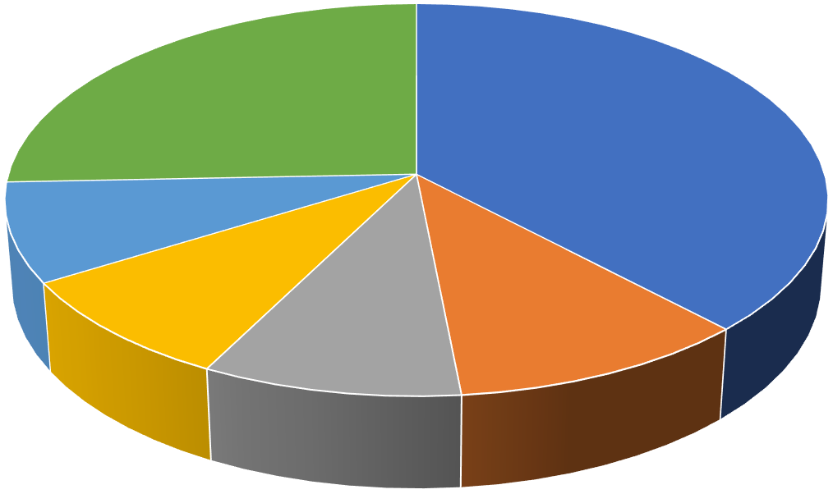
Species classification
Protobothrops mucrosquamatus
(37.97%)
Other
(25.64%)
Thamnophis sirtalis
(8.18%)
Ophiophagus hannah
(8.68%)
Pseudonaja textilis
(10.50%)
Notechis scutatus
(9.03%)

