Slide 1
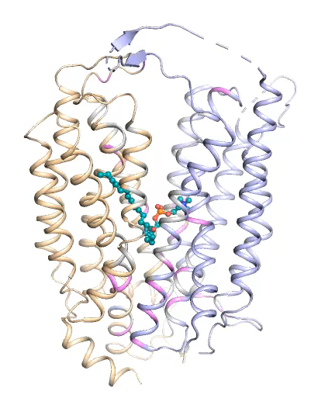
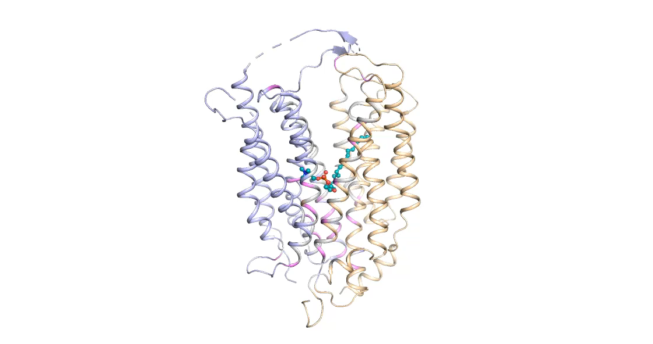
a
b
Out
90֯
α₈
α₅
α₂
α₁₁
In
Supplementary Movie 1

