Slide 1
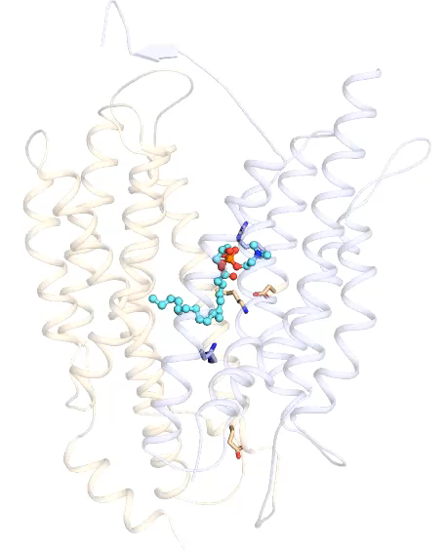
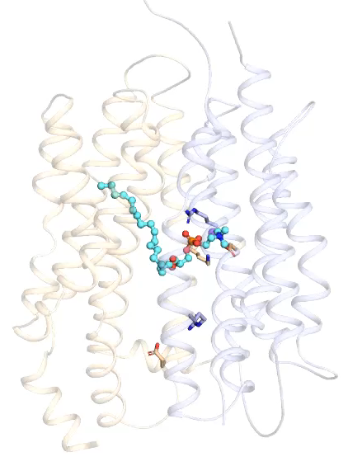
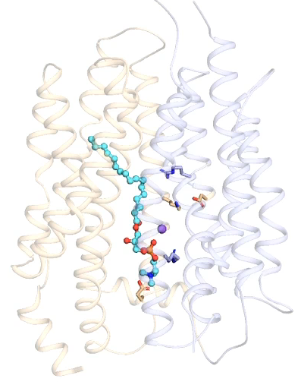
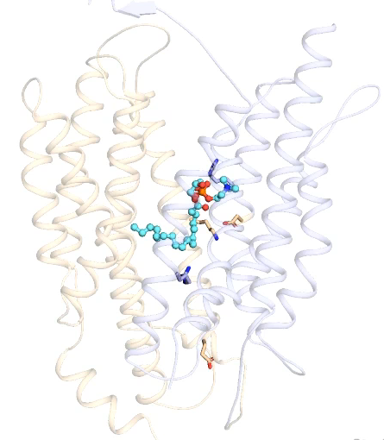
a
b
Out
R84
Z_{A}
R84
Z_{A}
D87
D87
K433
K433
R180
R180
Z_{B}
Z_{B}
E421
E421
In
Z_{C}
Z_{C}
c
d
Out
R84
Z_{A}
R84
Z_{A}
D87
D87
K433
K433
R180
R180
Z_{B}
Z_{B}
E421
In
E421
Z_{C}
Z_{C}
Supplementary Movie 3

