Slide 1
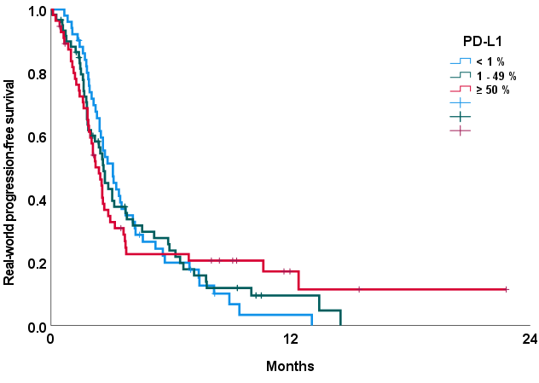
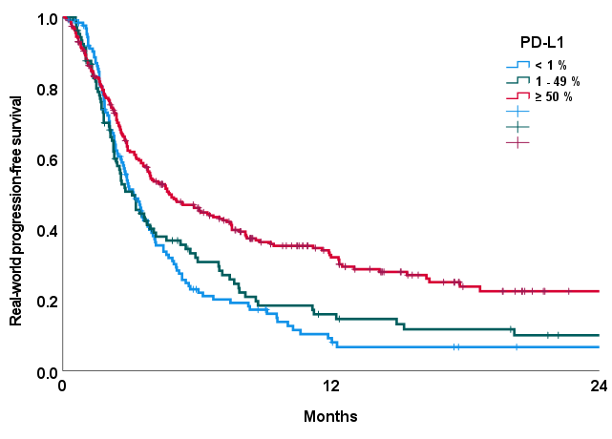
EGFR (n = 167)
KRAS (n = 514)
Log rank test p-value = 0.985
Log rank test p-value < 0.001
Notes:
Supplemental Fig. Kaplan-Meier curves of real-world progression free survival in EGFR and KRAS tumors by PD-L1 expression categories (< 1%, 1 – 49%, ≥ 50%)

