Slide 1
Cardiac Tamponade-Mediated Generalized Coronary Vasospasm Presenting as an Inferior ST-Segment Elevation Myocardial Infarction: A Case Report
January 2023
EHJ-CR-D-22-00788R1

Slide 2
Introduction
The triad of chest pain, ST-segment elevations, and elevated cardiac biomarkers is consistent with a type 1 myocardial infarction¹.
Conditions other than acute plaque rupture may present with this triad coronary vasospasm, myopericarditis, stress cardiomyopathy, and aortic or coronary dissection²⁻⁴.
Coronary vasospasm is a rare cause of STEMI and can be precipitated by endogenous catecholamines⁵.
EHJ-CR-D-22-00788R1

Slide 3
Case Presentation
History and Examination Findings
72 year old female with a history of chronic obstructive pulmonary disease presents to the emergency department with several hours of substernal chest pain.
Sudden onset, substernal pressure-like pain at rest
HR 130 BP 80/50
Appeared uncomfortable, tachycardic with regular rhythm, distant heart sounds, and elevated JVP
EHJ-CR-D-22-00788R1

Slide 4
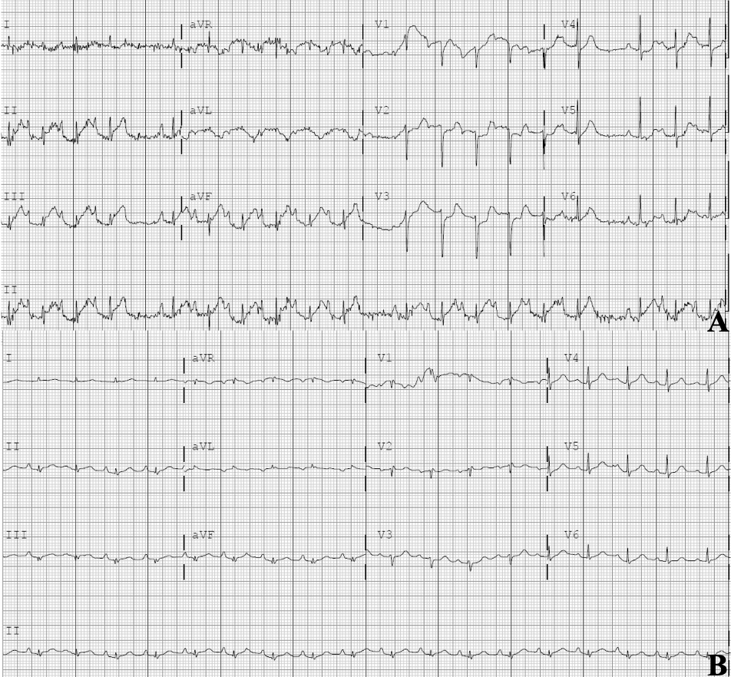
Case Presentation
Initial ECG on admission
Figure 1. A. ECG on initial presentation with ST elevations in II, III, aVF. Troponin of 1.6 ng/ml (ref <0.04 ng/ml) at time of ECG.
EHJ-CR-D-22-00788R1

Slide 5
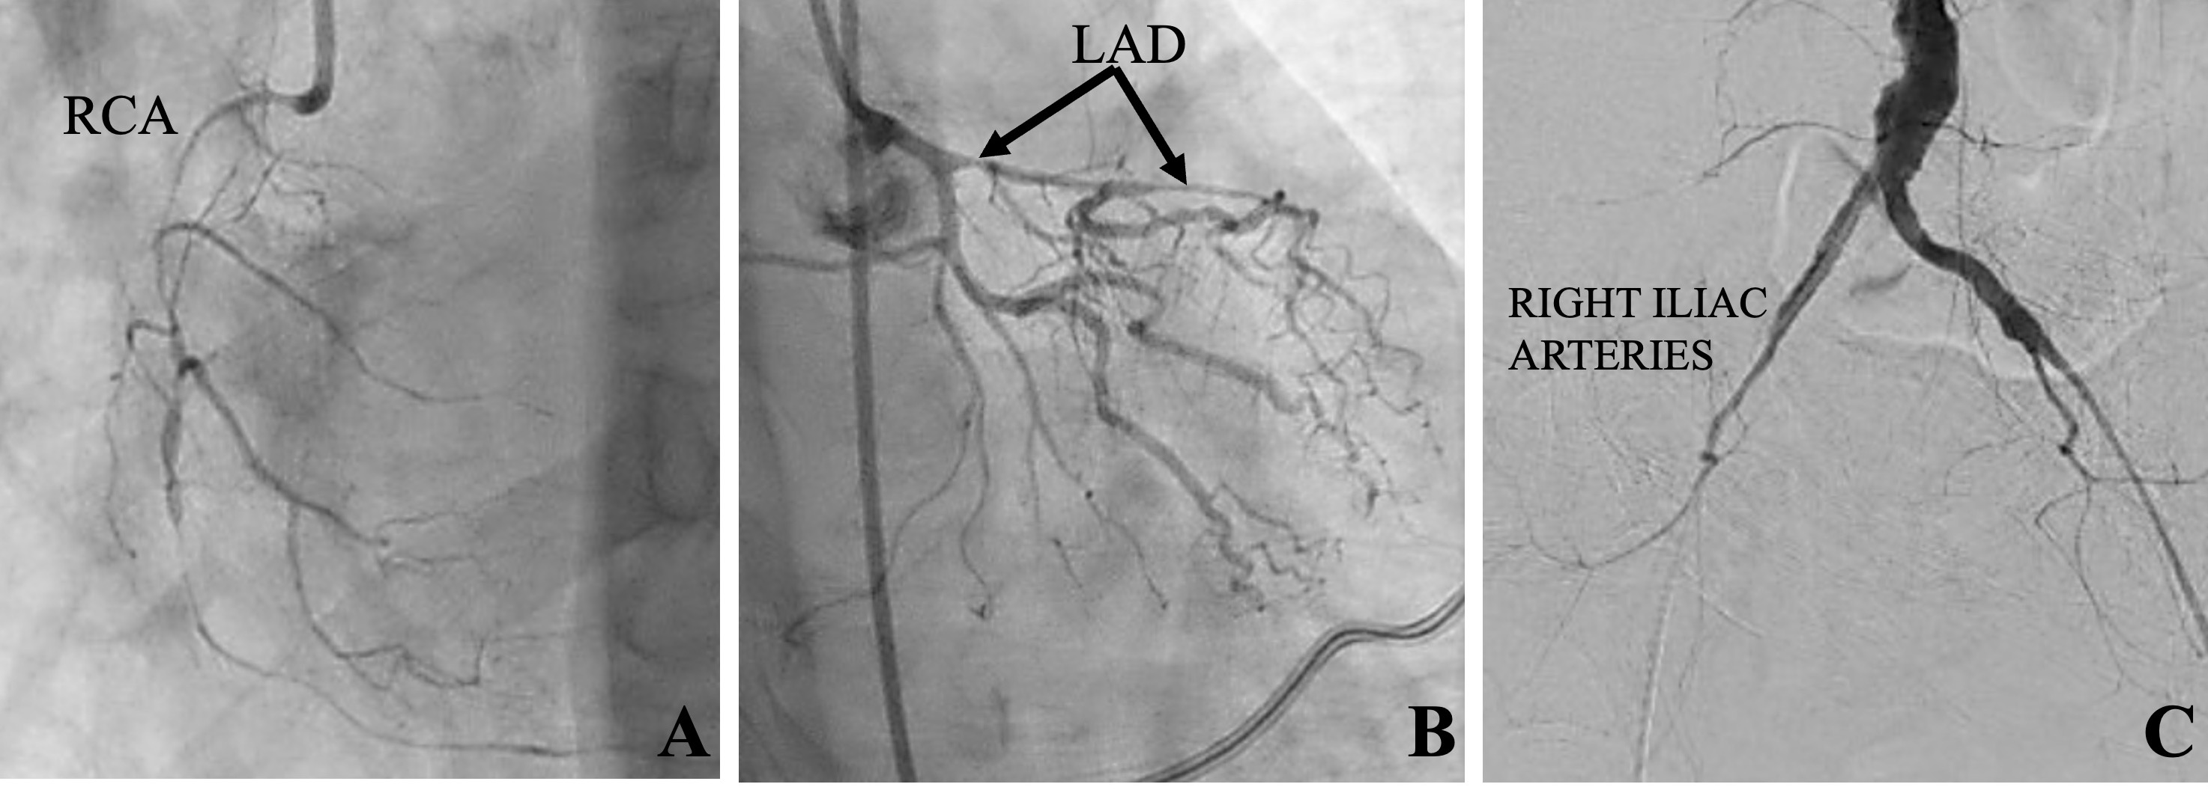
Case Presentation
Initial coronary angiogram
Figure 2: Initial angiography of the RCA (A), LAD (B), and aortoiliac system (C).
EHJ-CR-D-22-00788R1

Slide 6
Case Presentation
Investigations
Patient taken to the catheterization laboratory for coronary angiogram, revealing subtotal occlusion of RCA, 95% stenosis of LAD, severe diffuse aortoiliac stenoses.
CT angiogram of the chest reports large pericardial effusion
Emergent transthoracic echocardiogram in the catheterization lab demonstrates echocardiographic findings of tamponade
Pericardiocentesis performed
EHJ-CR-D-22-00788R1

Slide 7
Case Presentation
Management
Time since presentation | Event
0 minutes | Patient presented to the emergency department reporting several hours of chest pain with initial HR 130 bpm and BP 80/50 mmHg.
10 minutes | Initial ECG demonstrating ST elevations in the inferior leads (II, III, aVF).
40 minutes | CT angiogram chest demonstrates no aortic dissection but identifies large pericardial effusion.
1 hour 20 minutes | Coronary angiogram performed; right coronary artery (RCA) with diffuse subtotal occlusion; left anterior descending (LAD) with 95% proximal stenosis; distal abdominal aorta and bilateral common iliac arteries diffusely diseased.
1 hour 40 minutes | Emergent transthoracic echocardiogram performed in catheterization laboratory with large pericardial effusion and echocardiographic findings of tamponade; pericardiocentesis performed with 800 mL of serosanguinous fluid removed.
2 hours 30 minutes | Repeat ECG showed resolution of inferior ST elevations; HR 100 bpm and BP 140/60 mmHg.
17 hours | Repeat coronary angiogram showed RCA with 20% distal stenosis, LAD widely patent without stenosis, and aortoiliac arteries without stenosis.
2 days | Pericardial drain clamped without re-accumulation of pericardial effusion on repeat echocardiogram.
3 days | Pericardial drain removed.
EHJ-CR-D-22-00788R1

Slide 8
Case Presentation
ECG Post-Pericardiocentesis
Figure 1.B. ECG 50 minutes post-pericardiocentesis with resolution of inferior ST elevations
EHJ-CR-D-22-00788R1

Slide 9
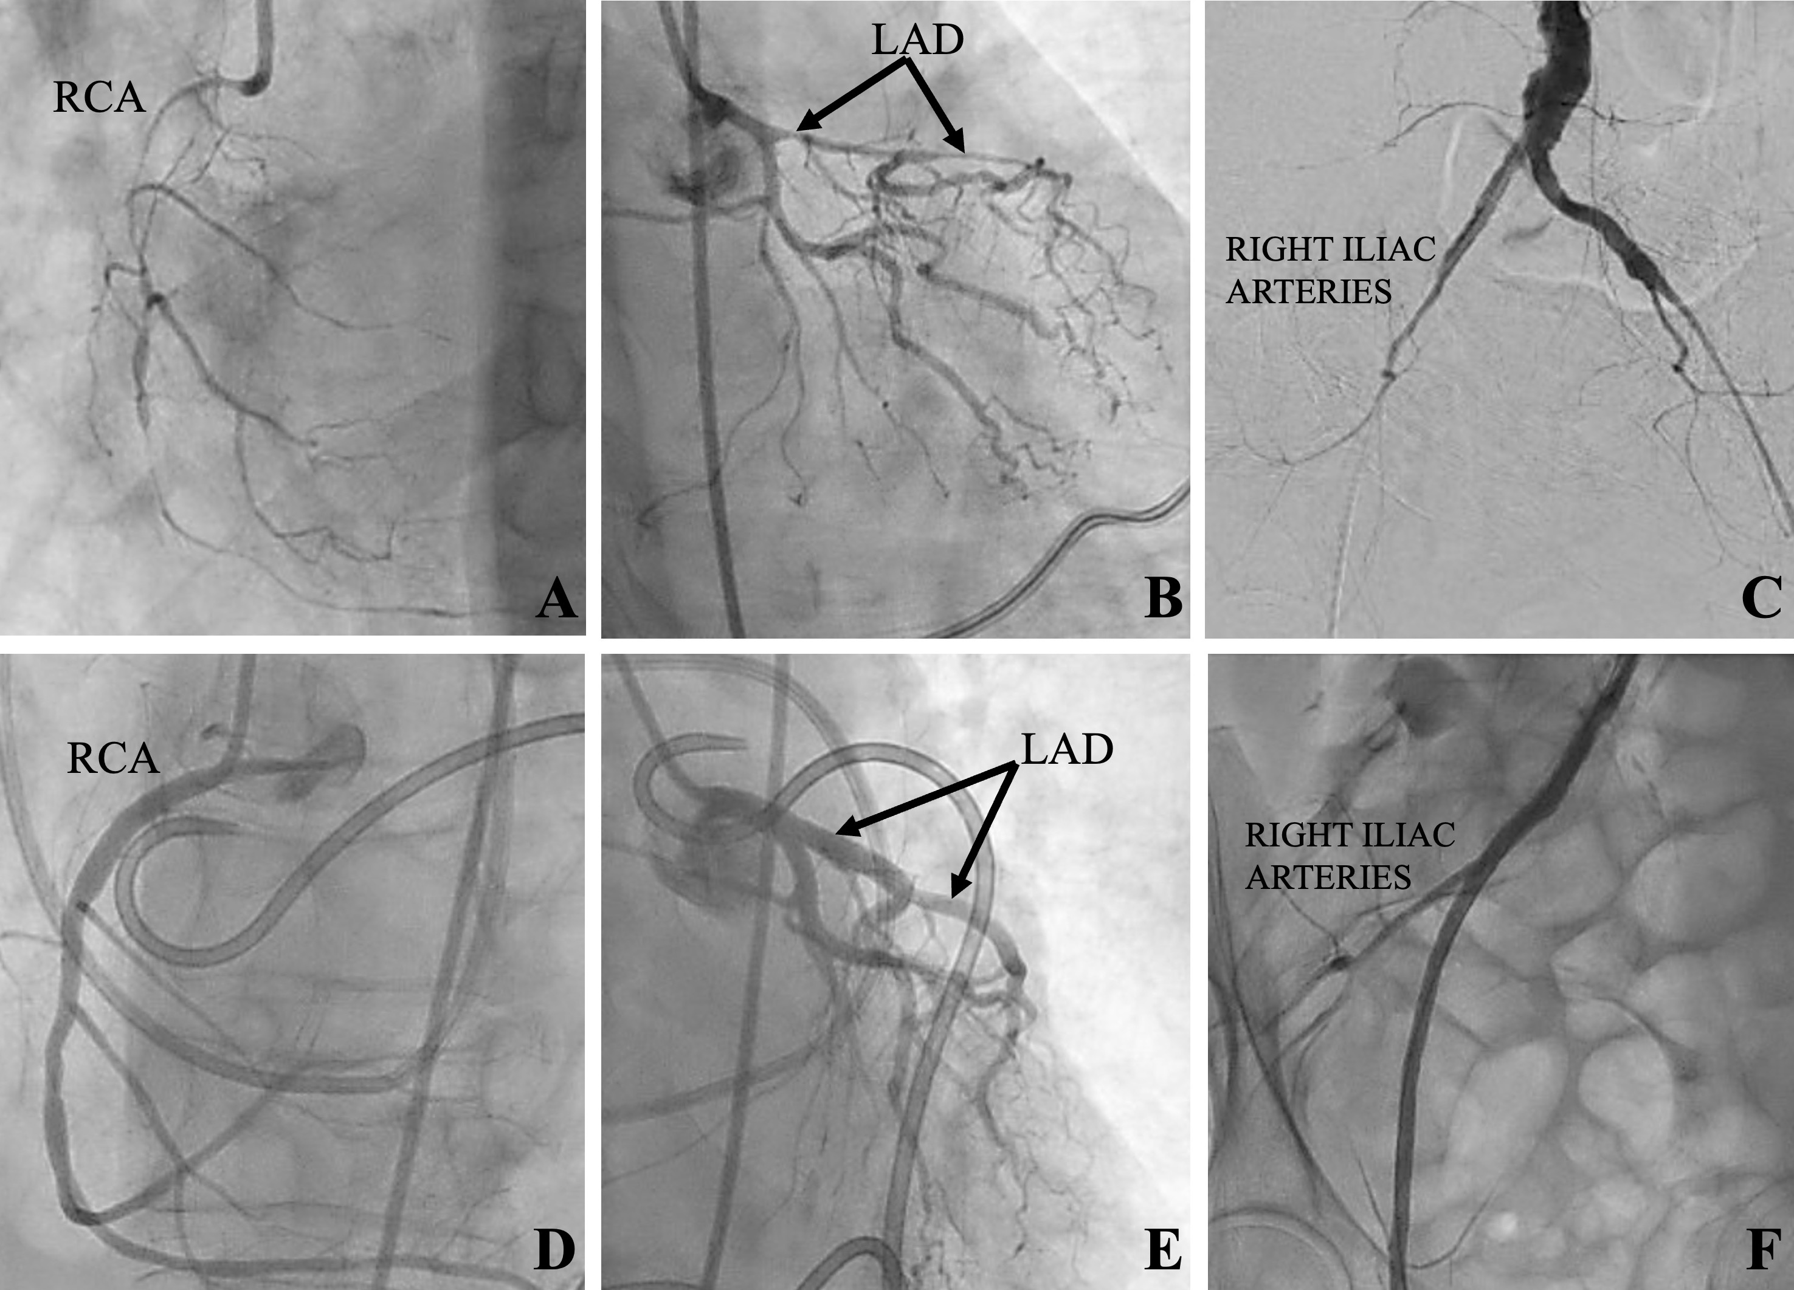
Case Presentation
Coronary Angiogram Pre and Post-Pericardiocentesis
Figure 2: Top row: Initial angiography of the RCA (A), LAD (B), and aortoiliac system (C). Bottom row: subsequent angiography next day of the RCA (D), LAD (E), and right iliac system (F) following correction of cardiac tamponade and cardiogenic shock.
EHJ-CR-D-22-00788R1

Slide 10
Discussion
Cardiogenic shock from cardiac tamponade led to an endogenous catecholamine surge resulting in diffuse arterial vasoconstriction, manifesting as an inferior STEMI.
Angiographic stenoses of the RCA, LAD, and aortoiliac vessels all dramatically improved after pericardiocentesis alone
Correcting the patient’s cardiogenic shock by performing pericardiocentesis resulted in improved perfusion almost immediately as evidenced by improved hemodynamics and resolution of ST elevations on ECG.
EHJ-CR-D-22-00788R1

Slide 11
Discussion
First reported case of diffuse coronary and peripheral artery vasospasm caused by endogenous catecholamines from cardiac tamponade.
Had tamponade not been recognized in the catheterization laboratory, attempts at percutaneous coronary intervention, rather than pericardiocentesis, could have resulted in a catastrophic clinical outcome.
Type 1 atherothrombotic events will continue to account for most STEMIs, however, consider diffuse arterial vasoconstriction from cardiogenic shock in the appropriate clinical context.
EHJ-CR-D-22-00788R1

Slide 12
Learning Points
Coronary vasospasm is a clinical entity capable of manifesting as ACS, including STEMI.
Both exogenous and endogenous catecholamines can produce profound coronary and peripheral arterial vasospasm.
In patients presenting with cardiogenic shock, physiologic arterial vasoconstriction can lead to functionally occlusive coronary physiology resulting in ST-segment elevations on ECG.
EHJ-CR-D-22-00788R1

Slide 13
References
1. Thygesen K, Alpert JS, Jaffe AS, Chaitman BR, Bax JJ, Morrow DA, et al. Fourth Universal Definition of Myocardial Infarction (2018). J Am Coll Cardiol 2018;72:2231-2264.
2. Imazio M, Trinchero R. Myopericarditis: Etiology, management, and prognosis. Int J Cardiol 2008;127:17-26.
3. Bybee KA, Prasad A. Stress-related cardiomyopathy syndromes. Circulation 2008;118:397-409.
4. Chen A, Ren X. Aortic dissection manifesting as ST-segment elevation myocardial infarction. Circulation 2015;131:503-504.
5. Wang K, Asinger RW, Marriott HJL. ST-segment elevation in conditions other than acute myocardial infarction. N Engl J Med 2003;349:2128-2135.
EHJ-CR-D-22-00788R1

