Slide 1
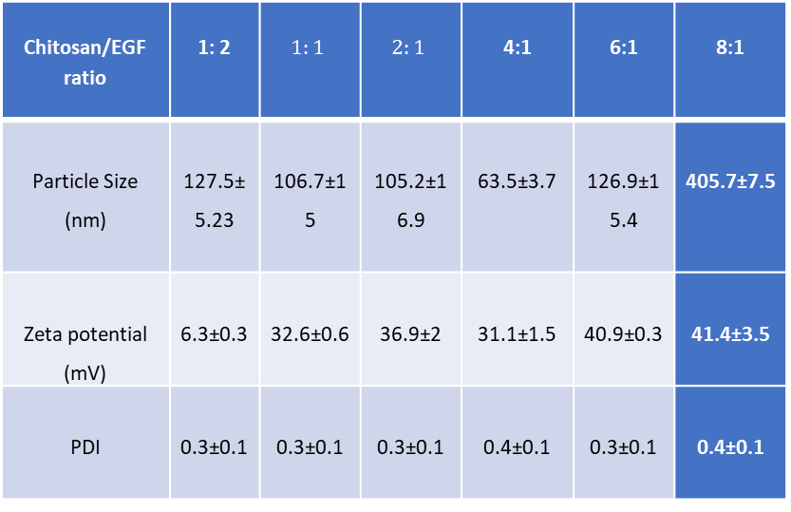
S 1. Size, zeta potential and PDI of Chitosan/EGF nanoparticles at different ratios. Data are represented as mean ± SD (n=3).
8:1 | 6:1 | 4:1 | $$2:1$$ | $$1:1$$ | 1: 2 | Chitosan/EGF ratio
405.7±7.5 | 126.9±15.4 | 63.5±3.7 | 105.2±16.9 | 106.7±15 | 127.5±5.23 | Particle Size (nm)
41.4±3.5 | 40.9±0.3 | 31.1±1.5 | 36.9±2 | 32.6±0.6 | 6.3±0.3 | Zeta potential (mV)
0.4±0.1 | 0.3±0.1 | 0.4±0.1 | 0.3±0.1 | 0.3±0.1 | 0.3±0.1 | PDI

Slide 2
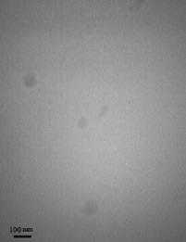
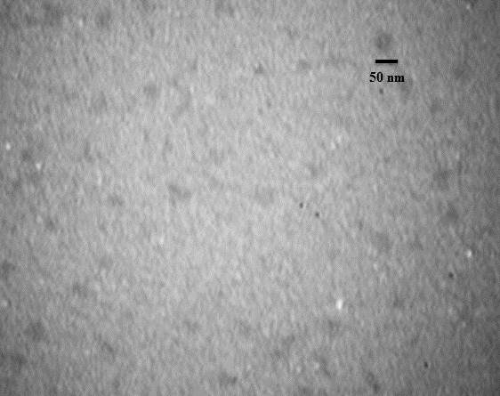
A B
S 2. TEM analysis of chitosan/EGF nanoparticles at ratio of 2:1 (a) Zoom in 40x1000 and (b) 25x1000.

Slide 3
S 3. EGF protein loading efficiency in nanoparticles with different ratio of chitosan/EGF. Data are represented as mean ± SD (n=3)
Loading efficiency (%) | Chitosan/EGF ratio
67±3 | 2:1
88± 4 | 1:1
90±3 | 1:2
96.4± 2 | 1:4
97.4±3 | 1:6

