Slide 1
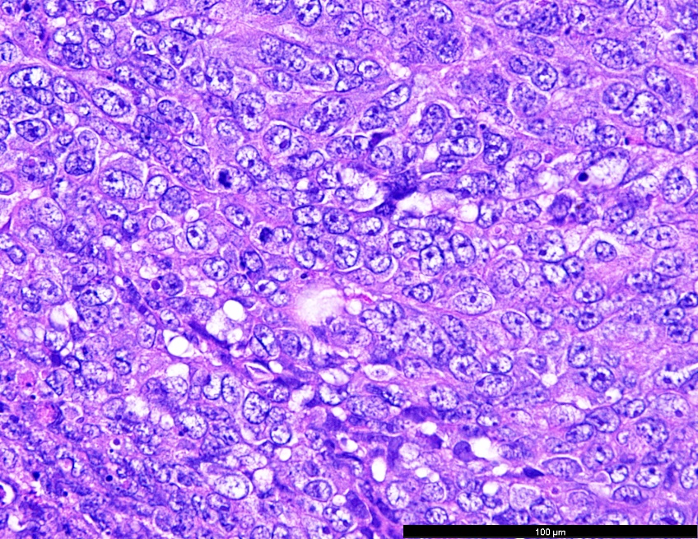
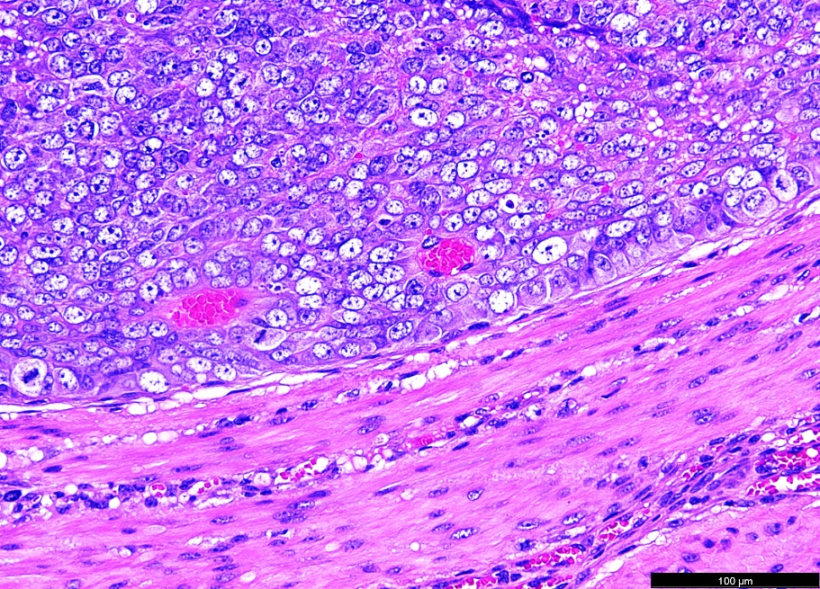
Supplementary Figure 1
Supplementary Figure 1. Histological analysis of PT340 cell line. PT340 cells were injected into NSG mice, and the resulting tumors were harvested for histological analysis, H&E staining showed features of Clear Cell Ovarian Carcinoma.

