Slide 1
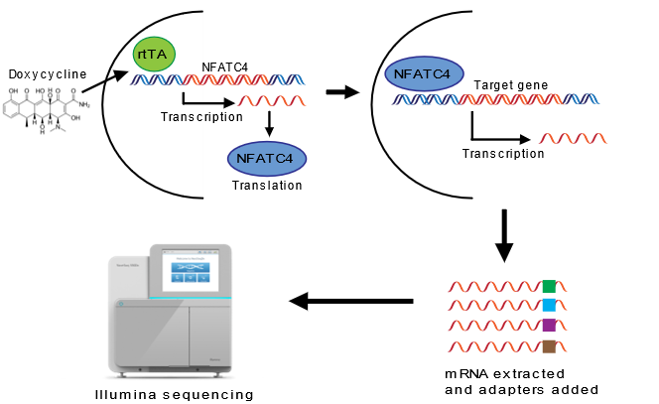
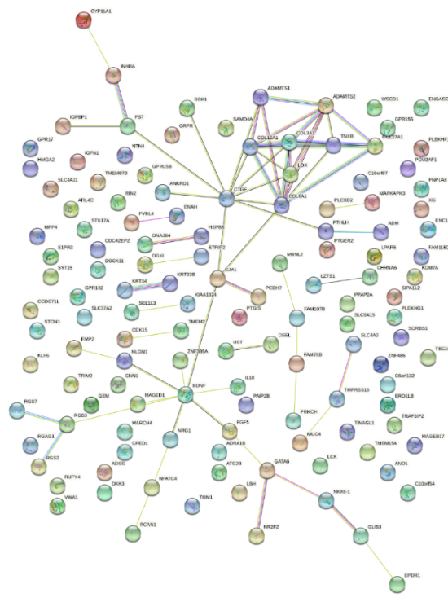
A
B
C
Supplementary Figure 2
D
C-Myc
E

Slide 2
Supplementary Figure 2. RNA-seq analysis. A. Schematic of the RNA-seq experimental design. B. Waterfall plot of RNA-seq data showing the 141 genes which were DE at all time points compared to luciferase control in HEY1 and SKOV3 cell lines. C. Unsupervised clustering analysis of the 141 DE genes. D. Box plots demonstrating MYC expression following NFATC4 activation. E. STRING analysis of the 141 DE genes.

