Slide 1
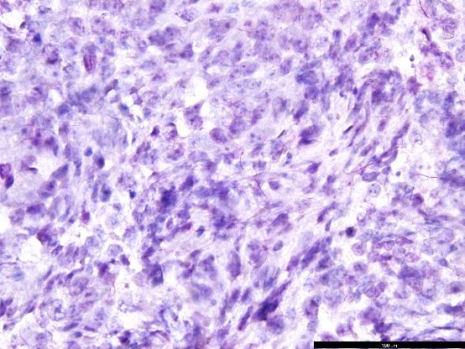
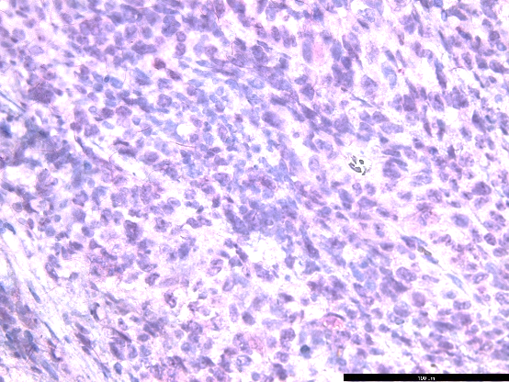
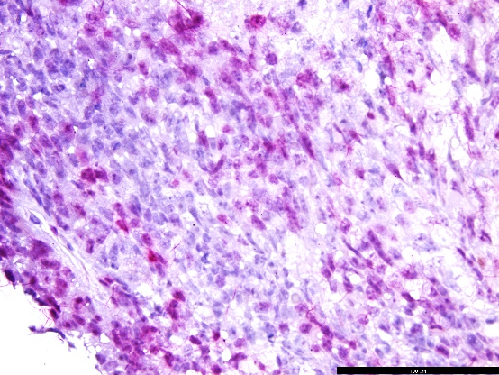
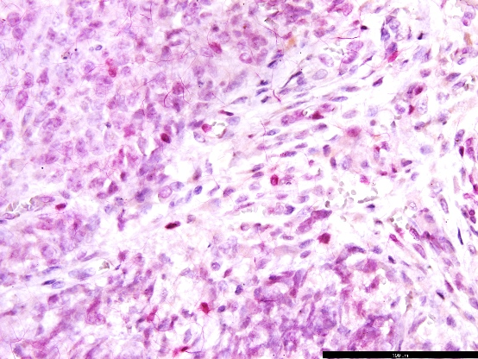
A
Ki67= Blue FST=Red
Supplementary Figure 3
B (i) (ii)
Untreated control
Taxol treated
C
OVSAHO

Slide 2
Supplementary Figure 3. The effect of FST or taxol treatment ovarian cancer proliferation and FST secretion, and the ability of a FST neutralization antibody to inhibit FST’s effect on proliferation. A. PT340 and PT412 cells were treated with 200 ng/mL FST for 72h before cell counts were performed. B (i) IHC images and (ii) FST+ cell bodies in OVSAHO tumor xenografts treated with or without taxol and stained with both Ki67 (Forangi Blue) and FST (Fast Red). C. Titer of the ability of the anti-FST neutralizing antibody to inhibit the effect of FST on cell growth.

