Slide 1
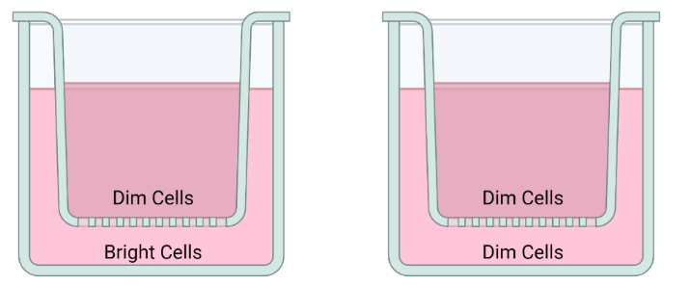
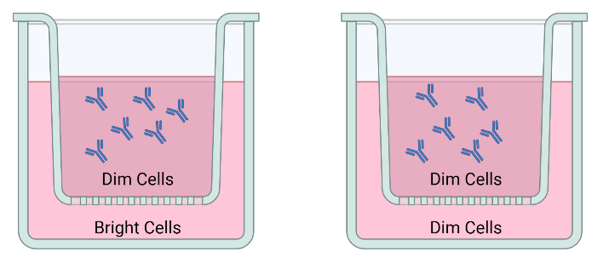
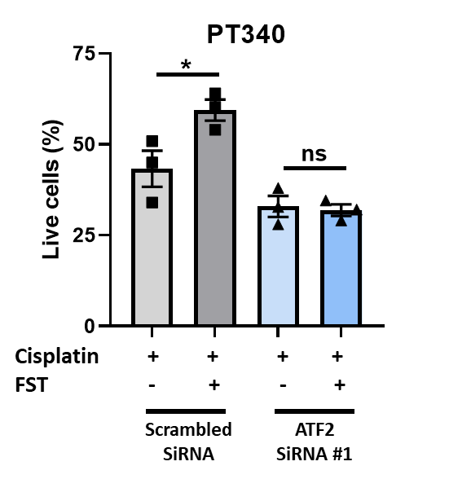
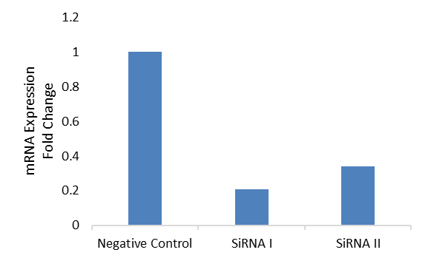
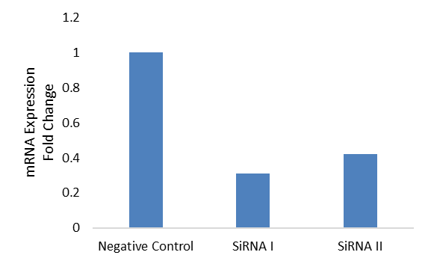
Supplementary Figure 4
A
Taxol + IgG
Untreated
Taxol + anti-FST Ab
Taxol
B
C
PT412 ATF2 siRNA
PT340 ATF2 siRNA

Slide 2
Supplementary Figure 4. The effect of ATF2 siRNA on gene expression and PT340 FST induced chemoresistance. A. Schematic detailing the transwell experiments. CellTrace Violet cells were sorted for rapidly dividing (Dim) or quiescent cells (Bright) which were then plated in transwell chambers either as Dim:Dim or Bright:Dim. Cells were untreated or treated with taxol alone or in combination with IgG or anti-FST antibody. Cell counts were performed on the dim cells and data was expressed as fold chnage. B. Relative ATF2 gene expression of PT412 and PT340 treated with scrambled siRNA or two independent ATF2 siRNAs (ATF2 siRNA #1 and #2). C. Viable cell number of PT340 cells treated with control scrambled siRNA or knocked down with ATF2 siRNA and treated with cisplatin +/- FST. *P<0.05, ns = not significant.

