Slide 1
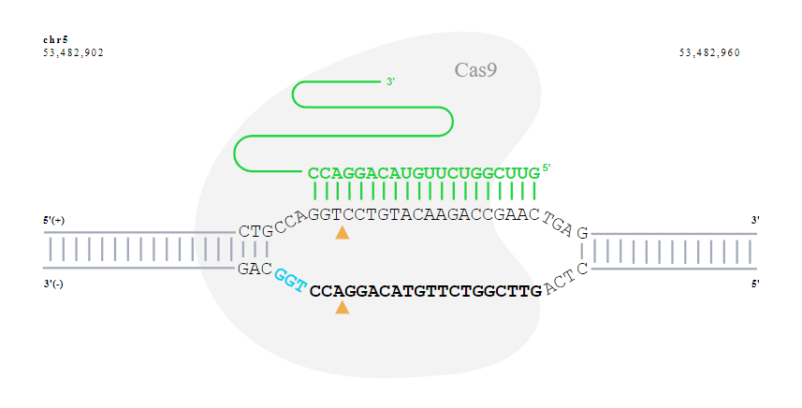
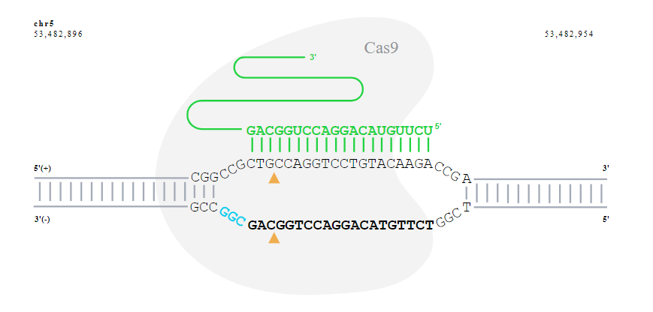
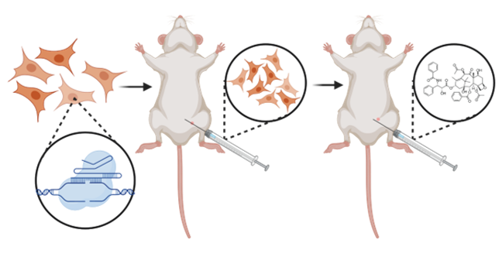
Supplementary Figure 5
A
FST sgRNA #1
FST sgRNA #2
B
Supplementary Figure 5. Schematic of FST CRISPR KO guides and in vivo experiment. A. Binding of the two commercially available FST CRISPR guides to FST to mediate KO. B. Mice were injected with SKOV3 cells expressing FST sgRNA #2. Mice were then treated 3 times with 10mg/kg Taxol intraperitoneal Paclitaxel at days 7, 14 and 21. C Dissection of control mice presenting with multiple metastases and an FST-KO mice which showed no residual disease. White arrows point to sites of disease.

