Slide 1
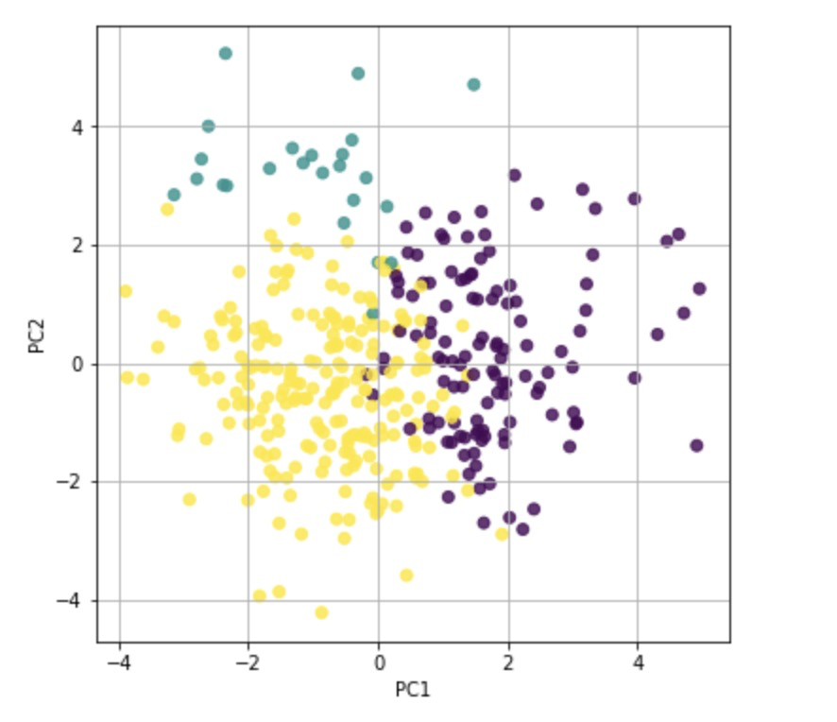
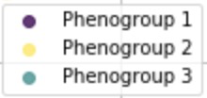
Supplementary Figure S2. Illustration of the distance between three phenogroups
and their overlap in principal component analysis.
PC1 and PC2 are principal components of their dataset.
The purple dot is Phenogroup 1, the yellow dot is Phenogroup 2 and the blue dot is Phenogroup 3.

