Slide 1
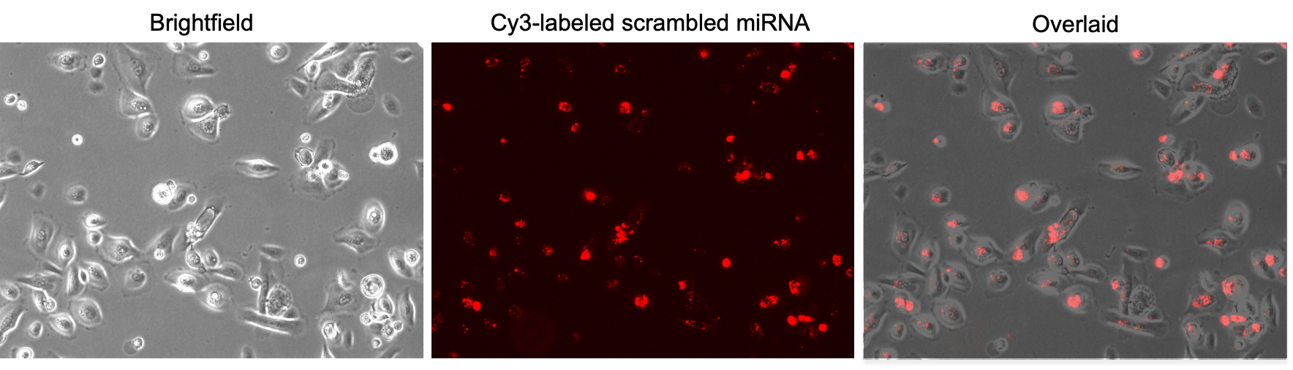
Supplementary Figure 1. Fluorescence microscopy of Cy3-labeled scrambled miRNA transfected primary LECs. Primary LECs transfection with 50 nm Cy3-labeled scrambled miRNA using RNAiMax revealed that 80% to 90% of cells were transfected.

Slide 2
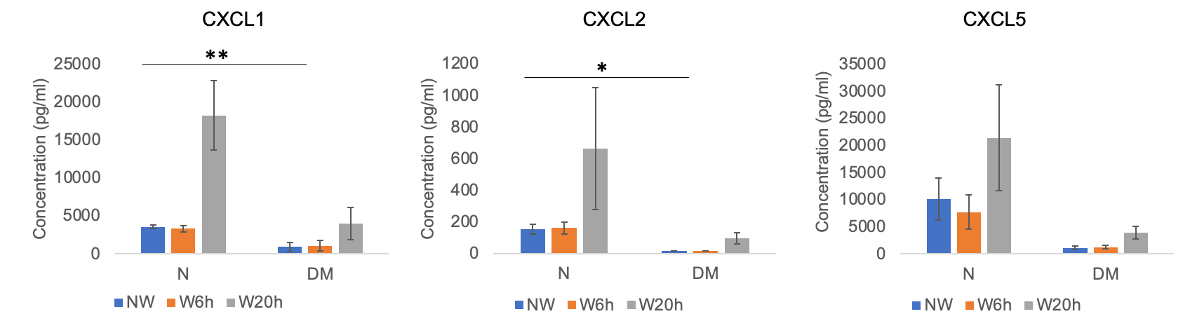
Supplementary Figure 2. Secretory chemokine levels at 6 and 20 h post-wounding in normal (N) and diabetic (DM) primary LECs. There were no significant changes of CXCL1, CXCL2, CXCL5 expression levels at 6 and 20 h post wounding in both N and DM LECs. However, the expression level of both CXCL1 and CXCL2 were significantly downregulated in DM vs. N LECs. Data are mean ± SEM, * p<.05, **p<.01 significant p values.

Slide 3
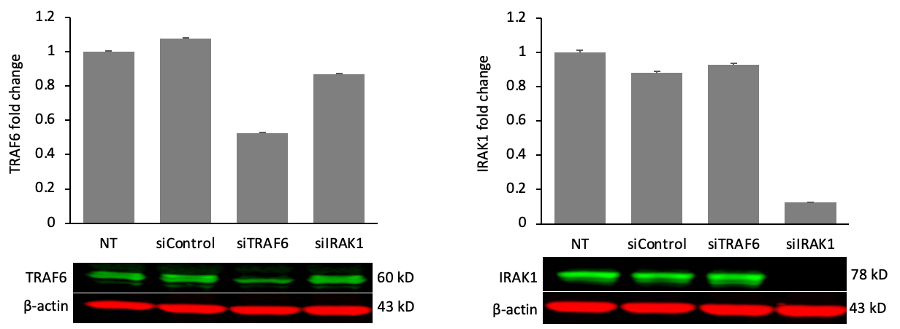
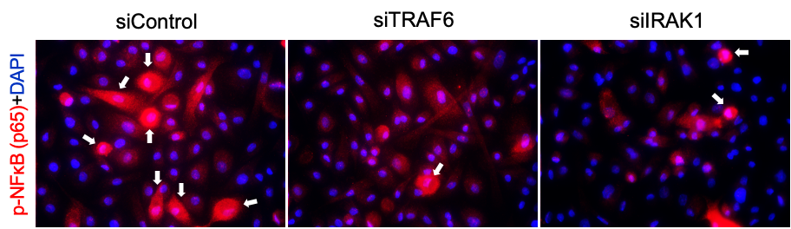
A
B
C
Supplementary Figure 3. Knockdown of TRAF6 and IRAK1 decreased p-NF-κB expression level. The primary LECs were transfected with siTRAF6, siIRAK1, or sicontrol for 72 h. The protein expression levels of TRAF6 (A) and IRAK1 (B) were significantly downregulated in comparison to sicontrol by western blot. (C) Transfection with siTRAF6 or siIRAK1 decreased p-NF-κB expression level compared to sicontrol in primary LECs by immunostaining. TRAF6, tumor necrosis factor receptor associated factor 6; IRAK1, interleukin-1-receptor-associated kinase 1; NF-κB, nuclear factor-κB.

Slide 4
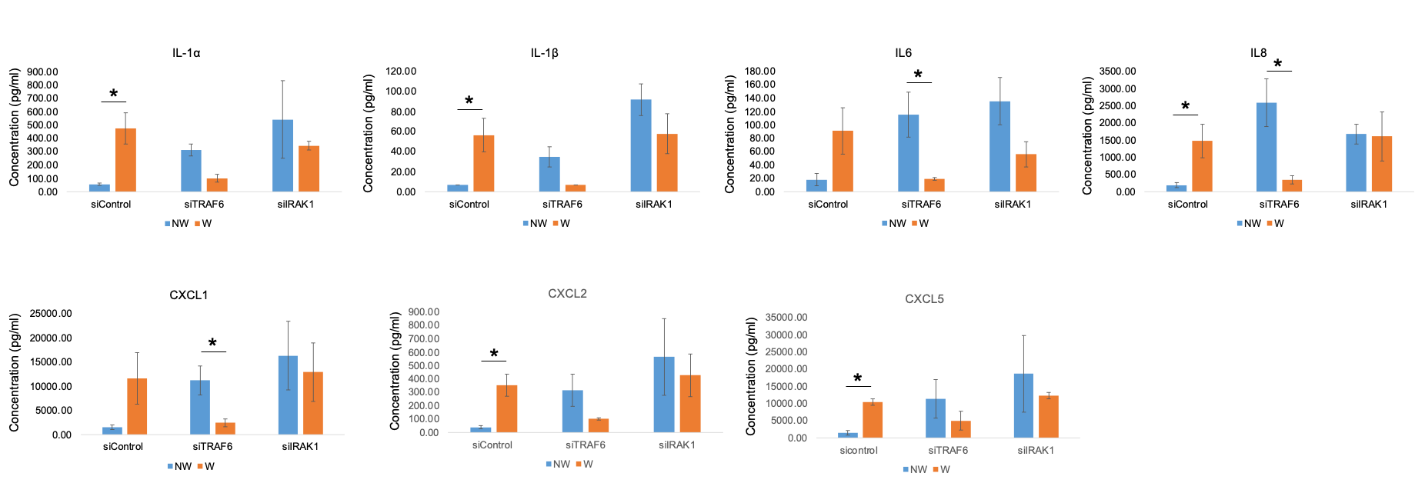
Supplementary Figure 4. Luminex analysis of secretory cytokine/chemokine levels at 6h post-wounding in siTRAF6 or siIRAK1 transfected primary LECs media. There was a significant downregulation in IL-6 (C) and IL-8 (D) and CXCL1 (F) expression levels at 6 h post-wounding. There was also a downregulation of IL-1α (A), IL-1β (B), CXCL2 (F) and CXCL5 (G), which didn’t reach significance in primary LEC media after transfection with siTRAF6 or siIRAK1.

