Slide 1
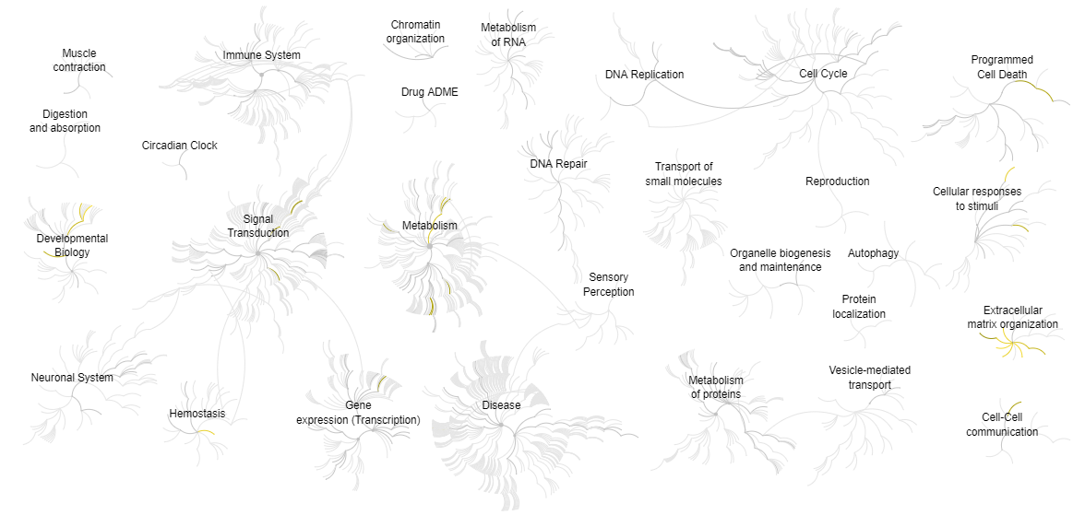

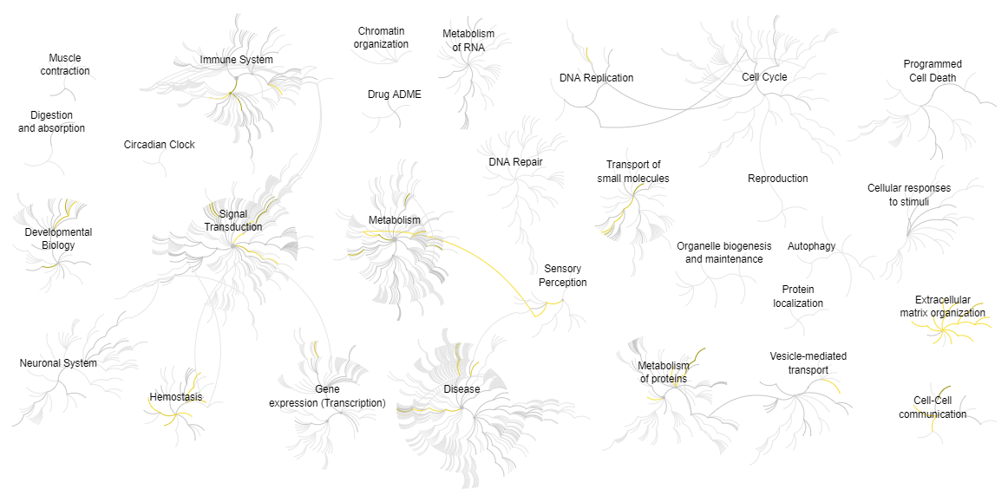
A
Cell extract
B
Secretome
Fig. S3 Reactome pathway analysis. Genome-wide overview of Reactome pathways for dysregulated proteins in the cell extract A and secretome B of shC1GALT1 ECC-1 cells. Significant pathways in which these proteins are involved were represented in yellow (p value < 0.05). Light grey represents pathways with no significant representation.

