Slide 1
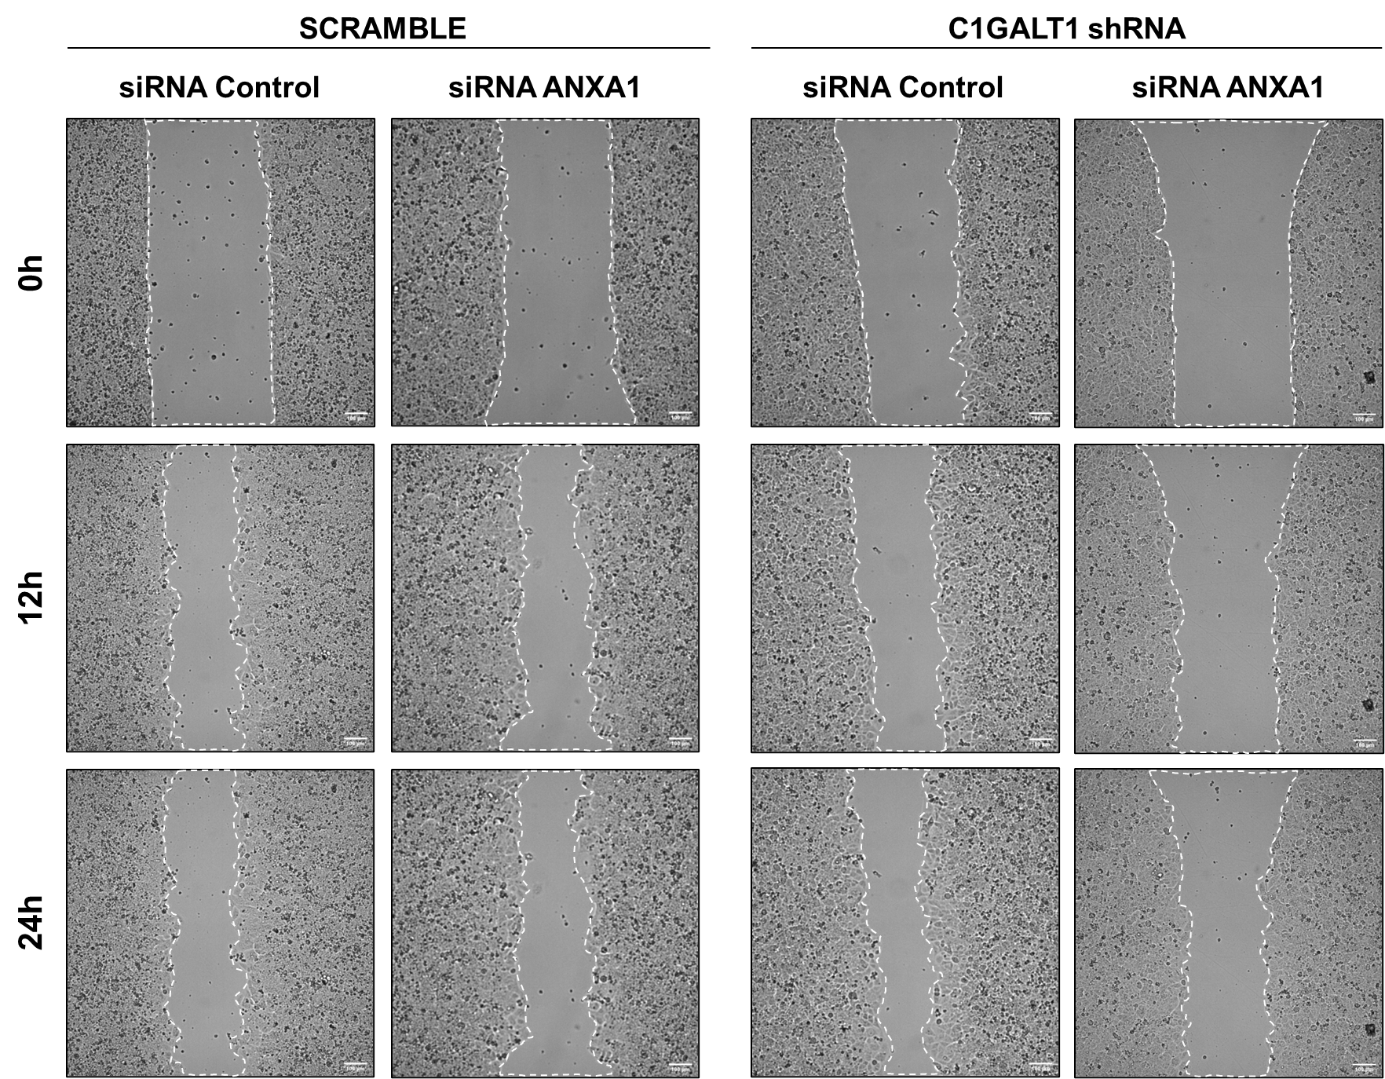
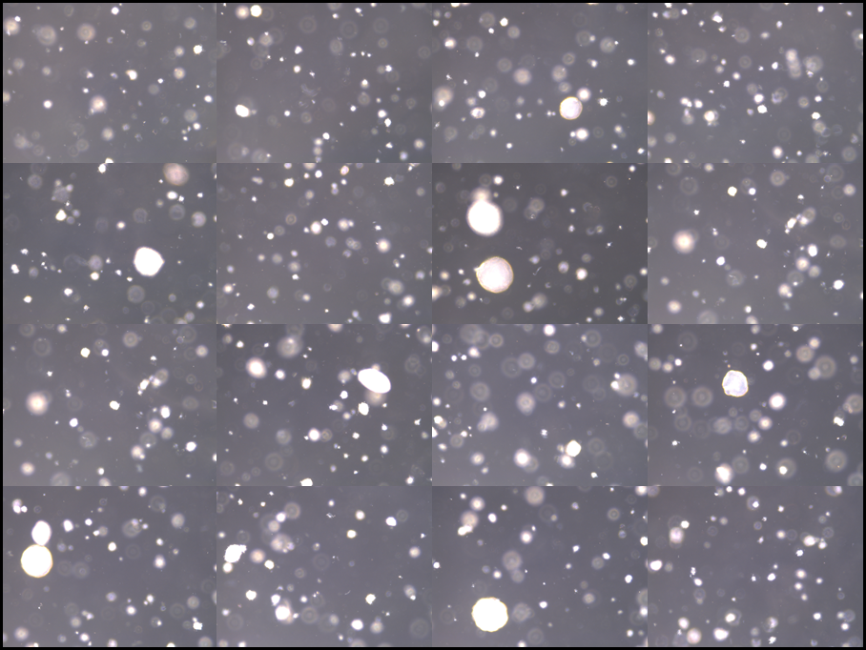
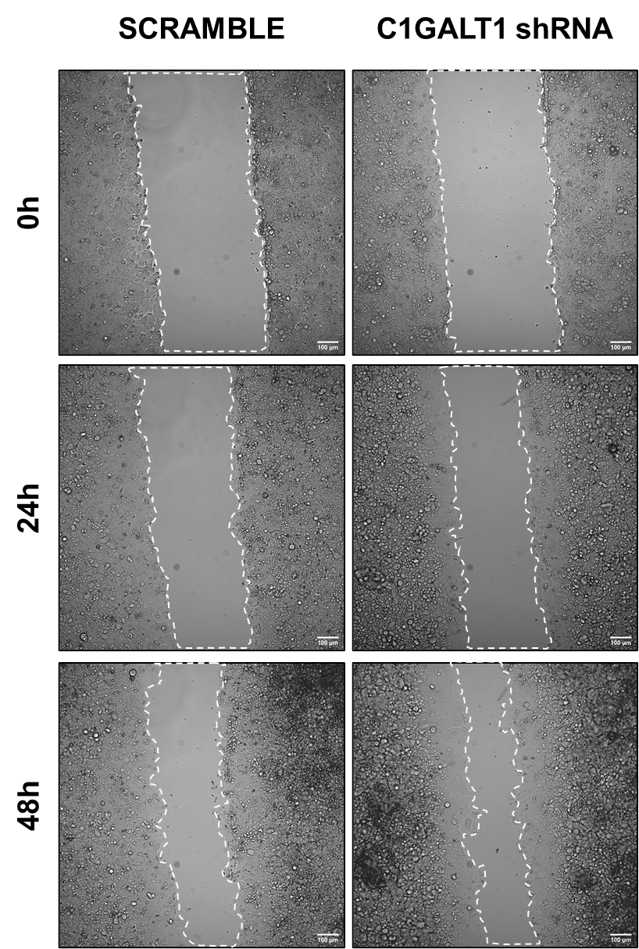
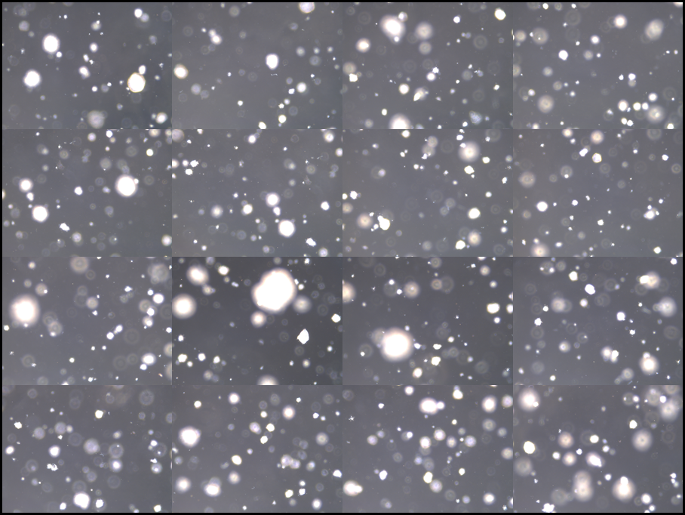
A
B
C
Wound healing assay
Colony soft agar
Wound healing assay
SCRAMBLE
C1GALT1 shRNA
Fig. S4 Characterization of the metastatic and tumorigenic properties of shC1GALT1 ECC-1 cells. C1GALT1 depleted cells possessed a higher wound closure speed A and colony formation ability B in comparison with SCRAMBLE cells. C Transient silencing of ANXA1 significantly reduced the wound closure speed of C1GALT1 depleted ECC1 cells, not modifying the wound closure speed of SCRAMBLE cells.

