Slide 1
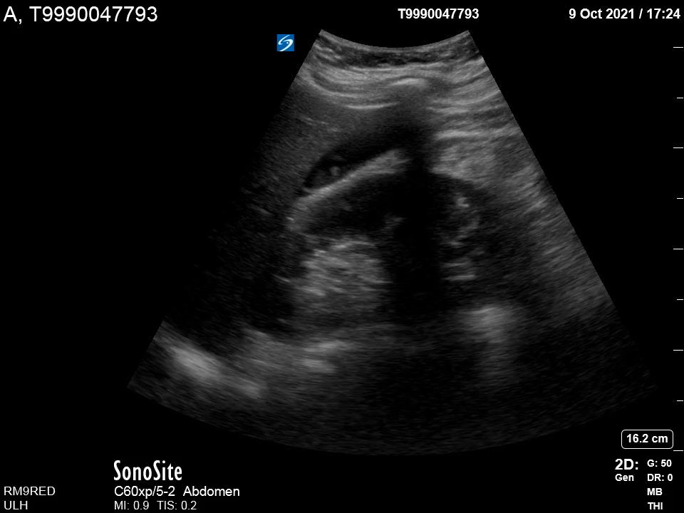
RUQ View
L
HP
RK

