Slide 1
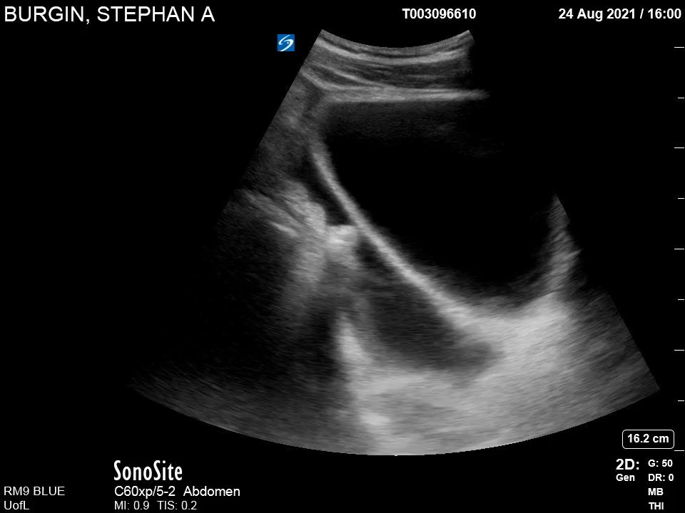
Pelvis Sagittal
B
HP
HP

