Slide 1
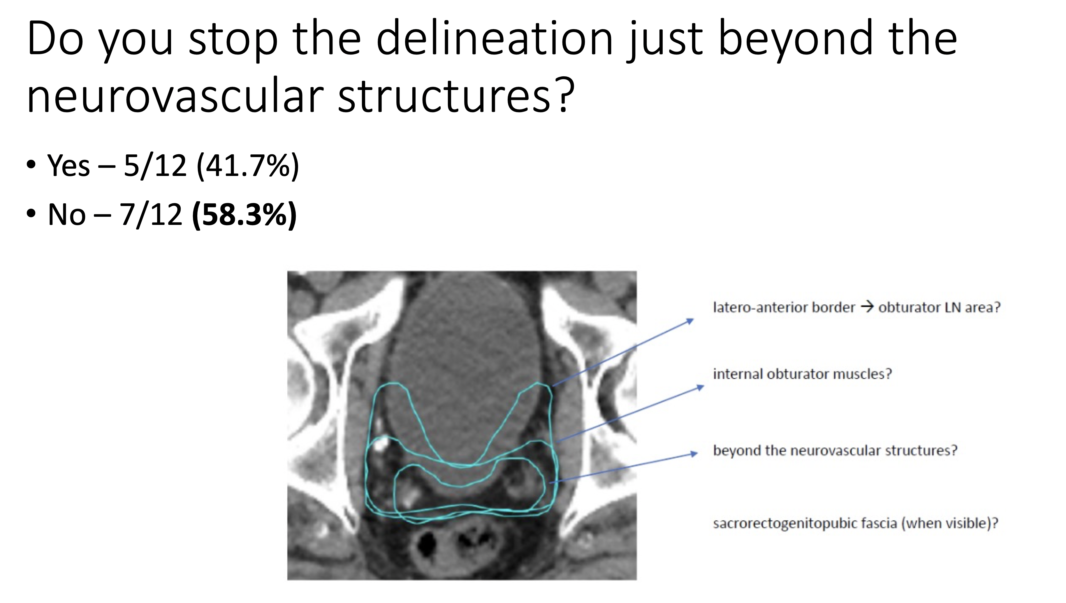
Supp. Figure
Case-specific surveys
This is an example of the multiple questions that we used in our case-specific surveys for discussions that led to the ESTRO-ACROP recommendations.

