Slide 1
Figures and Tables for submission

Slide 2
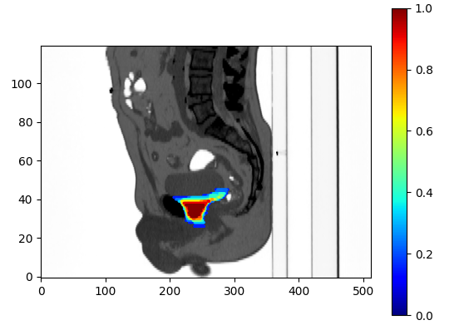
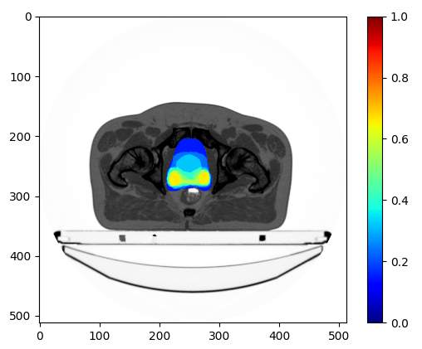
Fig. 1
anterior
superior
inferior*
Notes:
The 3 areas of greatest variability consisted of (1) the superior-most aspect at the seminal vesicles level, (2) the inferior part at the prostate apex level, and (3) anteriorly, next to the pubic symphysis.

Slide 3
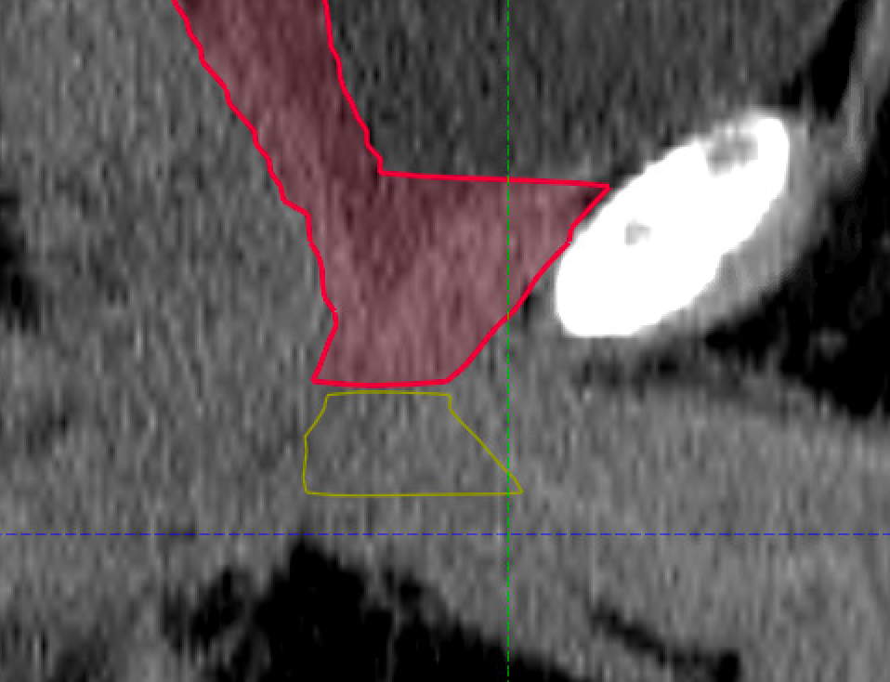
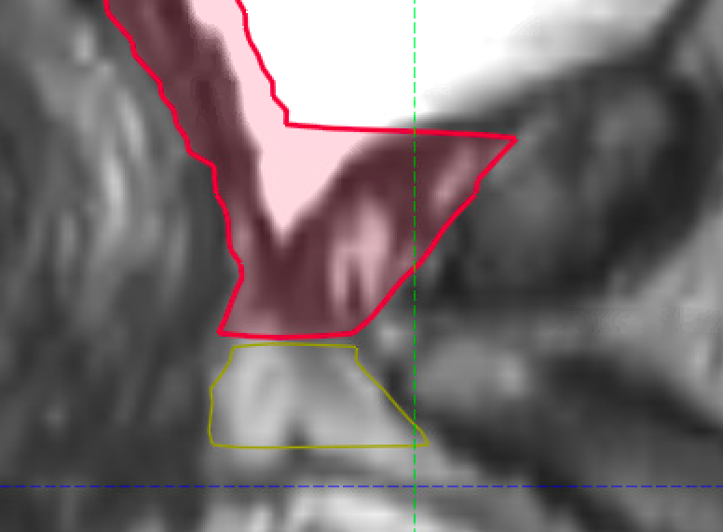
Fig 2
a)
b)
VUA
VUA
penile bulb
penile bulb
MRI-based delineation
CT-based delineation
MRI-based delineation

Slide 4
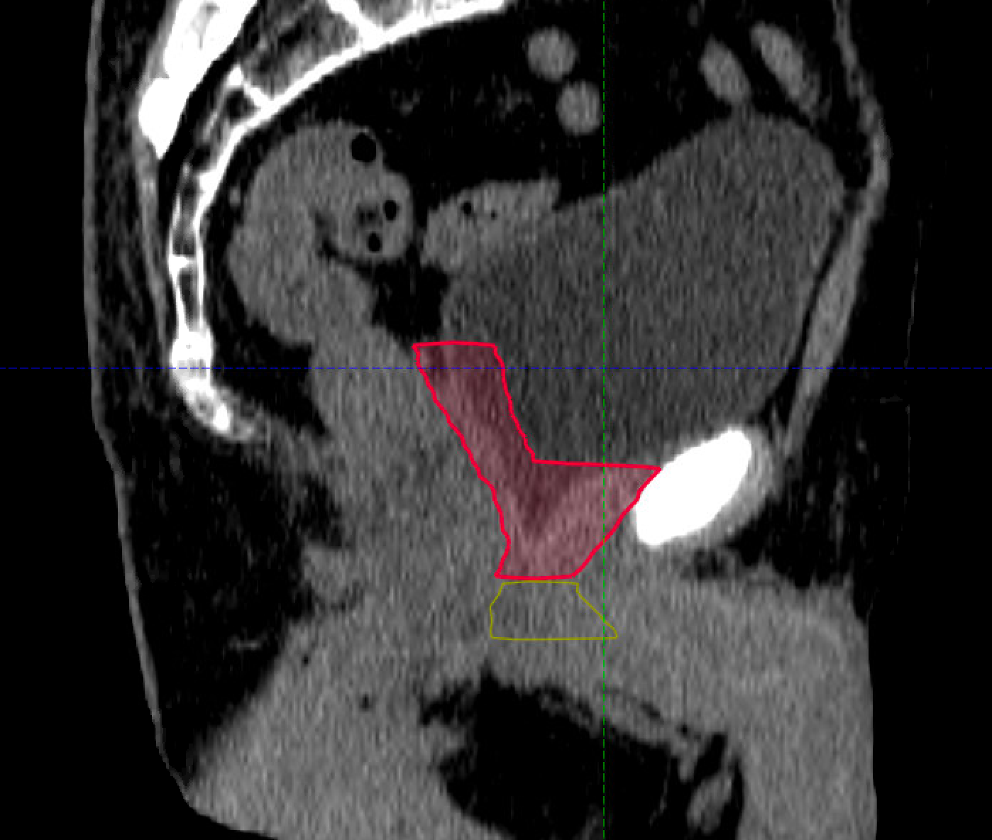
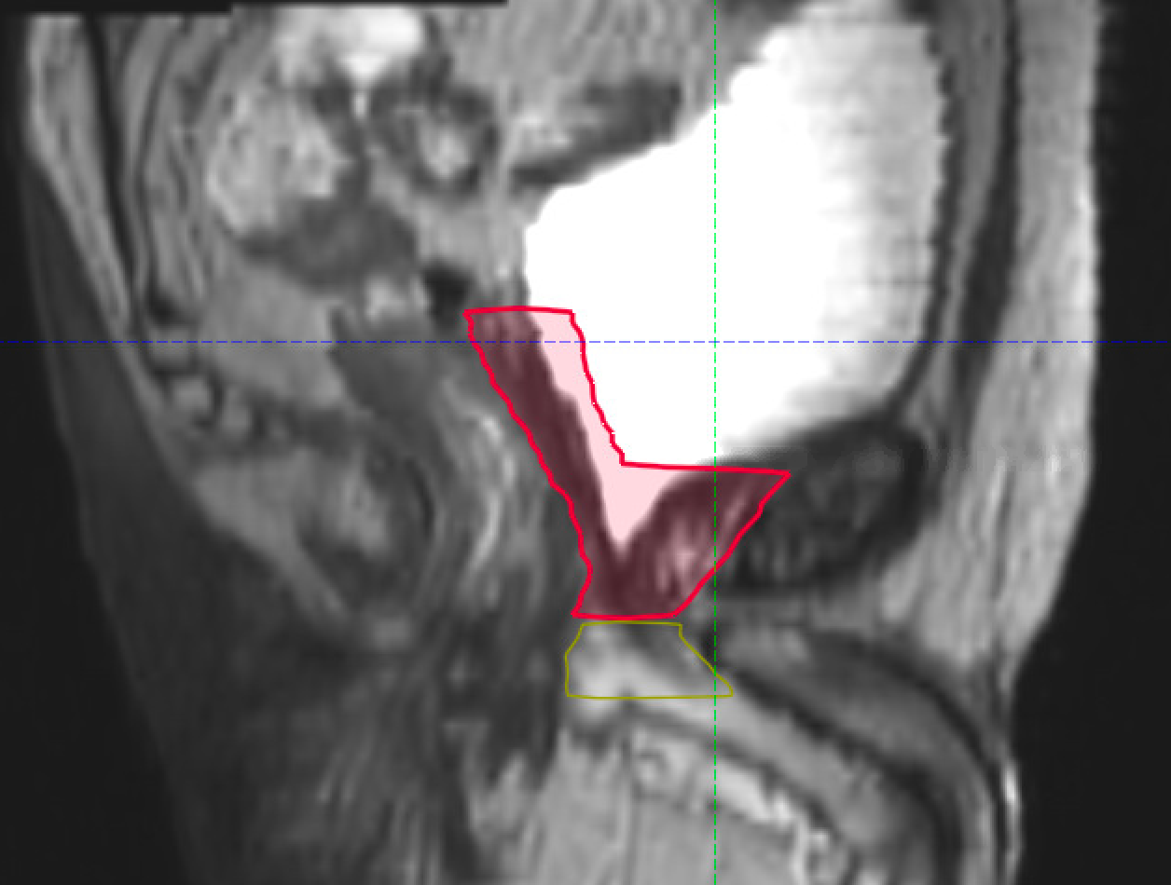
Fig. 3
a)
b)
c)
CT-based delineation
MRI-based delineation

Slide 5
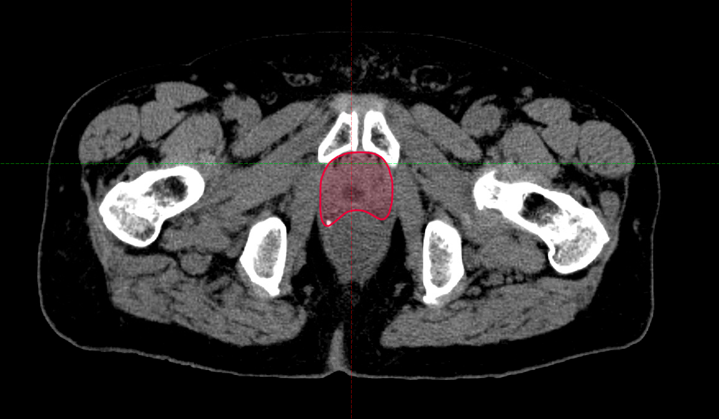
Fig. 4
a)
b)
Caudal

Slide 6
Fig. 5
a)
b)

Slide 7
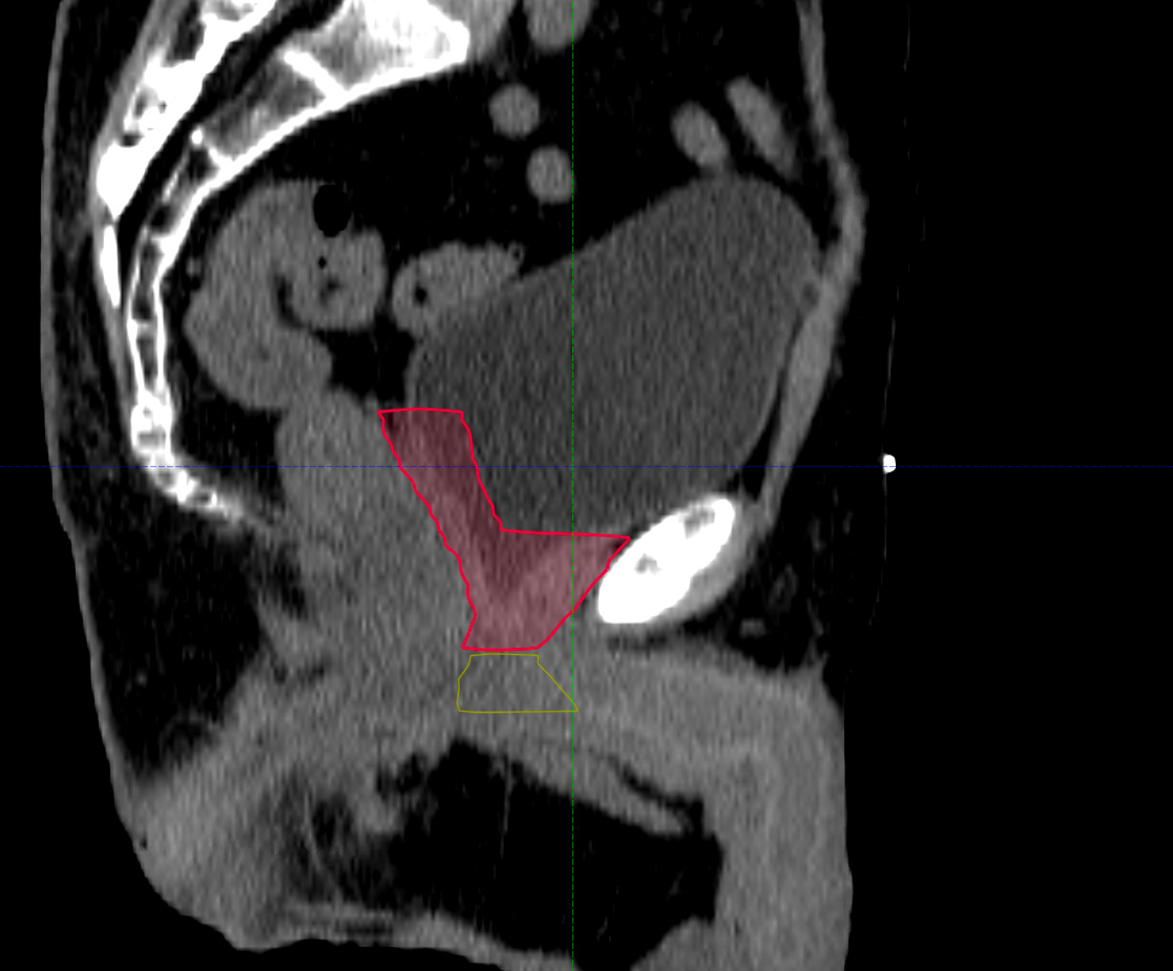
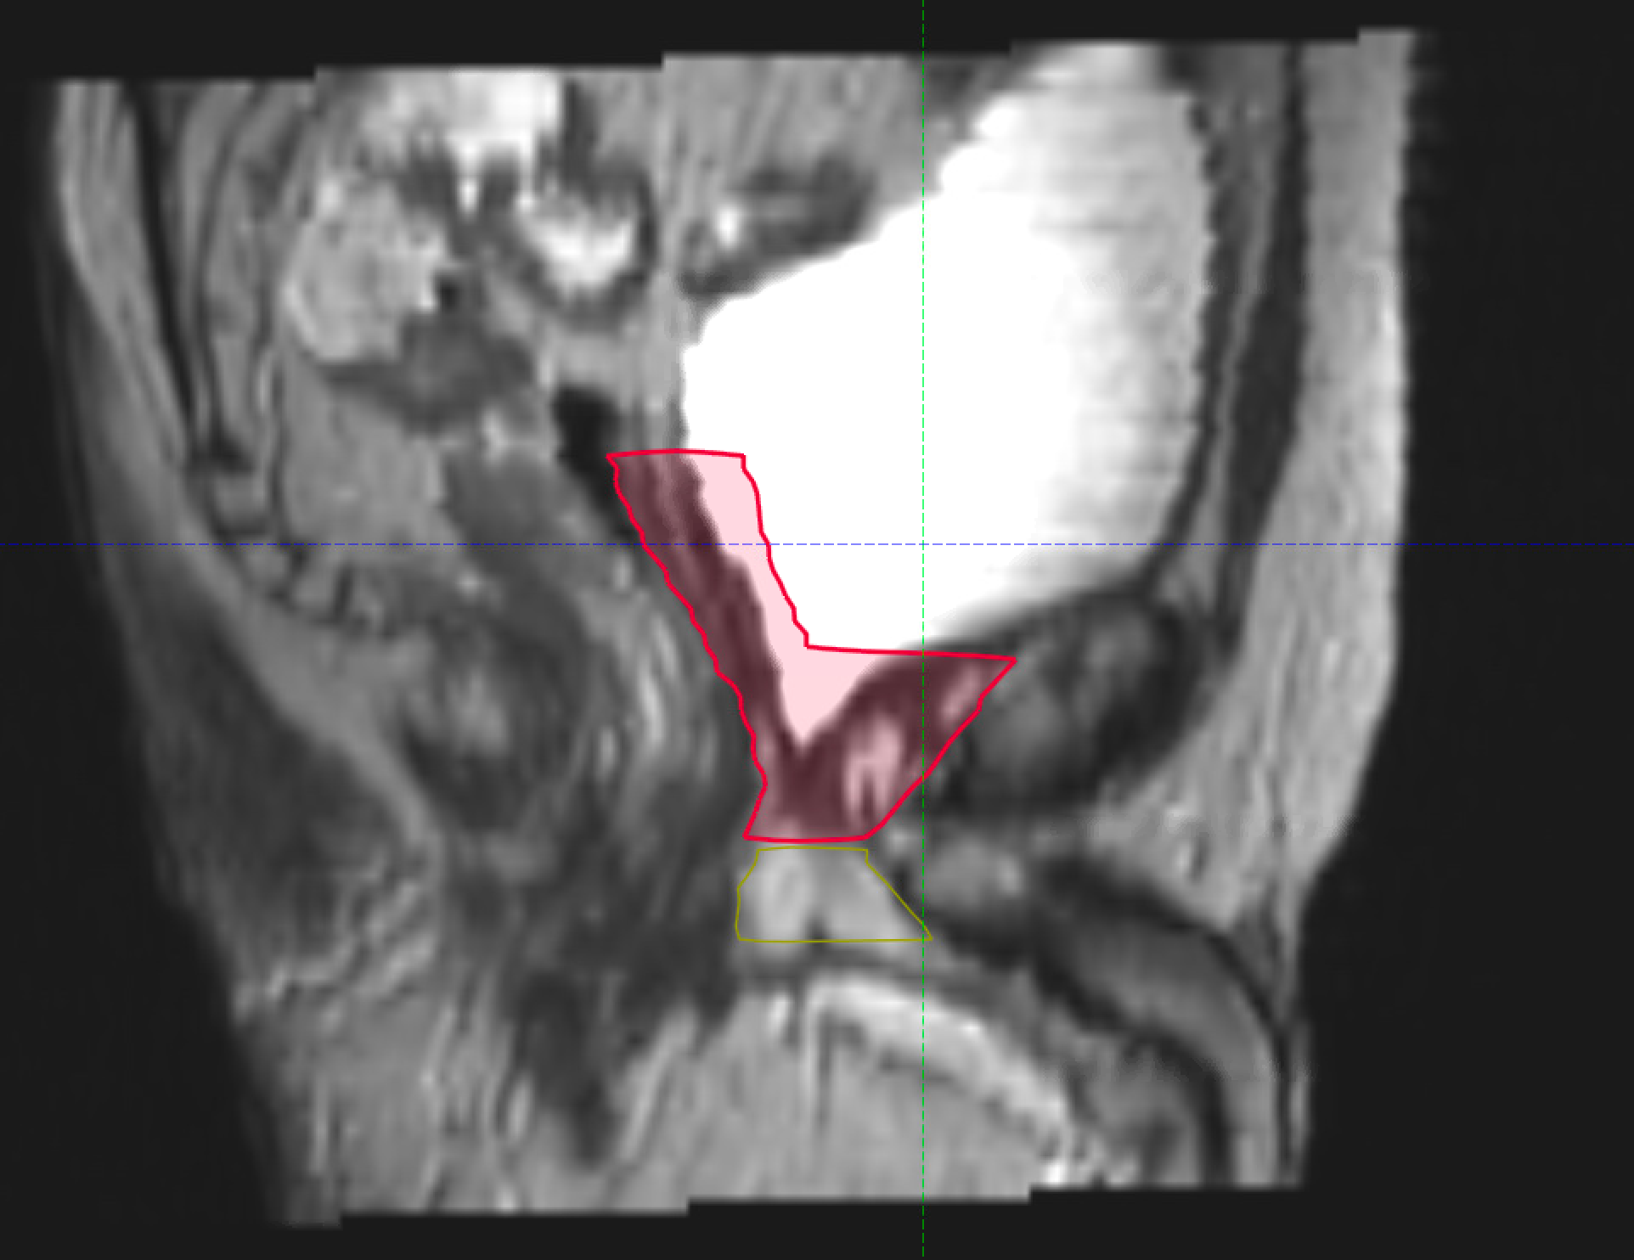
Fig. 6
a)
b)
c)

Slide 8
Table 1
Border
Inferior | Use VUA as anatomic landmark and contour 8-12 mm below the VUA The VUA is defined as the slice below the last slice where fluid (urine) is seen If VUA is not visible, use penile bulb as an anatomic landmark and contour to the slice right above the penile bulb
Anterior | Cranially, CTV should cover 1-2 cm of the posterior bladder wall or stop at the posterior margin of bladder wall Caudally, stop at the posterior margin of the pubic bone up to half to two thirds of the symphysis pubis
Posterior | Contour up to the anterior rectal wall Cranially, up to the mesorectal fascia when visualized Include the antero-lateral angles of the rectum and existing surgical clips
Lateral | Contour up to the internal margins of the internal obturator muscles CTV should not be extended latero-anteriorly toward the region of the obturator lymph More caudally, the lateral borders are the internal margins of the internal obturator muscles or internal borders of the levator ani muscles
Superior | Include region of both seminal vesicles with 3-5 mm “bridge” If no seminal vesicles invasion, include the base (lower third) of the seminal vesicles bed (I.e., level of cut end of vas deferens) If seminal vesicles invasion, include the entire seminal vesicle bed Attempt to include existing surgical clips superiorly

Slide 9
Supplementary material

Slide 10
Supp. Table 1
 | Inferior | Anterior | Lateral | Posterior | Superior
EORTC [4] | x | x | x | o | x
PMH [5] | o | x | x | x | x
FROGG [7] | x | x | o | o | o
RTOG [3] | o | x | x | o | x
GFRU [6] | x | x | o | o | x
o= similar x= different

Slide 11
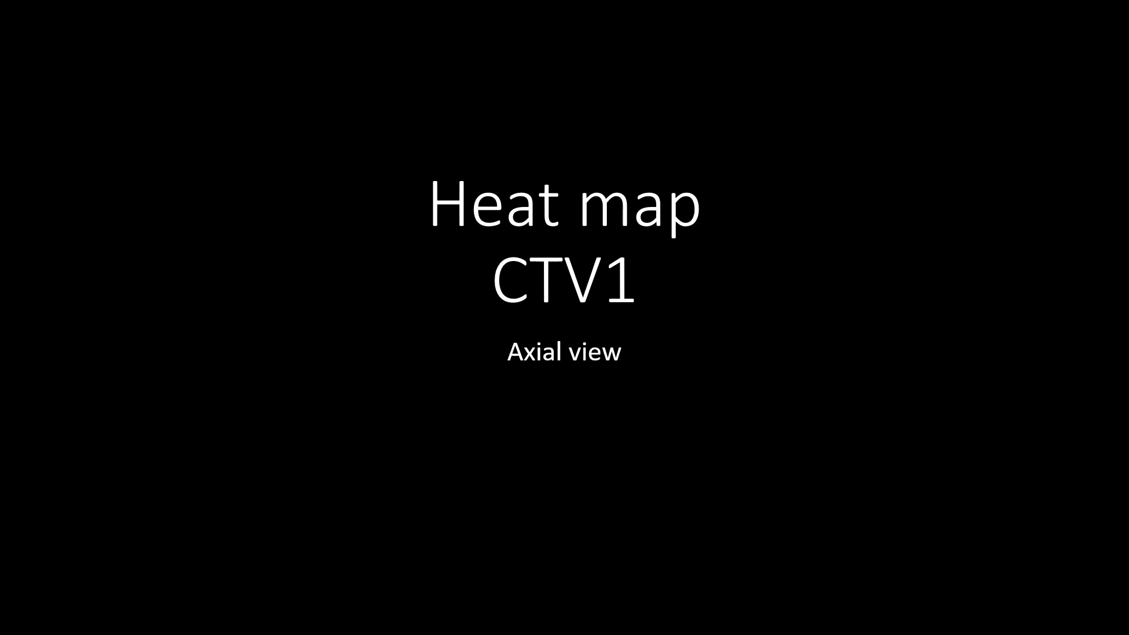
Supp. Video 1

Slide 12
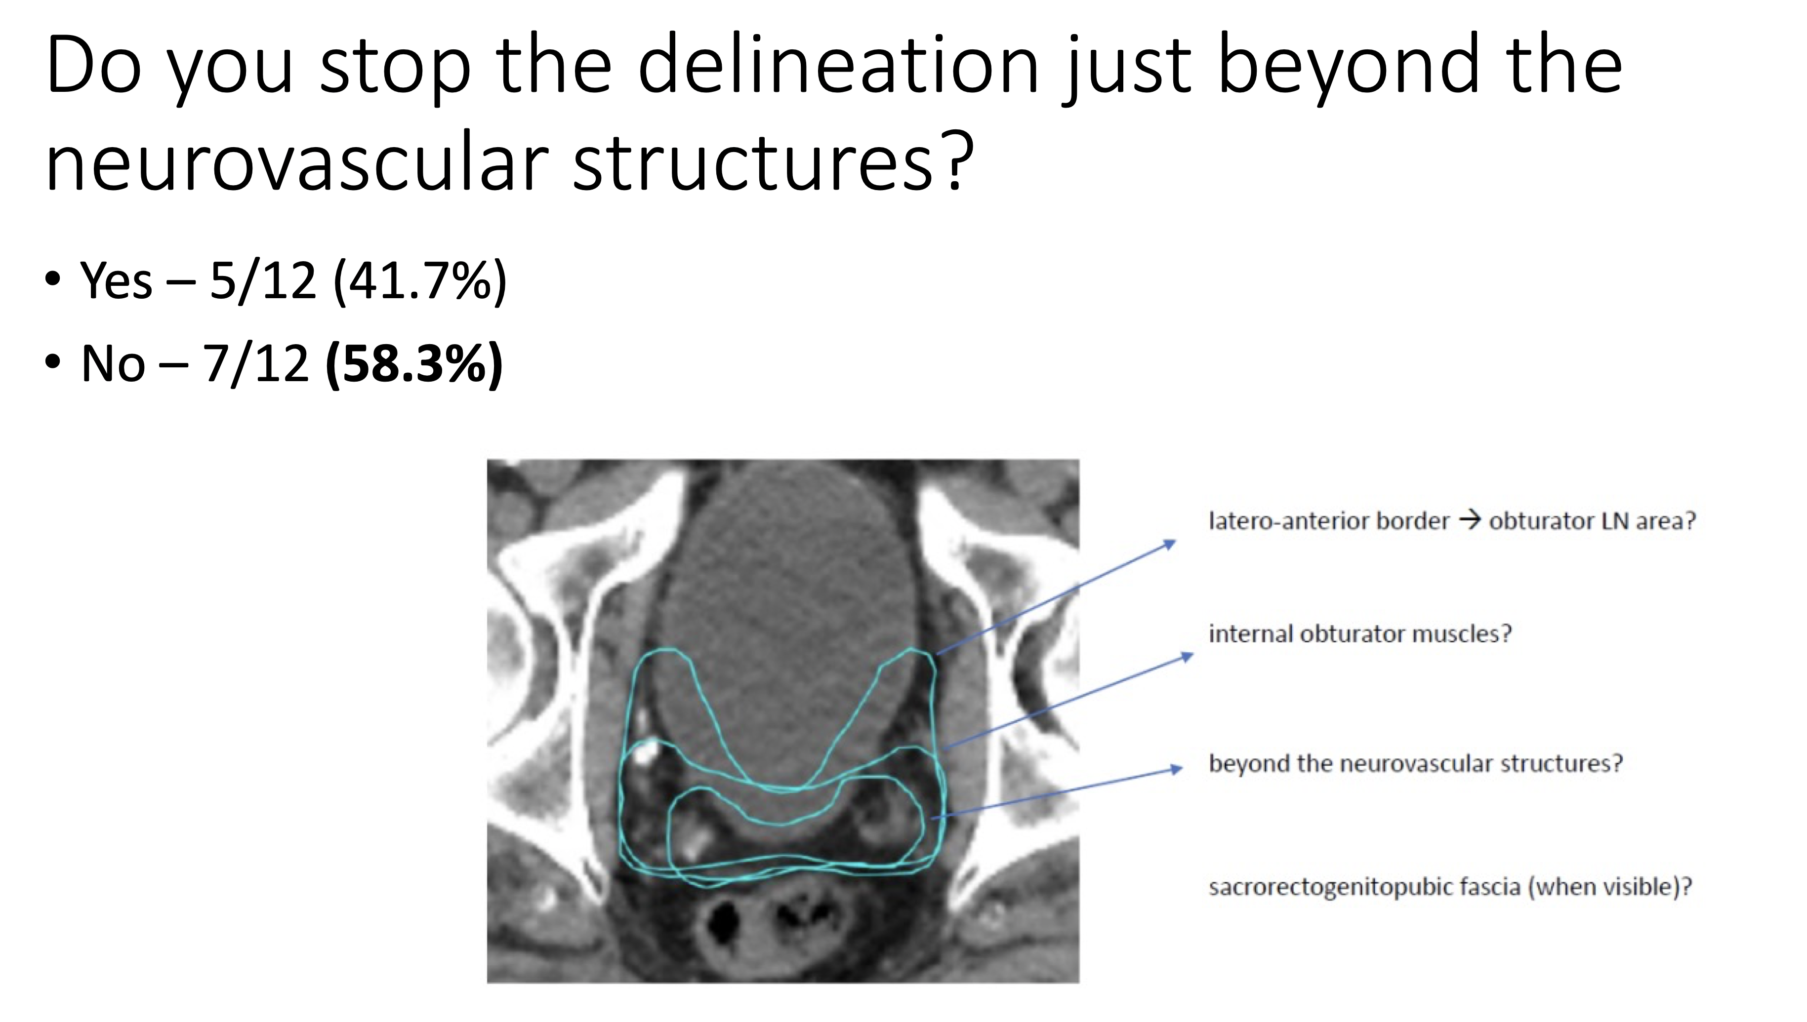
Supp. Figure
Case-specific surveys
This is an example of the multiple questions that we used in our case-specific surveys for discussions that led to the ESTRO-ACROP recommendations.

Slide 13
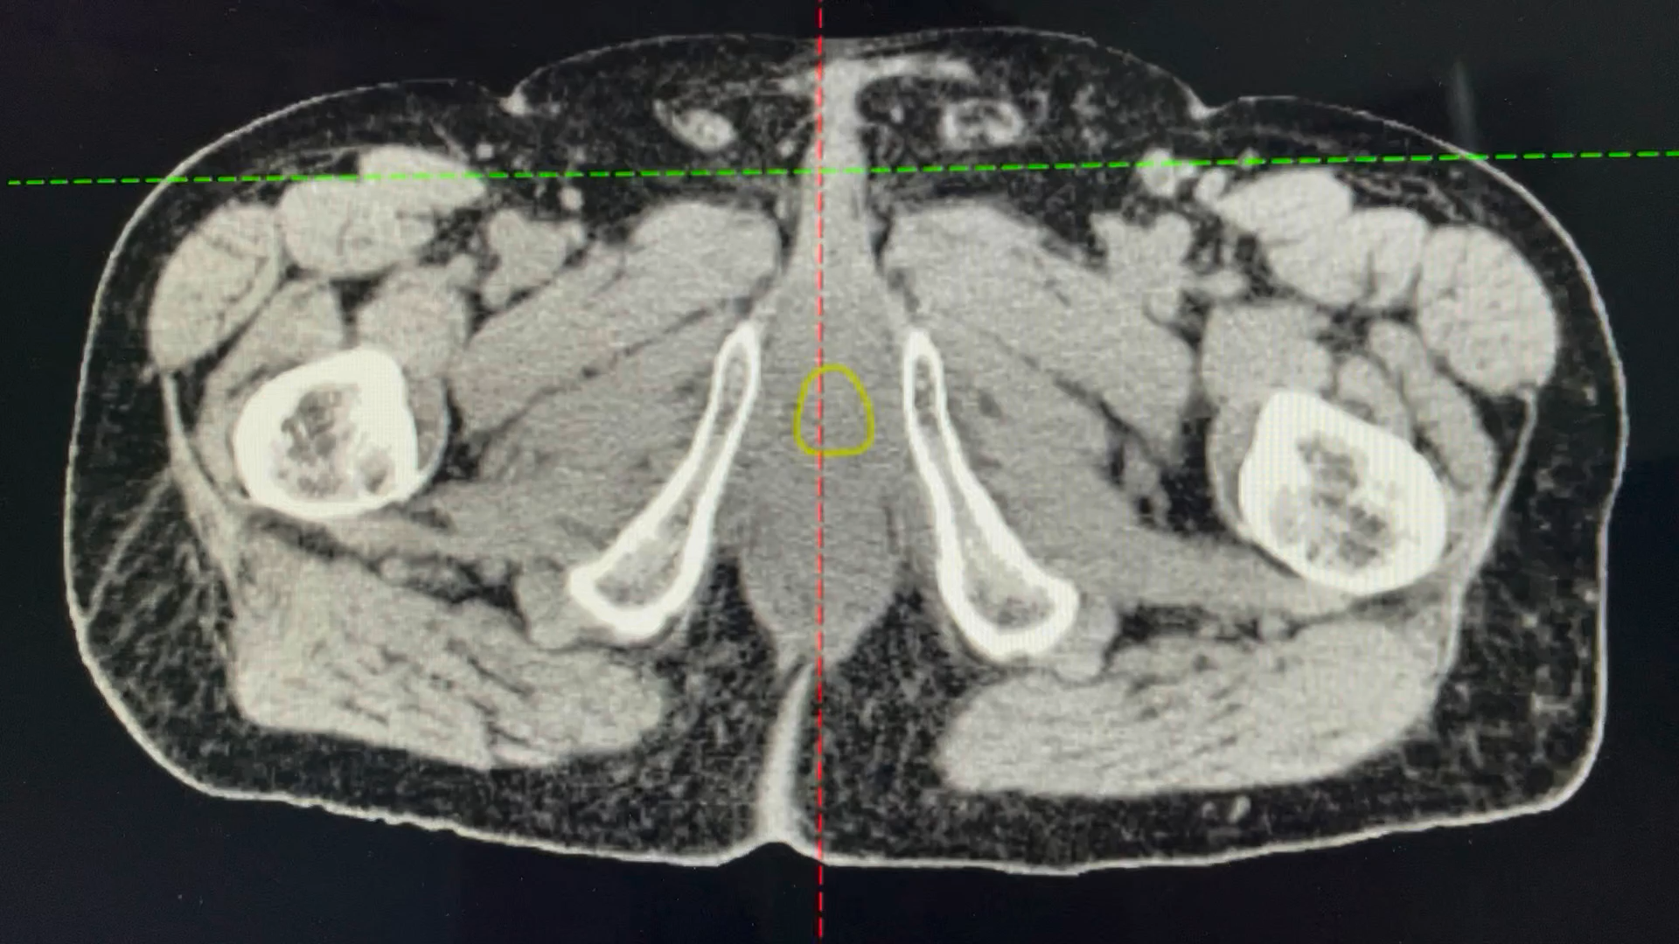
Supp. Video 2. CT-cased delineation

