Slide 1

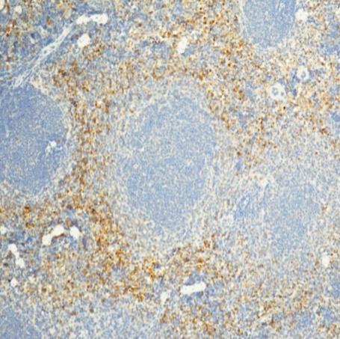
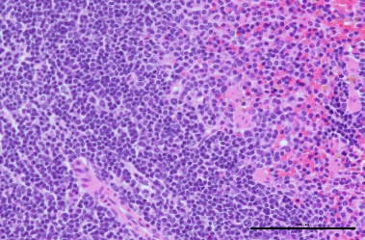
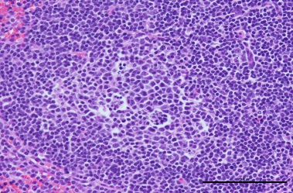
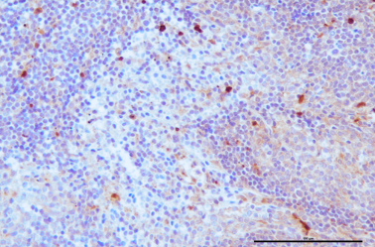
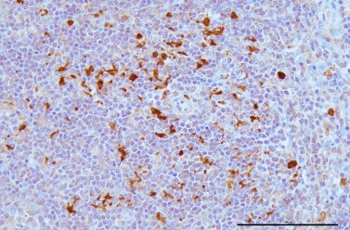
A
Ly6
100X
HPβCD
SCH-479833
B
*
H&E
CC3
HPβCD
SCH-479833
Supplemental Fig. 1: A. IHC analysis of spleen from untreated and antagonist-treated tumor bearing animals using Ly6 antibody. B. IHC analysis malignant apoptotic cells in spleen metastasis of untreated and antagonist-treated KC tumor bearing mice.

Slide 2
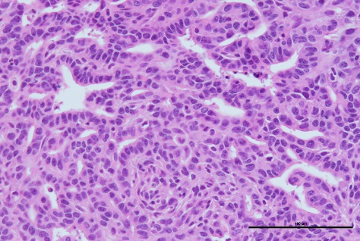
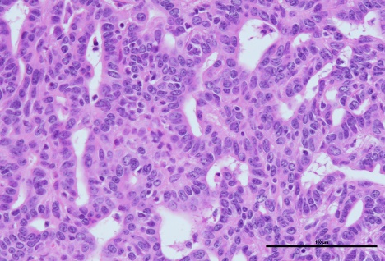
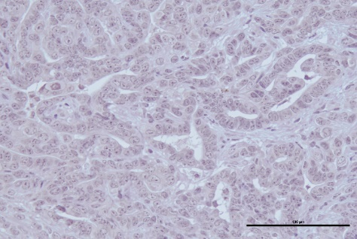
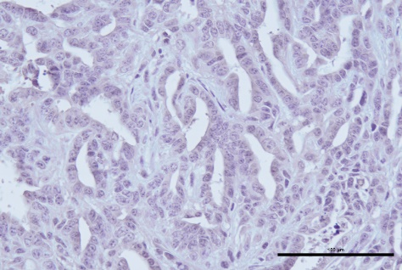
H&E
F4/80
HPBCD SCH-479833
Supplemental Fig. 2: IHC analysis of spleen from untreated and antagonist-treated tumor bearing animals using Ly6 antibody.

