Slide 1
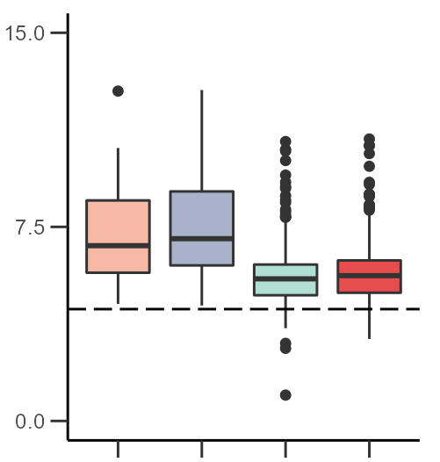
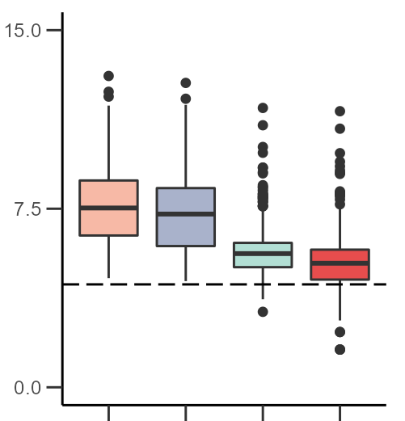
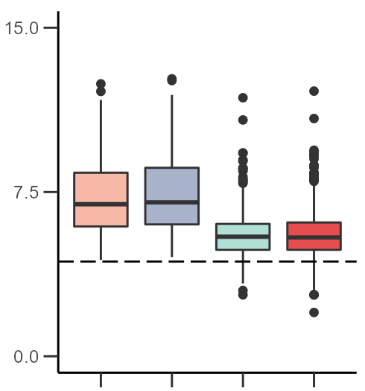
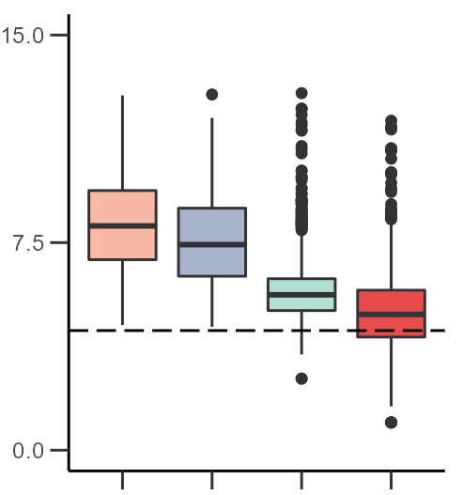
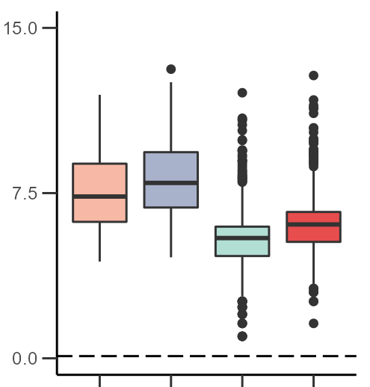
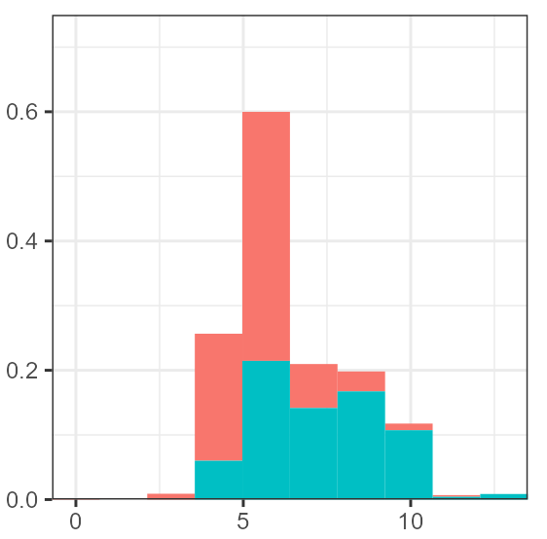
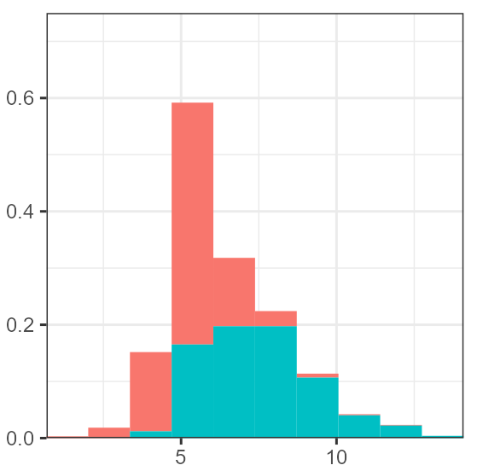
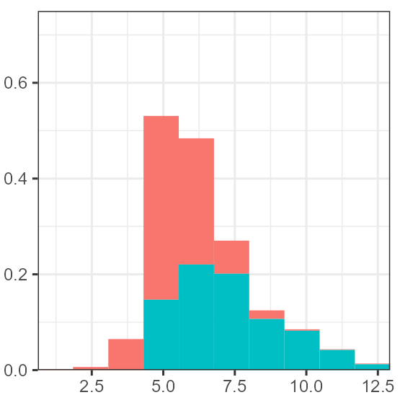
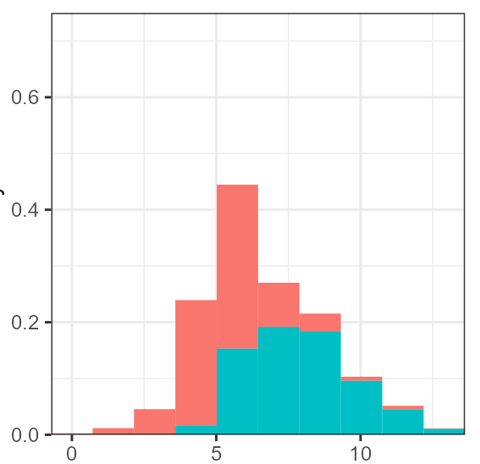
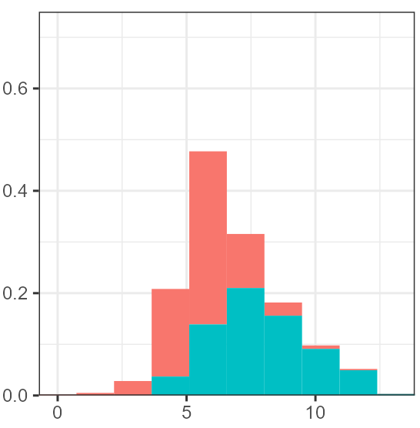
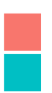
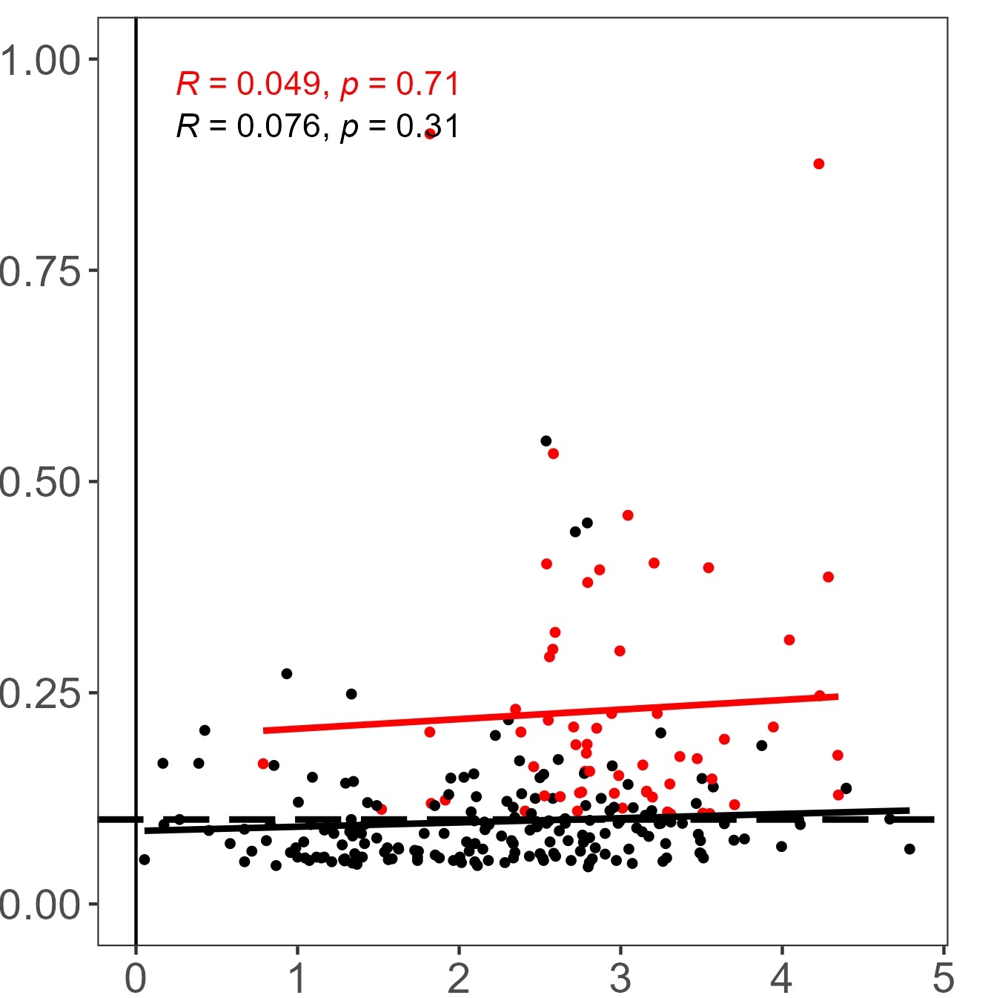
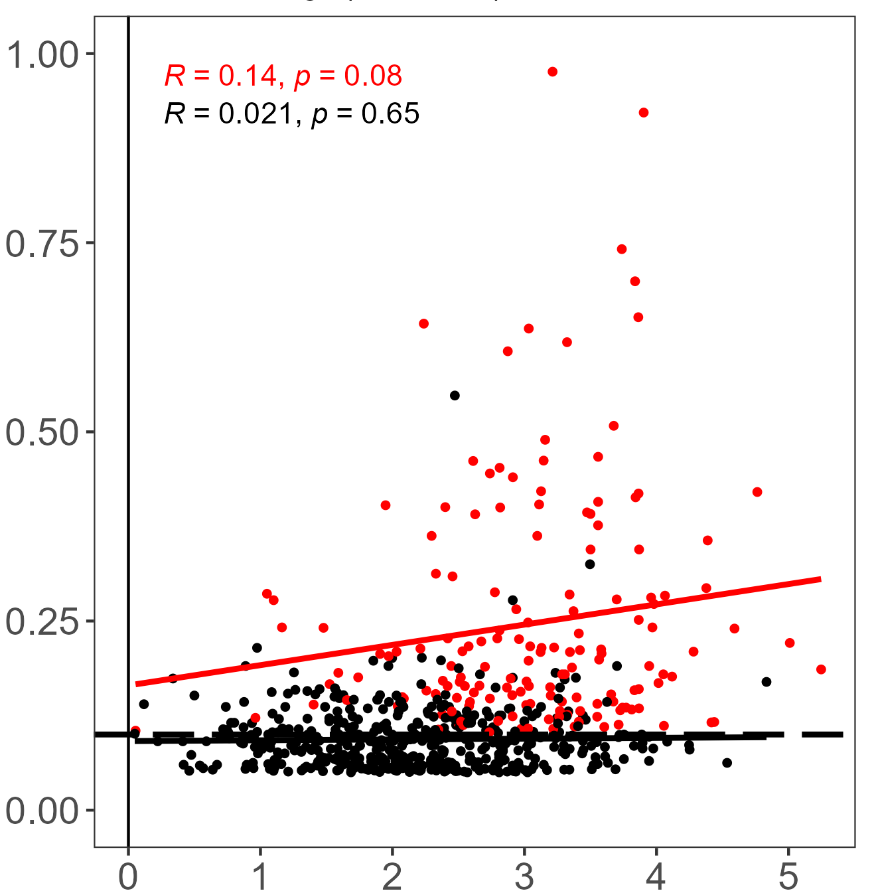
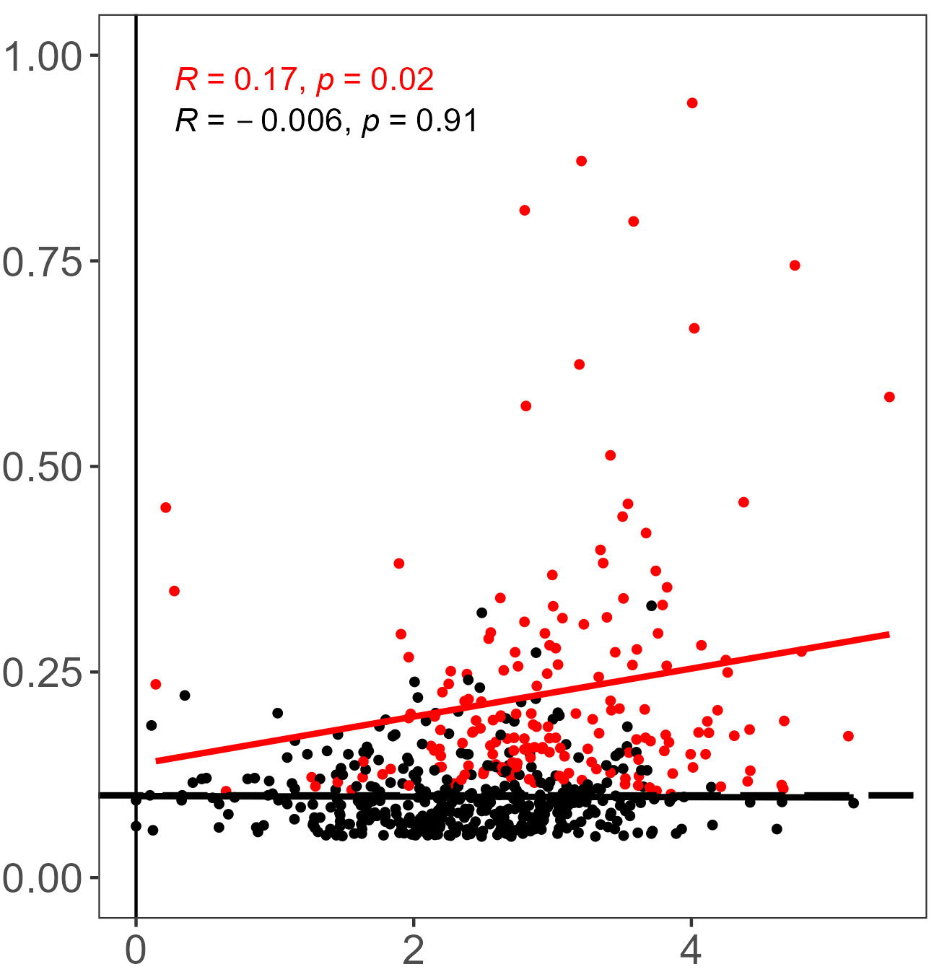
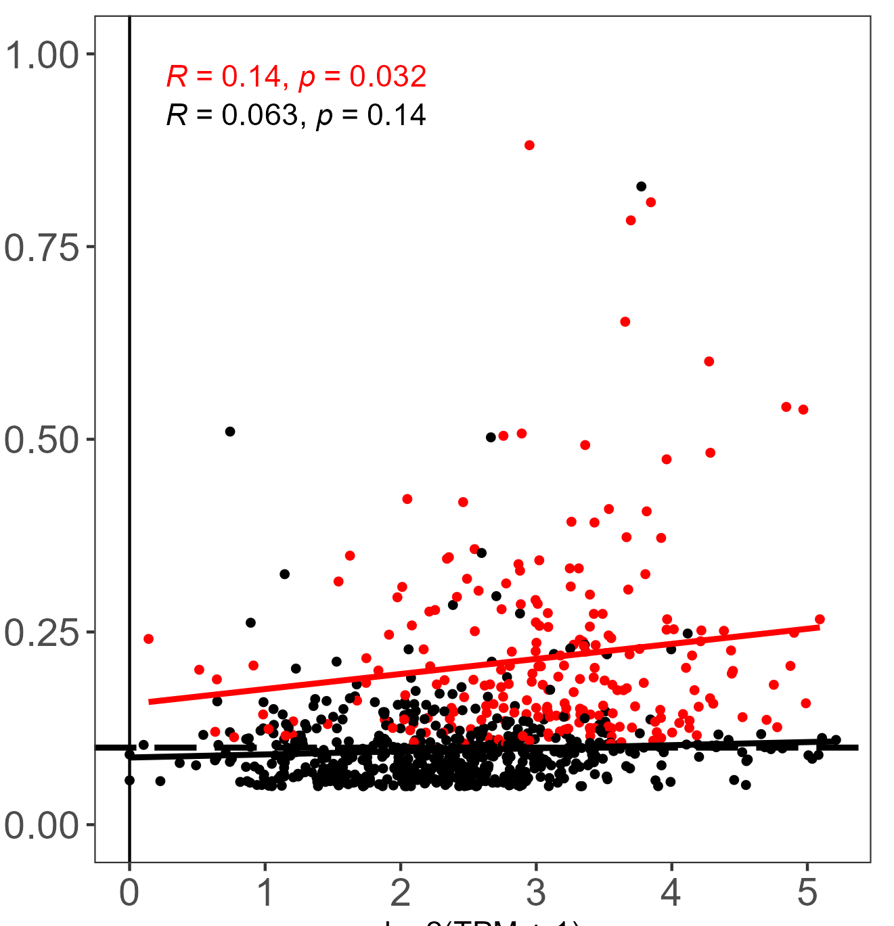
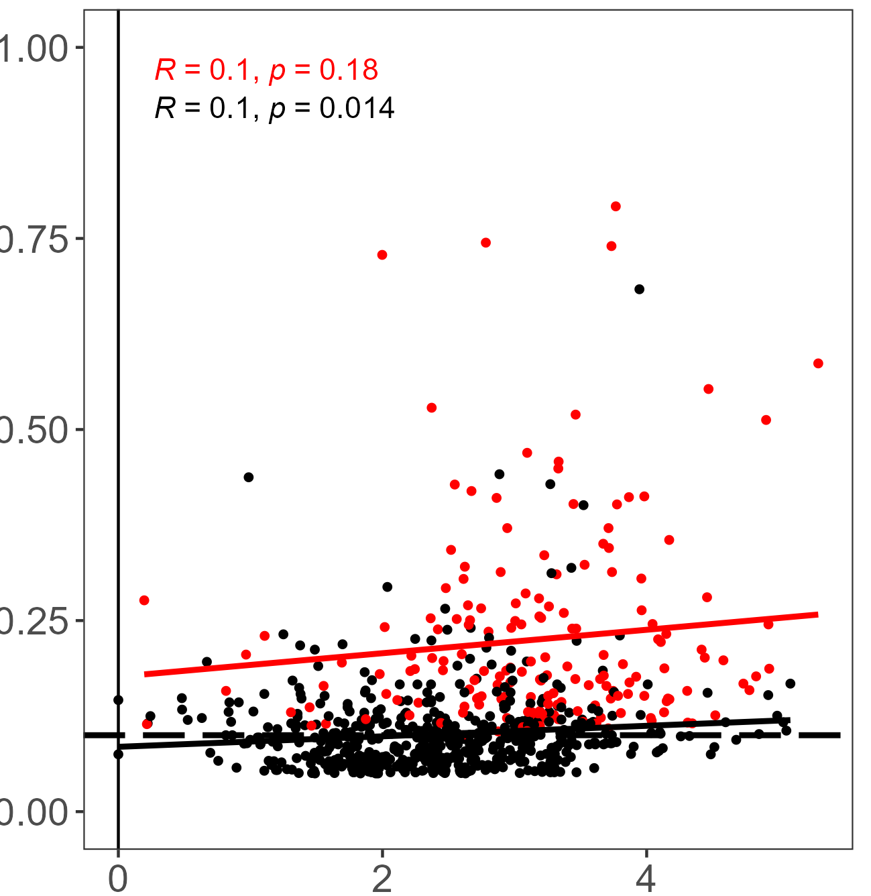
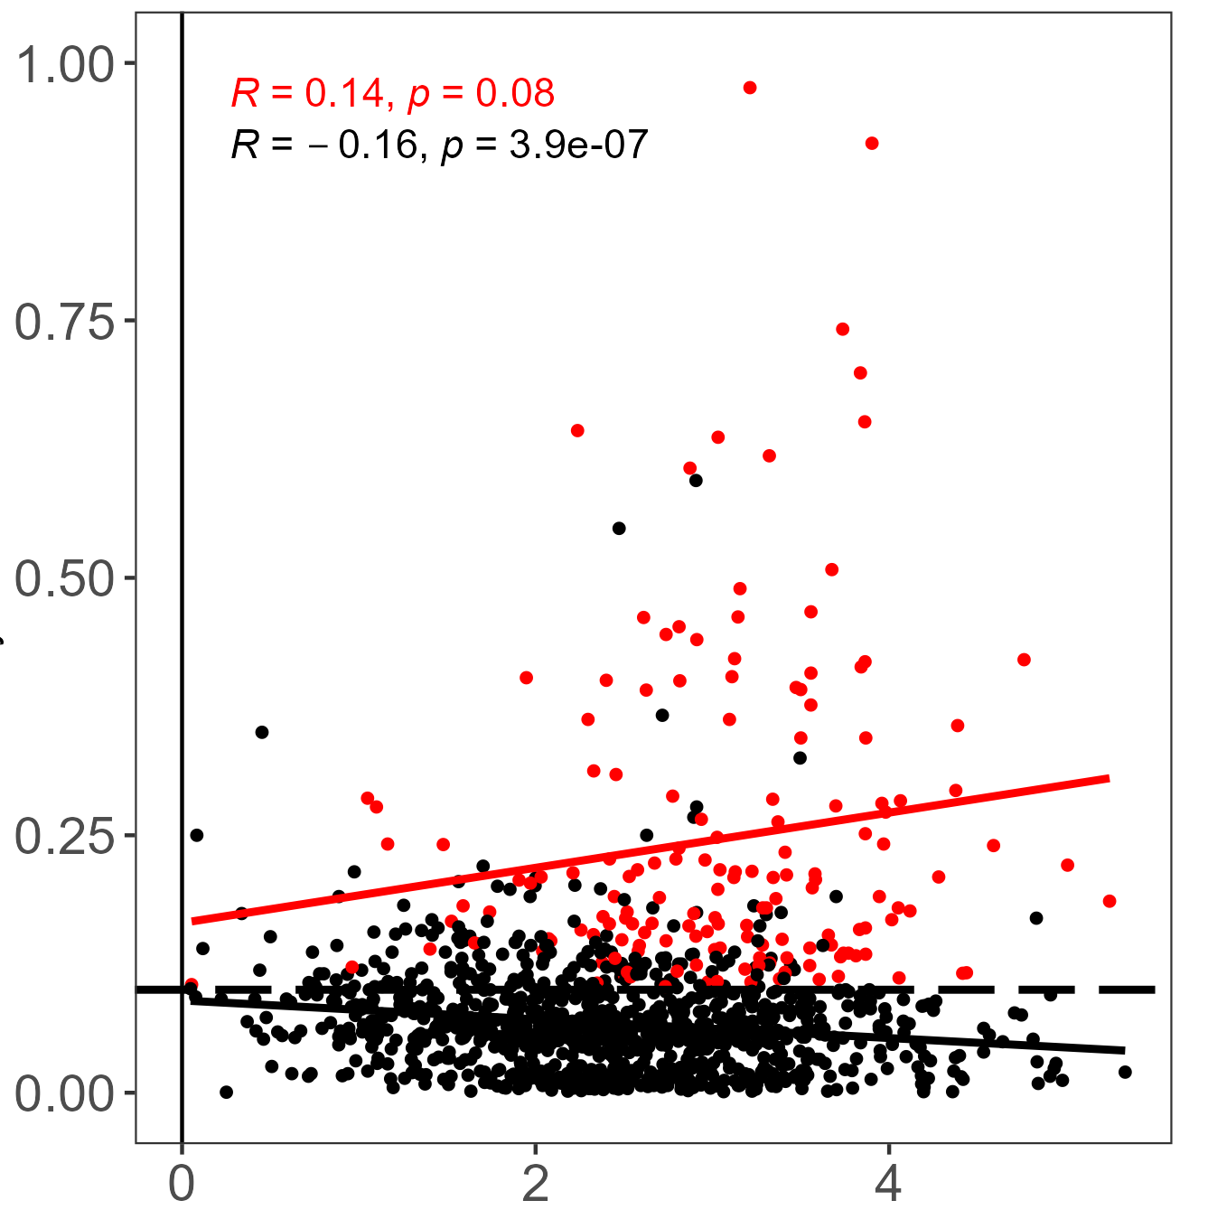
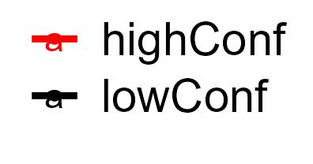
A
NSC
Neuron
P0
P17
6W
Log2(BS-seq coverage +1)
Rep 1 low-conf
Rep 2 high-conf
Rep 2 low-conf
Rep 1 low-conf
Rep 1 high-conf
Rep 2 high-conf
Rep 2 low-conf
Rep 1 low-conf
Rep 1 high-conf
Rep 2 high-conf
Rep 2 low-conf
Rep 1 high-conf
Rep 1 low-conf
Rep 2 high-conf
Rep 2 low-conf
Rep 1 high-conf
Rep 1 low-conf
Rep 2 high-conf
Rep 2 low-conf
Rep 1 high-conf
B
NSC
Neuron
P0
P17
6W
Low-conf
High-conf
Density
C
Log2(BS-seq coverage +1)
NSC
Neuron
P0
P17
6W
Methylation level
log2(RNA BS-seq TPM + 1)
Notes:
Supplementary Figure 2. Read coverage and methylation level comparisons between high and low confidence sites. (A) RNA BS-seq coverage of low and high-confidence m5C sites. (B) Distribution of read coverage for high and low-confidence m5C sites. (C) Correlation of read coverage and methylation level for high and low-confidence m5C sites in five conditions.

