Slide 1
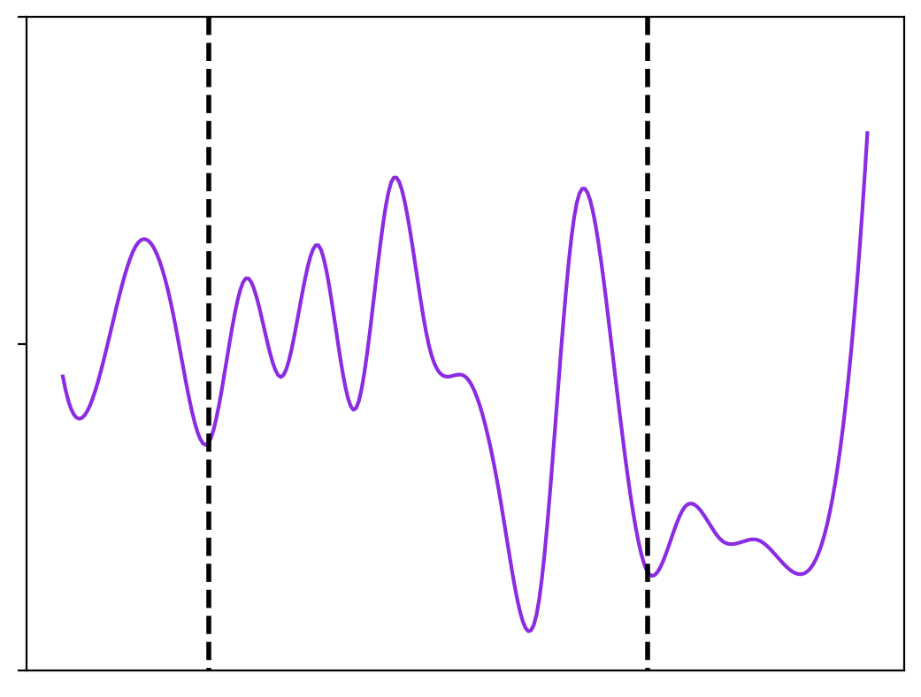
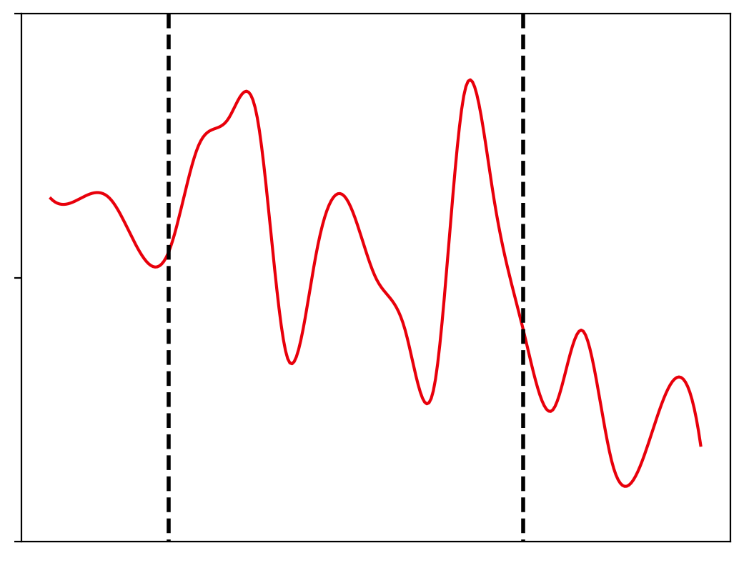
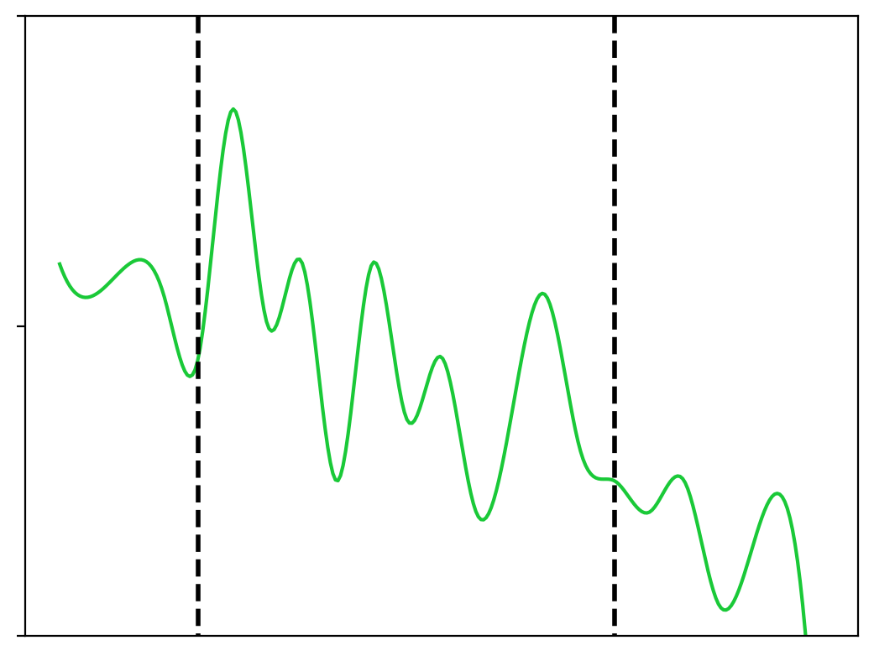
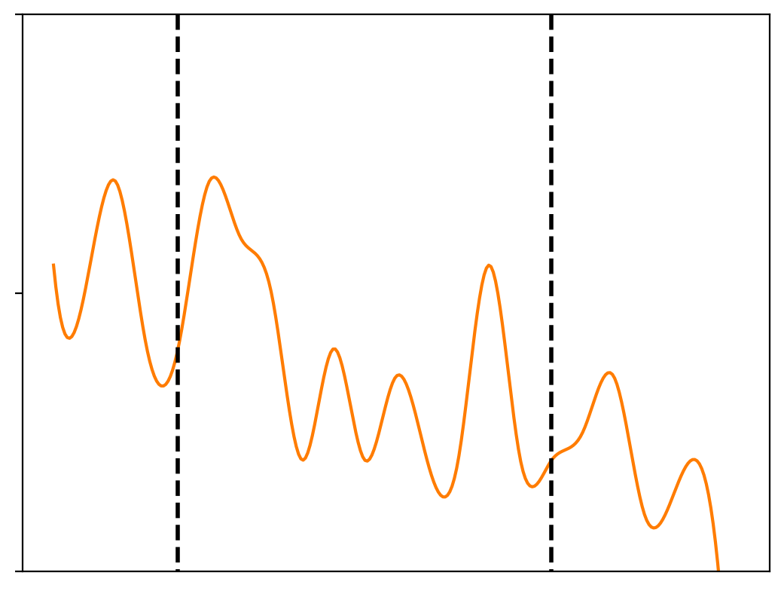
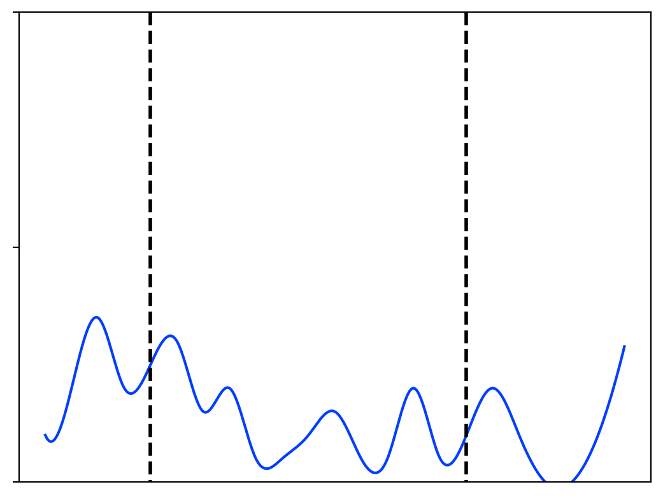

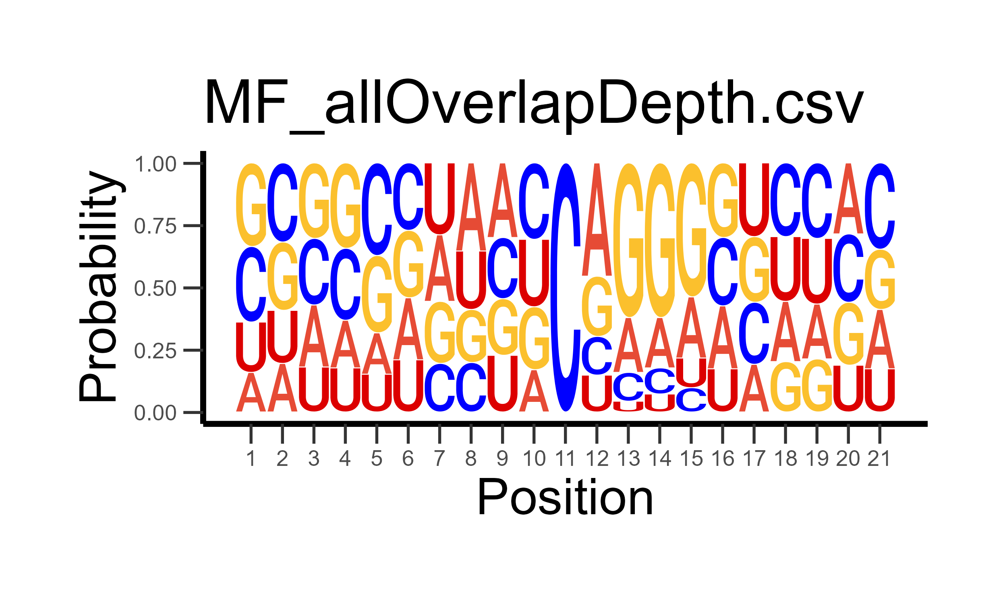
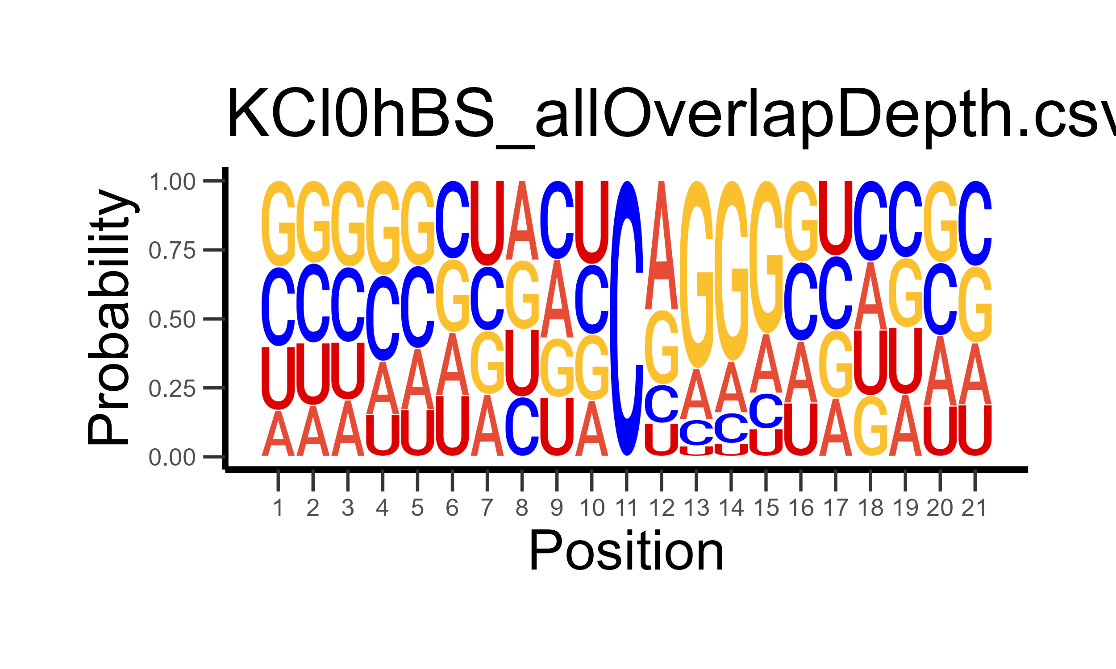
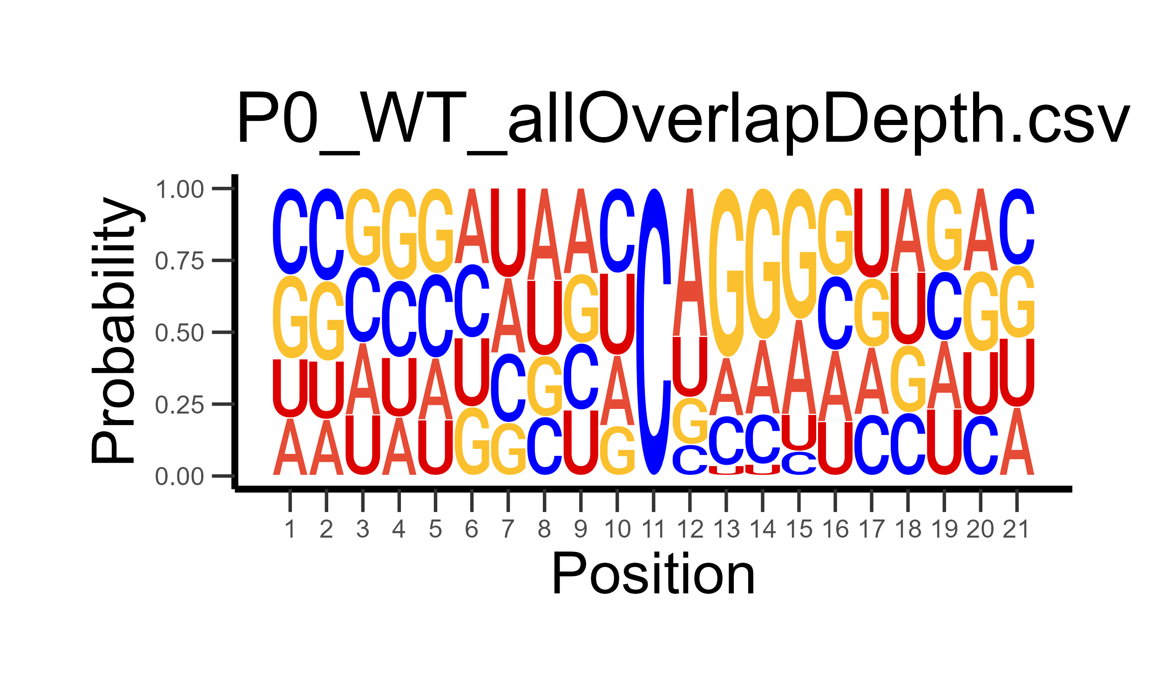
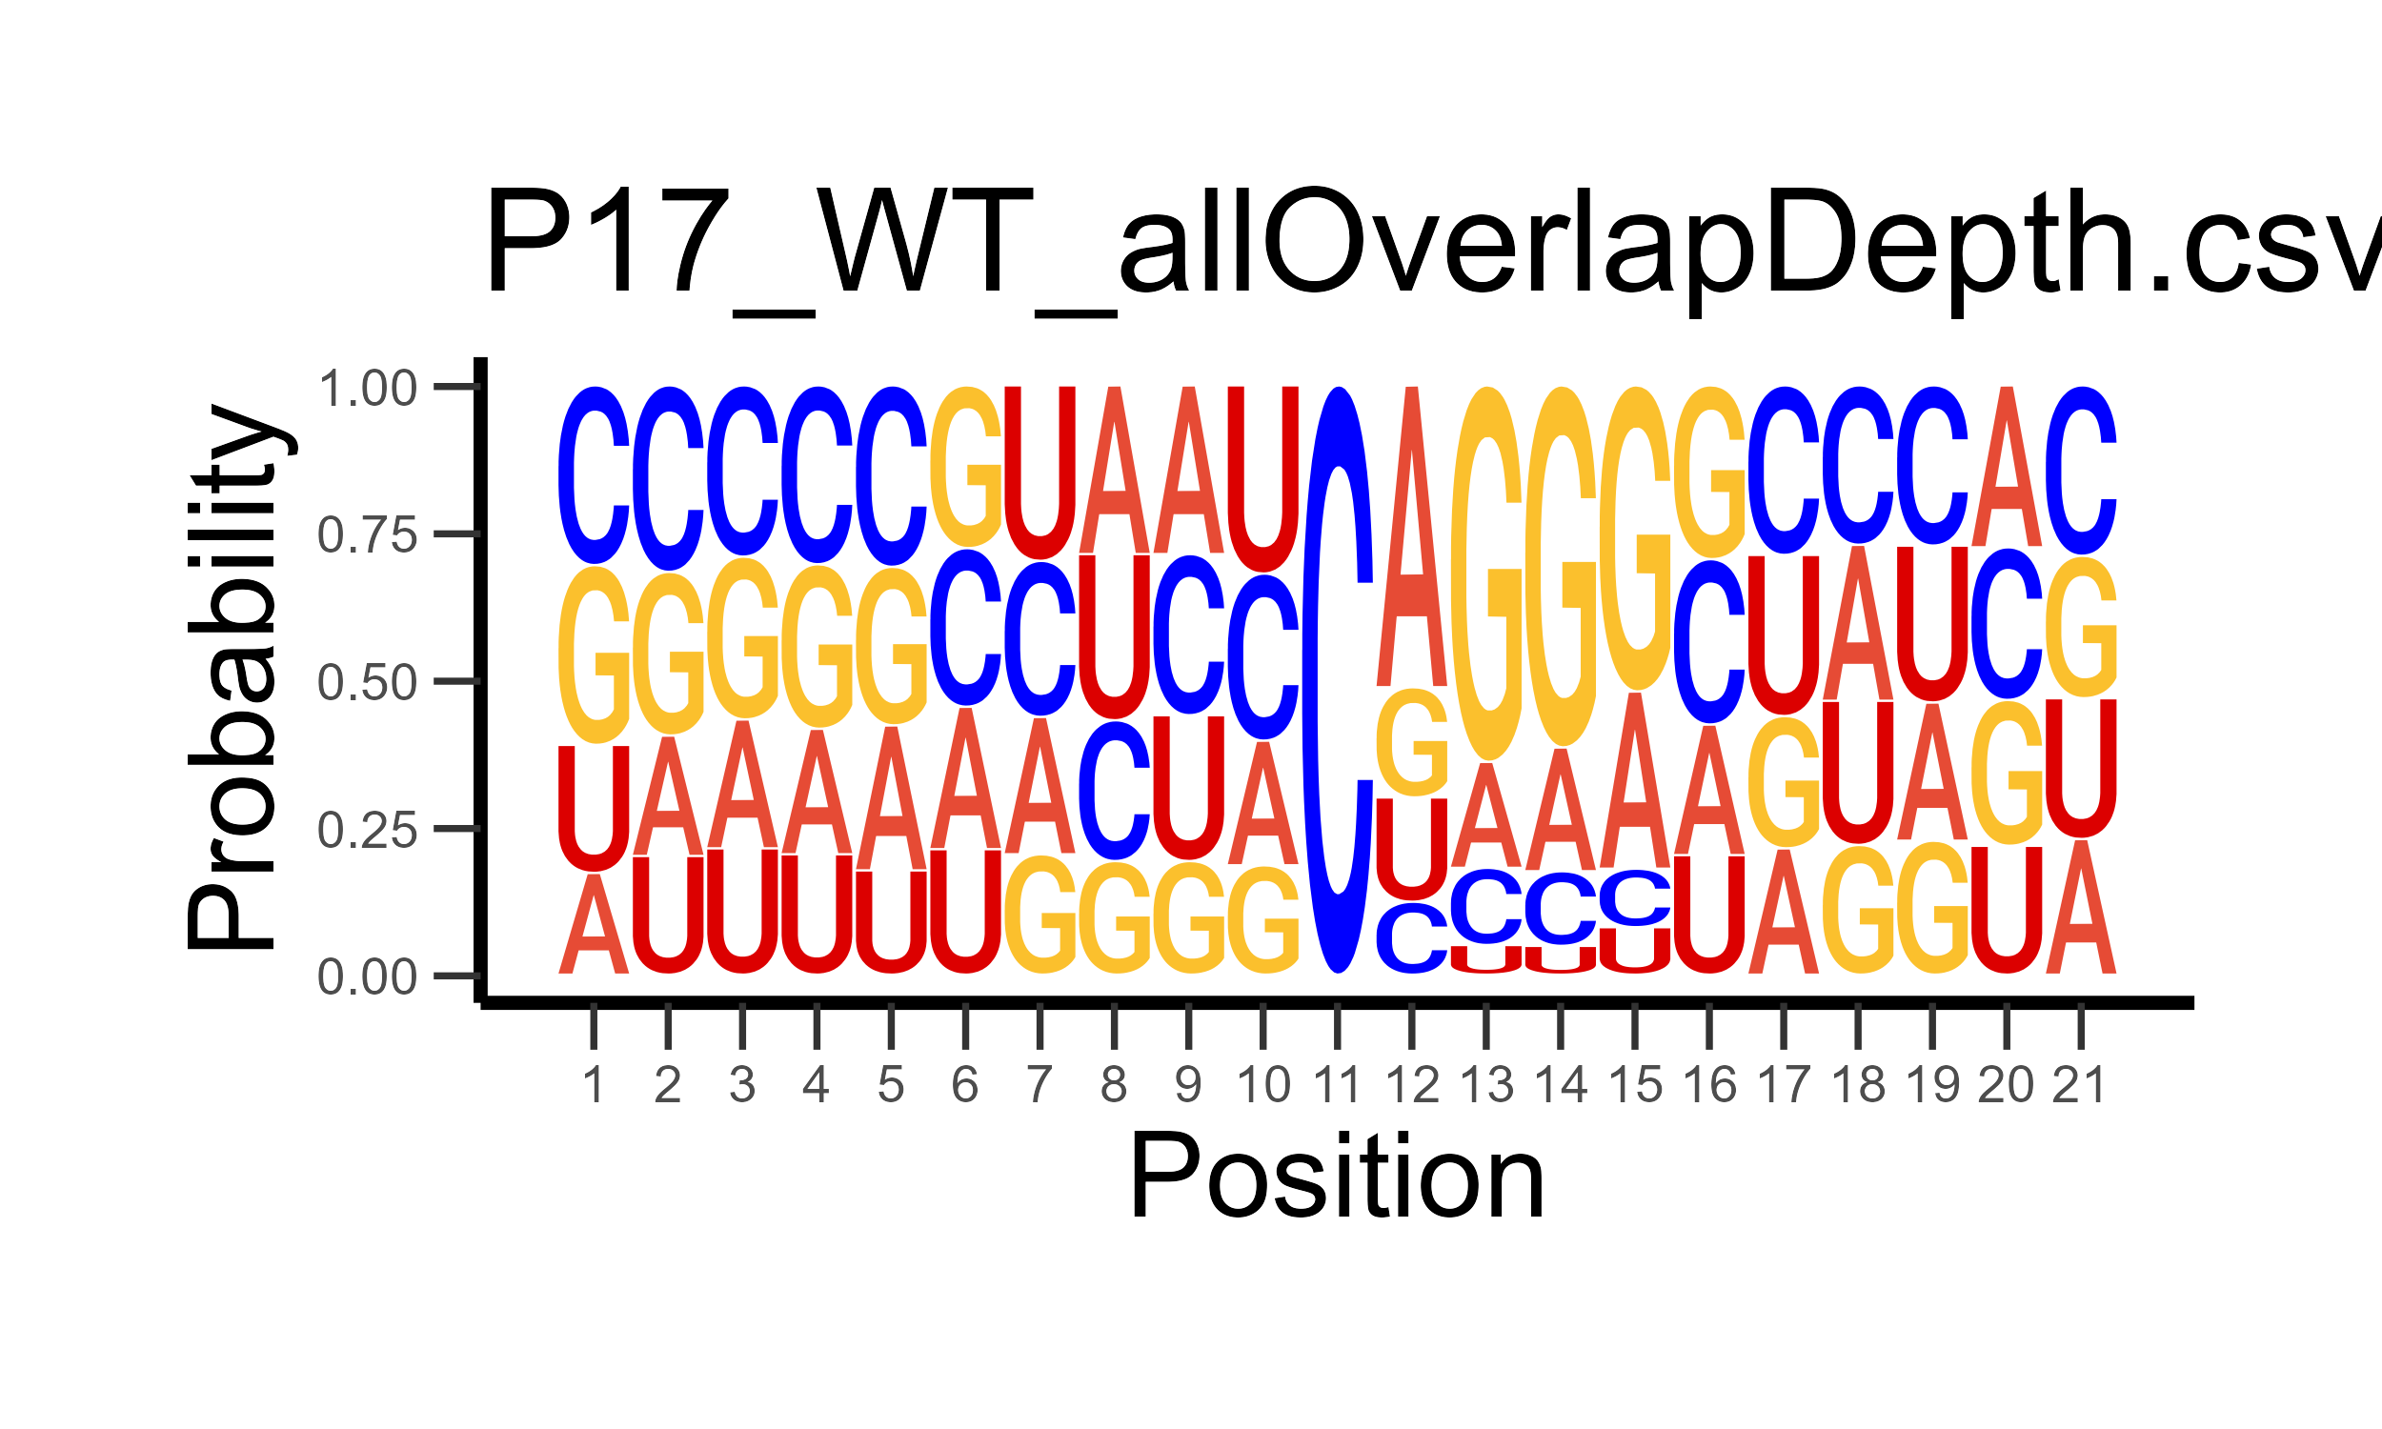
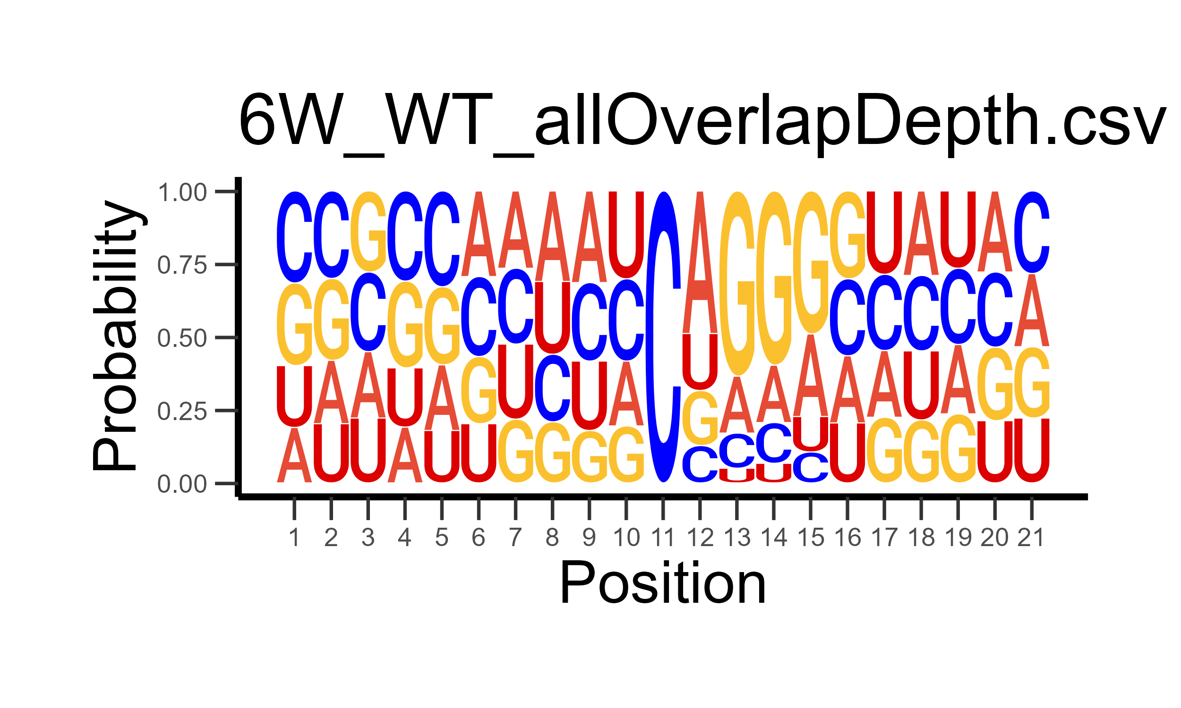
A
1
0.5
0
NSC
Neuron
P0
P17
6W
Density (x10⁻²)
5’UTR
CDS
3’UTR
B
NSC
Neuron
P0
P17
6W
Notes:
Supplementary Figure 4. Features of high-confidence m⁵C sites. (A) Density of m⁵C sites identified on a theoretical transcript. Transcripts were binned according to length (provided by Ensembl annotation) and assigned 5’UTR, CDS, and 3’UTR annotations based on bin location. (B) Sequence context of 10bp segments surrounding m⁵C sites.

