Slide 1
JAMA Ophthalmology Journal Club Slides:
Efficacy and Safety of 0.01% and 0.02% Atropine for the Treatment of Pediatric Myopia Progression Over 3 Years
Zadnik K, Schulman E, Flitcroft, I, et al. Efficacy and safety of 0.01% and 0.02% atropine for the treatment of pediatric myopia progression over 3 years: A randomized clinical trial. JAMA Ophthalmol. Published online June 1, 2023. doi:10.1001/jamaophthalmol.2023.2097

Slide 2
Introduction
Importance:
  The global prevalence of myopia is predicted to approach 50% by 2050, increasing the risk of visual impairment later in life.
  Despite growing evidence supporting the use of low-dose atropine for myopia progression, no pharmacologic therapy is approved for treating childhood myopia progression in the US.
  There is limited information available on the long-term safety and efficacy of low-dose atropine in Western populations of children with myopia.
Objective:
  To assess the safety and efficacy of NVK002 (Vyluma), a novel, preservative-free, 0.01% and 0.02% low-dose atropine formulation for myopia progression in children.

Slide 3
Methods
Study Design, Setting, and Participants:
  Double-masked, placebo-controlled, parallel-group, randomized phase 3 clinical trial of placebo vs low-dose atropine, 0.01% and 0.02% (2:2:3 ratio).
  Participants from 26 clinical sites across the US and 5 countries in Europe aged 3 to 16 years with −0.50 diopter (D) to −6.00 D spherical equivalent refractive (SER) error.
  Randomized to once-daily placebo, 0.01% atropine, or 0.02% atropine eye drops for 36 months.
Main Outcomes and Measures at Month 36 in a Modified Intention-to-Treat (mITT) Group of Participants Aged 6 to 10 Years at Baseline:
  Primary outcome: proportion of eyes responding to therapy (<0.50 D myopia progression).
  Secondary outcomes:
    Mean change from baseline in SER error and axial length.
    Safety measurements.
Limitations:
  Participants who discontinued trial medication and switched to confounding treatments.
  Lower representation of participants aged 3 to 5 years and 11 to 17 years.

Slide 4
Results
576 participants were randomly assigned to treatment groups.
  573 were included in the safety set.
  489 (84.9%) aged 6 to 10 years at randomization were included in the mITT set.
At month 36, compared with placebo, low-dose atropine, 0.01%:
  significantly increased the responder proportion (odds ratio [OR], 4.54; P = .03)
  slowed mean SER progression (least squares mean [LSM] difference, 0.24 D; P < .001)
  slowed axial elongation (LSM difference, −0.13 mm; P < .001)
At month 36, compared with placebo, low-dose atropine, 0.02%, also showed benefit in slowing mean axial length progression (LSM difference, −0.08 mm; P = .005) but did not significantly increase the responder proportion or slow mean SER progression.
There were no serious ocular adverse events and few serious nonocular events; none were judged to be associated with atropine.

Slide 5
Results
Prespecified subgroup analyses for baseline characteristics, analyzed for both responder rate and SER change from baseline, were consistent with overall outcomes, generally showing a positive treatment effect vs placebo across all subgroups.
Prespecified analyses of the efficacy of atropine, 0.01% and 0.02%, vs placebo across all 3 end points in the ITT population showed similar results as in the mITT population.
Post hoc analysis comparing atropine, 0.01% and 0.02%, showed comparable efficacy.
Post hoc evaluation of confounding therapies indicated that exclusion of data associated with confounding myopia control therapies, such as orthokeratology, multifocal contact lenses, progressive addition spectacles, and compounded atropine, led to an increased treatment effect size.

Slide 6
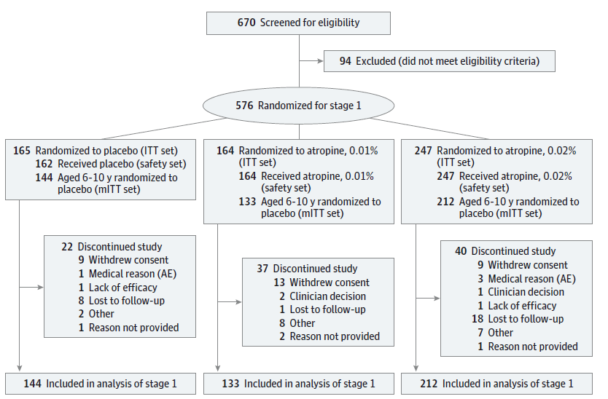
Results
Figure 1. Participant Disposition

Slide 7
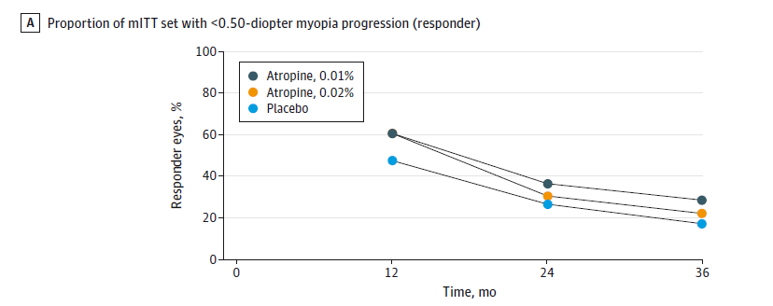
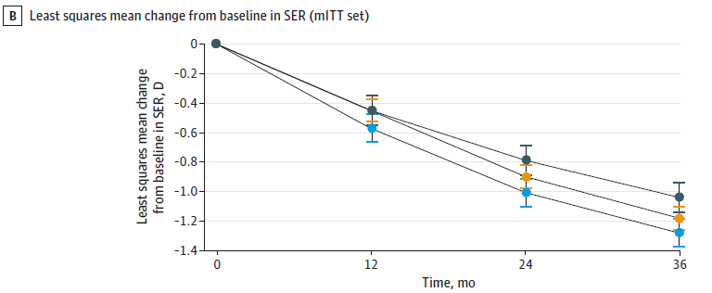
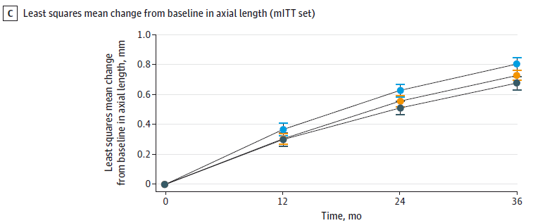
Results
Figure 2. Change in Ophthalmic Parameters Over Time
At 36 months, atropine, 0.01%, produced statistically significant and clinically meaningful differences compared with placebo for all efficacy measures (responder analysis, SER change from baseline, axial length change from baseline).

Slide 8
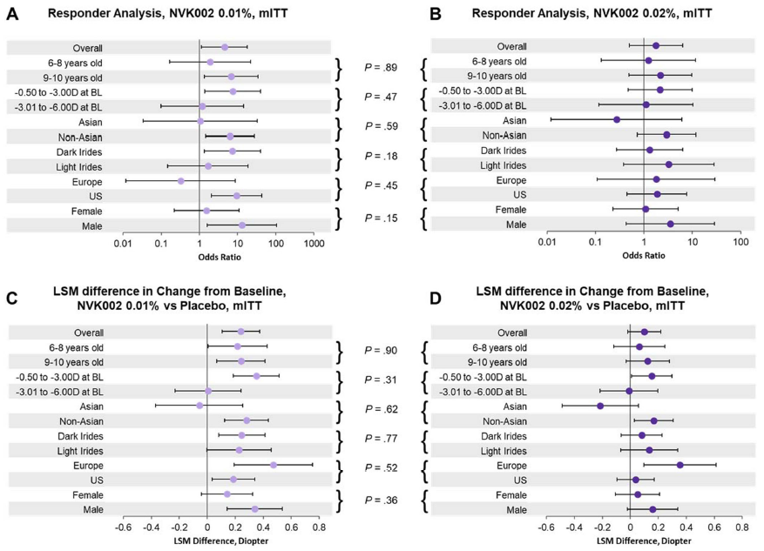
Results
eFigure 3. Subgroup and Subgroup-by-Treatment Interaction Analyses (mITT Set)
Subgroup analyses for baseline characteristics, analyzed for both responder rate and SER change from baseline, were consistent with overall outcomes, generally showing a positive treatment effect vs placebo across all subgroups.

Slide 9
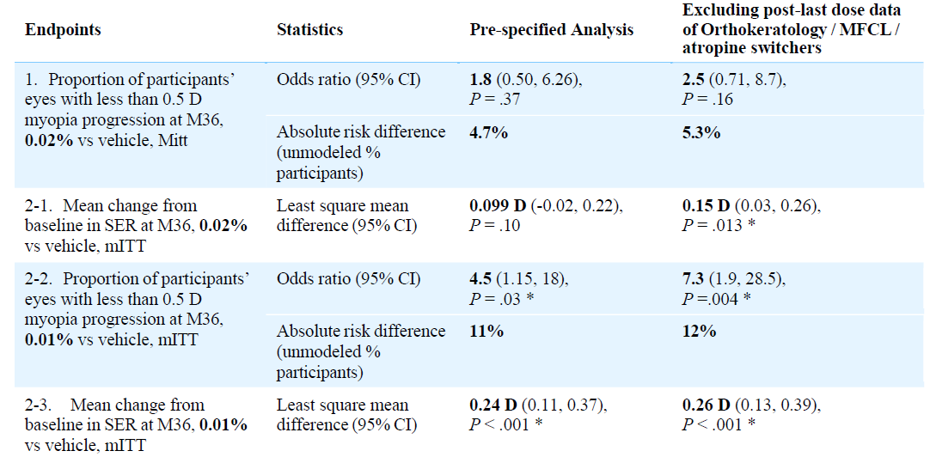
Results
eTable 4. Post Hoc Analyses on Primary and Secondary Endpoints (mITT Month 36) Excluding Post-Last Dose Data From 23 Participants Who Discontinued Trial Treatment, Stayed in Trial, and Switched to Orthokeratology or Multifocal Contact Lens (MFCL) or Compounded Atropine
Post hoc analyses on primary and secondary endpoints that excluded post-last dose data of participants who switched to confounding therapies produced an increased treatment effect size.

Slide 10
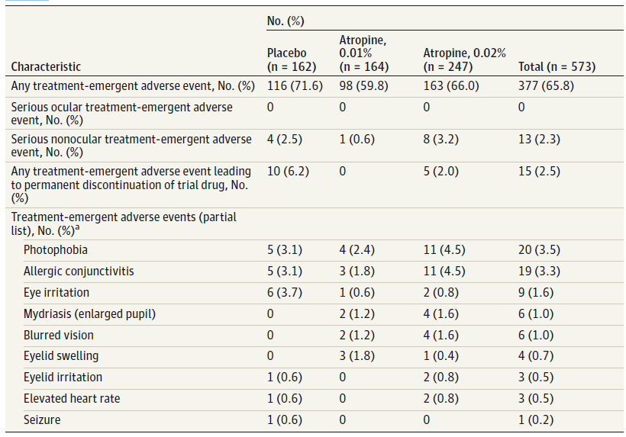
Results
Table 3. Treatment-Emergent Adverse Events (Safety Set)
Atropine, 0.01% and 0.02%, both have excellent safety and tolerability profiles.
Neither dose of atropine led to a serious ocular treatment-emergent adverse event.

Slide 11
Comment
The CHAMP trial demonstrated in a heterogenous population of myopic children in the US and Europe:
  Atropine, both 0.01% and 0.02%, slowed axial elongation compared with placebo at all time points measured over 3 years.
  Atropine, 0.01%, produced a significant treatment effect that slowed myopia progression compared with placebo for all efficacy measures in participants aged 6 to 10 years.
  The treatment effect observed with atropine, 0.01%, is clinically meaningful.
  Both atropine concentrations exhibited a safety profile notable for minimal ocular adverse events.
  There was no increase in nonocular antimuscarinic adverse events with atropine compared with placebo.
In slowing myopia progression and axial elongation, atropine, 0.01%, may lead to:
  Less frequent or delayed changes in glasses.
  Progression to less severe overall correction and a potential reduction of long-term sequelae.
  Reduced vision loss later in life from conditions such as glaucoma, retinal detachment, and myopic maculopathy.

Slide 12
Comment
From a risk/benefit perspective:
  The favorable tradeoff of efficacy and safety observed during the study suggests that atropine, 0.01%, may provide an attractive treatment option for children aged 3 to 17 years with myopia progression.
In the heterogeneous population studied:
  The low dropout rate over 3 years suggests low-dose atropine was well tolerated.
  Early treatment with atropine, 0.01%, could be an important safe and effective treatment option for young children with myopia.

Slide 13
Contact Information
If you have questions, please contact the corresponding author:
  Karla Zadnik, OD, PhD, The Ohio State University College of Optometry, 338 W10th Ave, Columbus, OH 43210 (zadnik.4@osu.edu).
  Funding/Support
This trial is sponsored and funded by Vyluma Inc.
Conflict of Interest Disclosures
Dr Zadnik reported receiving consultant fees from Vyluma Inc during the conduct of the study. Dr Schulman reported receiving logistical and financial support from SUNY College of Optometry during the conduct of the study. Dr Flitcroft reported receiving consulting fees from Vyluma Inc; personal fees from CooperVision, EsilorLuxottica, Johnson & Johnson Vision, and Thea; contractual fees for analyses from Ocumetra; and having the following patents pending outside the submitted work: 63/414,779; 63/348,256; 63/402,374; 17/767530; and 20788700.1. Dr Fogt reported receiving grants from Vyluma Inc (an affiliate of Nevakar), Bausch+Lomb, Eyenovia, Innovega, CooperVision, and Interojo; personal fees from Alcon; and financial support from Tearoptix outside the submitted work. Dr Blumenfeld reported receiving personal fees from Vyluma Inc during the conduct of the study. Dr Fong reported receiving consultant fees and being an employee of Vyluma Inc during the conduct of the study. Dr Lang reported receiving grants from Vyluma Inc during the conduct of the study. Dr Hemmati reported receiving personal fees and being an employee of Vyluma Inc outside the submitted work. Dr Chandler reported being an employee of Vyluma Inc outside the submitted work. No other disclosures were reported.

