Slide 1
Number of Allogeneic HCTs in the US Reported to CIBMTR

Slide 2
Relative Proportion of Allogeneic HCT Donor Types in the US by Recipient Age, 2015-2020
N |  | 7623 | 9280 | 22939 | 10281
Abbreviations - MRD: Matched related donor; MUD: Matched unrelated donor;
Haplo: Haploidentical donor (includes all mismatched related donors); MMUD: Mismatched unrelated donor; CB: Cord blood
Notes:
Sum of percentage may not equal 100% due to rounding
Excludes twin donor, multiple donor, match unknown unrelated donor, and not reported donors

Slide 3
Number of Allogeneic HCTs in the US in Recipients Aged <18 Years by Graft Source
A

Slide 4
Number of Allogeneic HCTs in the US in Recipients Aged ≥18 Years by Graft Source
B

Slide 5
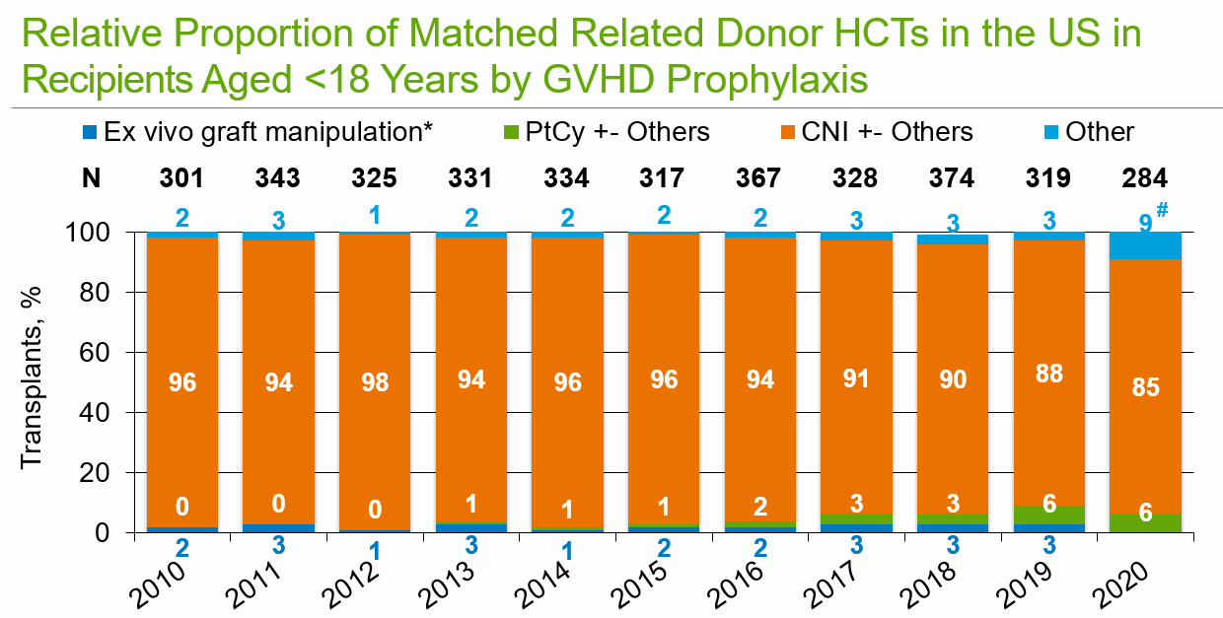
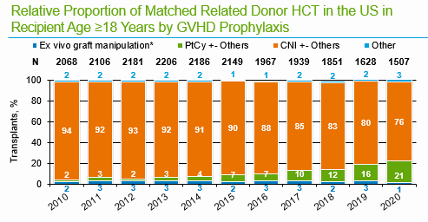
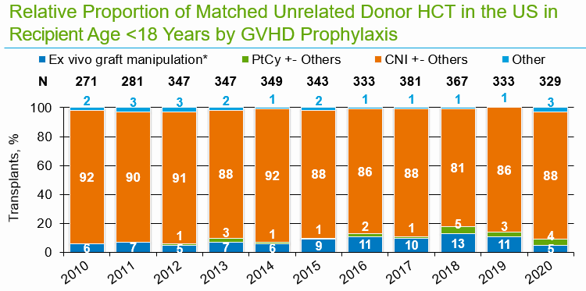
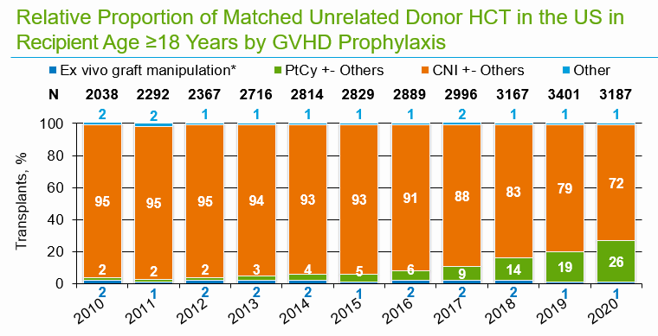
A
B
C
D
Suppl Figure 4
Notes:
Sum of percentage may not equal 100% due to rounding
Excludes not reported GVHD prophylaxis

Slide 6
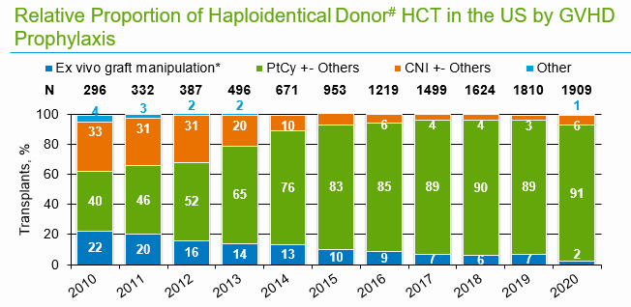
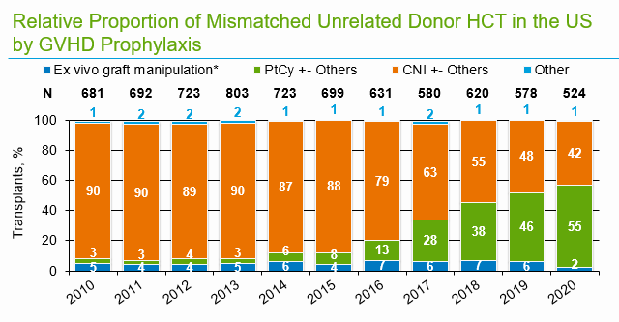
E
F
Suppl Figure 4
Notes:
Sum of percentage may not equal 100% due to rounding
Excludes not reported GVHD prophylaxis

Slide 7
Relative Proportion of Matched Related Donor HCTs in the US in Recipients Aged <18 Years by GVHD Prophylaxis
A
N |  | 301 | 343 | 325 | 331 | 334 | 317 | 367 | 328 | 374 | 319 | 284
#
Notes:
Sum of percentage may not equal 100% due to rounding
Excludes not reported GVHD prophylaxis

Slide 8
Relative Proportion of Matched Related Donor HCTs in the US in Recipients Aged ≥18 Years by GVHD Prophylaxis
B
N |  | 2068 | 2106 | 2181 | 2206 | 2186 | 2149 | 1967 | 1939 | 1851 | 1628 | 1507
Notes:
Sum of percentage may not equal 100% due to rounding
Excludes not reported GVHD prophylaxis

Slide 9
Relative Proportion of Matched Unrelated Donor HCTs in the US in Recipients Aged <18 Years by GVHD Prophylaxis
C
N |  | 271 | 281 | 347 | 347 | 349 | 343 | 333 | 381 | 367 | 333 | 329
Notes:
Sum of percentage may not equal 100% due to rounding
Excludes not reported GVHD prophylaxis

Slide 10
Relative Proportion of Matched Unrelated Donor HCTs in the US in Recipients Aged ≥18 Years by GVHD Prophylaxis
D
N |  | 2038 | 2292 | 2367 | 2716 | 2814 | 2829 | 2889 | 2996 | 3167 | 3401 | 3187
Notes:
Sum of percentage may not equal 100% due to rounding
Excludes not reported GVHD prophylaxis

Slide 11
Relative Proportion of Haploidentical Donor# HCTs in the US by GVHD Prophylaxis
E
N |  | 296 | 332 | 387 | 496 | 671 | 953 | 1219 | 1499 | 1624 | 1810 | 1909
Abbreviations - PtCy: Post-transplant Cyclophosphamide; CNI: Calcineurin inhibitor
*includes T cell depletion/CD34 selection +- others; #includes all mismatched related donors
Notes:
Sum of percentage may not equal 100% due to rounding
Excludes not reported GVHD prophylaxis

Slide 12
Relative Proportion of Mismatched Unrelated Donor HCTs in the US by GVHD Prophylaxis
F
N |  | 681 | 692 | 723 | 803 | 723 | 699 | 631 | 580 | 620 | 578 | 524
Notes:
Sum of percentage may not equal 100% due to rounding
Excludes not reported GVHD prophylaxis

Slide 13
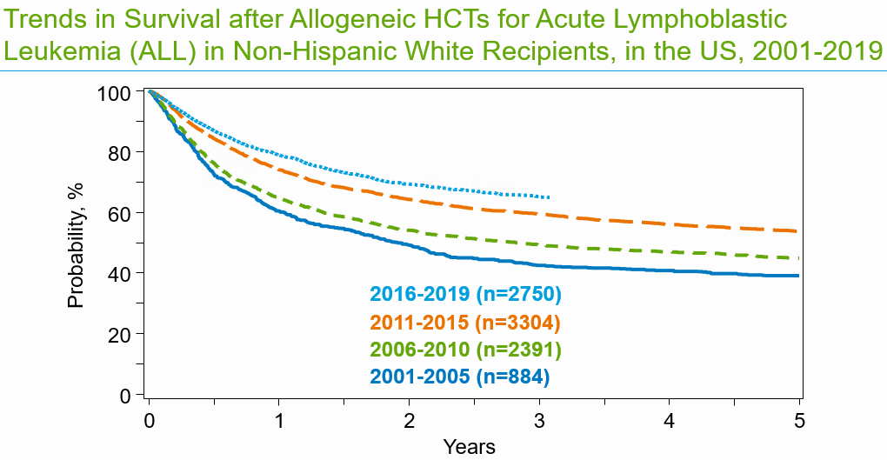
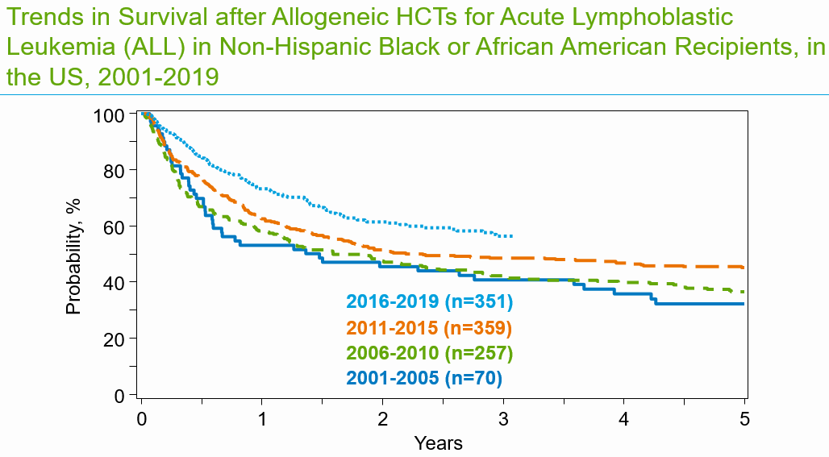
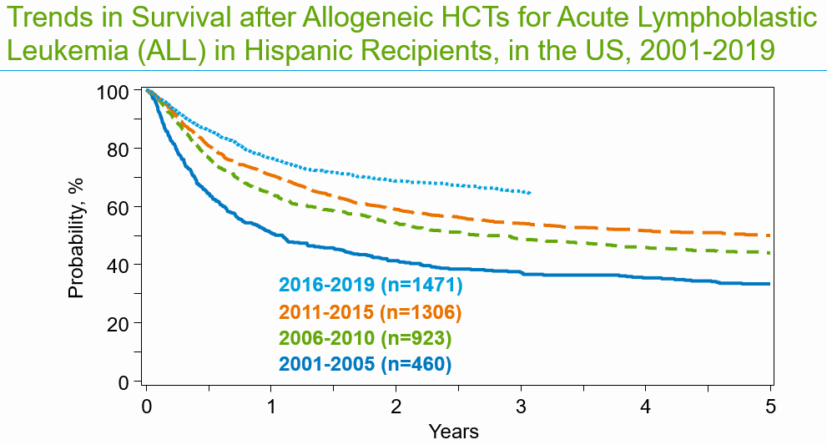
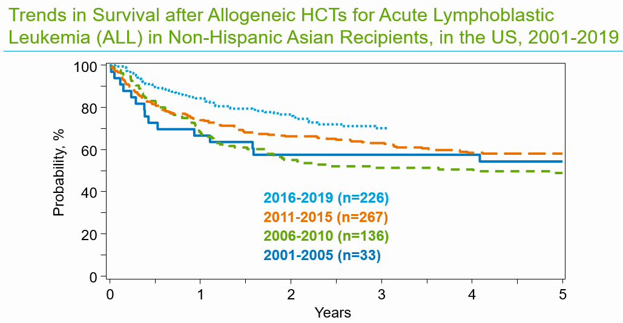
A
B
C
D

Slide 14
Trends in Survival after Allogeneic HCTs for Acute Lymphoblastic Leukemia (ALL) in Non-Hispanic White Recipients, in the US, 2001-2019
A
100
80
60
Probability, %
40
2016-2019 (n=2750)
20
2011-2015 (n=3304)
2006-2010 (n=2391)
2001-2005 (n=884)
0
0
1
2
3
4
5
Years

Slide 15
Trends in Survival after Allogeneic HCTs for Acute Lymphoblastic Leukemia (ALL) in Non-Hispanic Black or African American Recipients, in the US, 2001-2019
B
100
80
60
Probability, %
40
2016-2019 (n=351)
20
2011-2015 (n=359)
2006-2010 (n=257)
2001-2005 (n=70)
0
0
1
2
3
4
5
Years

Slide 16
Trends in Survival after Allogeneic HCTs for Acute Lymphoblastic Leukemia (ALL) in Hispanic Recipients, in the US, 2001-2019
C
100
80
60
Probability, %
40
2016-2019 (n=1471)
20
2011-2015 (n=1306)
2006-2010 (n=923)
2001-2005 (n=460)
0
0
1
2
3
4
5
Years

Slide 17
Trends in Survival after Allogeneic HCTs for Acute Lymphoblastic Leukemia (ALL) in Non-Hispanic Asian Recipients, in the US, 2001-2019
D
100
80
60
Probability, %
40
2016-2019 (n=226)
2011-2015 (n=267)
20
2006-2010 (n=136)
2001-2005 (n=33)
0
0
1
2
3
4
5
Years

Slide 18
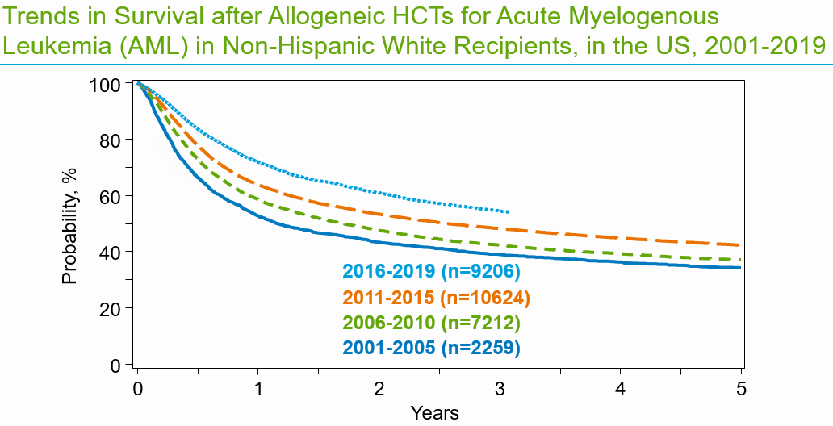
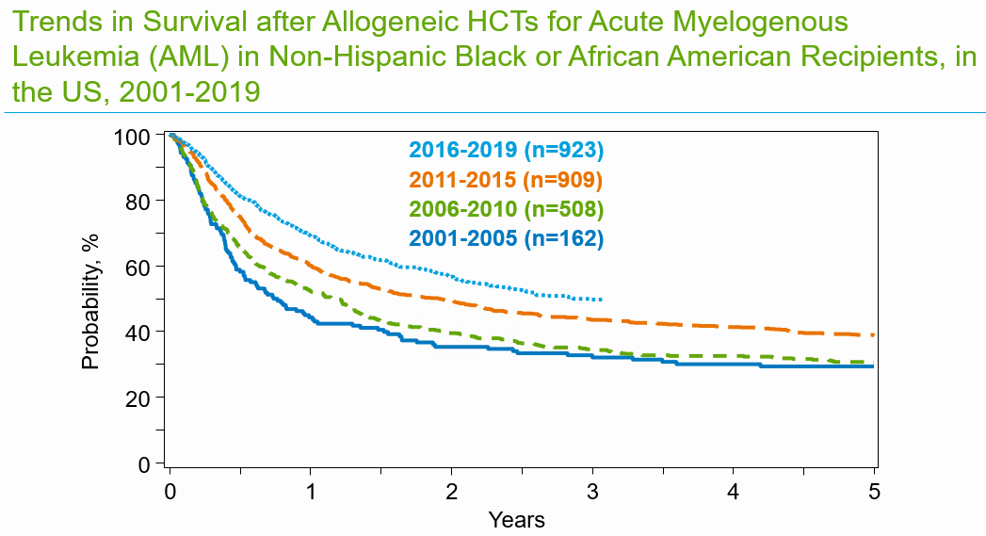
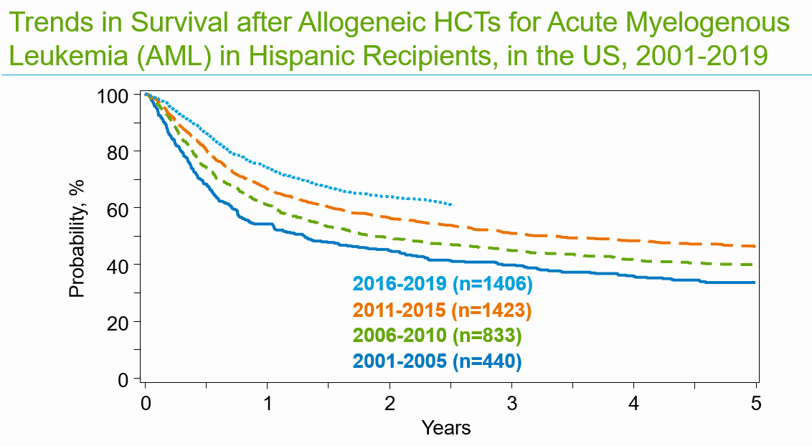
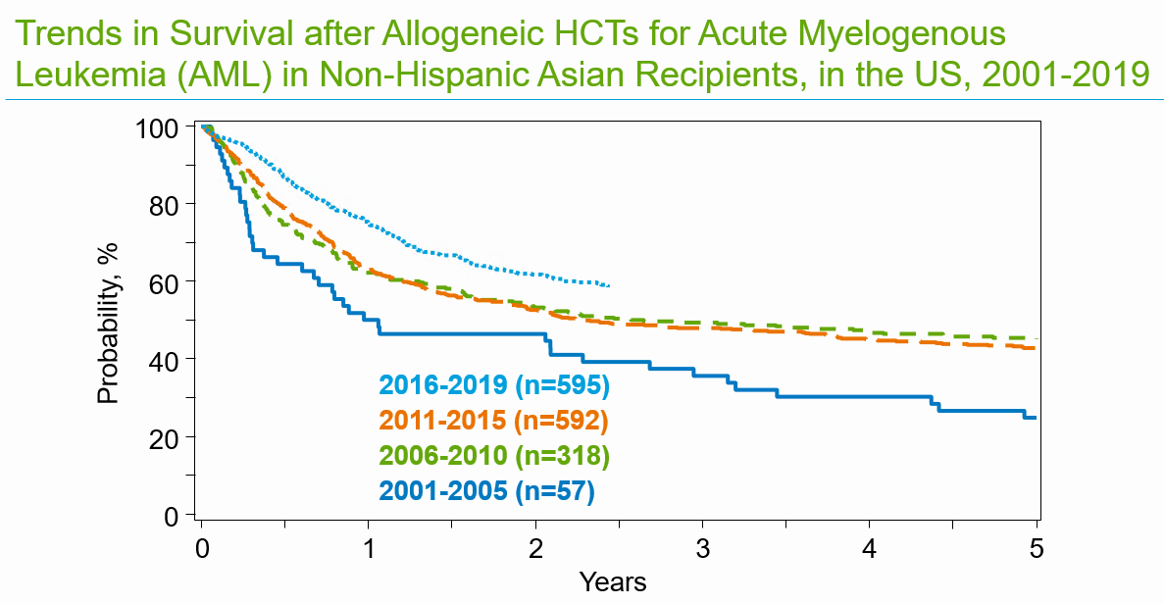
A
B
C
D

Slide 19
Trends in Survival after Allogeneic HCTs for Acute Myelogenous Leukemia (AML) in Non-Hispanic White Recipients, in the US, 2001-2019
A
100
80
60
Probability, %
40
2016-2019 (n=9206)
20
2011-2015 (n=10624)
2006-2010 (n=7212)
2001-2005 (n=2259)
0
0
1
2
3
4
5
Years

Slide 20
Trends in Survival after Allogeneic HCTs for Acute Myelogenous Leukemia (AML) in Non-Hispanic Black or African American Recipients, in the US, 2001-2019
B
100
2016-2019 (n=923)
2011-2015 (n=909)
80
2006-2010 (n=508)
2001-2005 (n=162)
60
Probability, %
40
20
0
0
1
2
3
4
5
Years

Slide 21
Trends in Survival after Allogeneic HCTs for Acute Myelogenous Leukemia (AML) in Hispanic Recipients, in the US, 2001-2019
C
100
80
60
Probability, %
40
2016-2019 (n=1406)
20
2011-2015 (n=1423)
2006-2010 (n=833)
2001-2005 (n=440)
0
0
1
2
3
4
5
Years

Slide 22
Trends in Survival after Allogeneic HCTs for Acute Myelogenous Leukemia (AML) in Non-Hispanic Asian Recipients, in the US, 2001-2019
D
100
80
60
Probability, %
40
2016-2019 (n=595)
20
2011-2015 (n=592)
2006-2010 (n=318)
2001-2005 (n=57)
0
0
1
2
3
4
5
Years

Slide 23
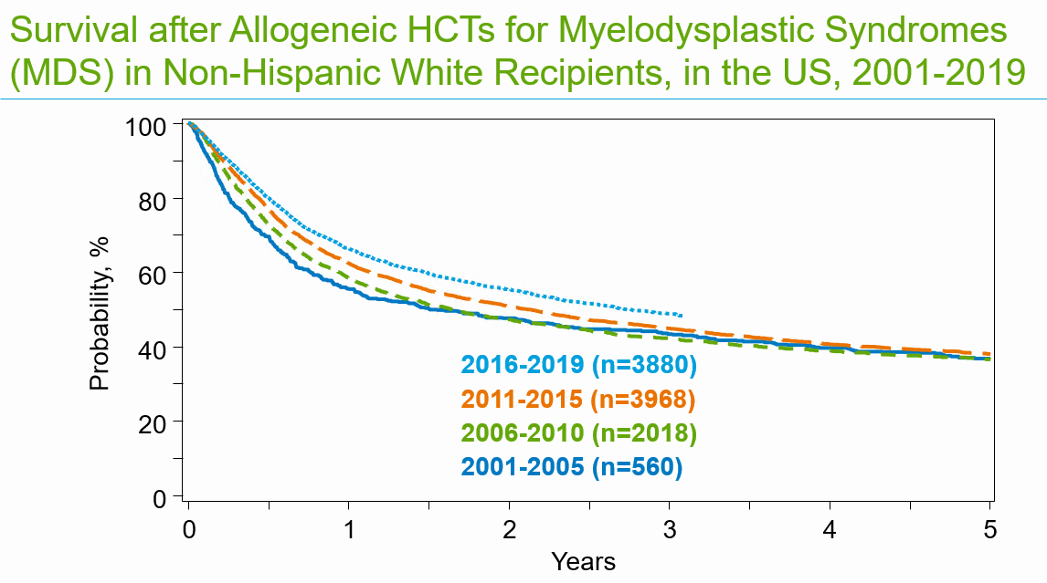
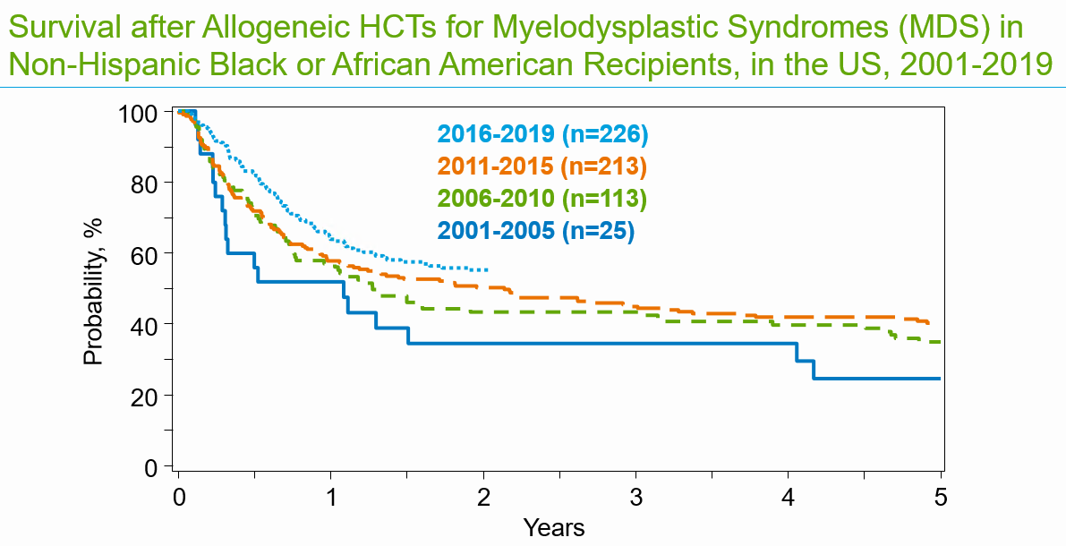
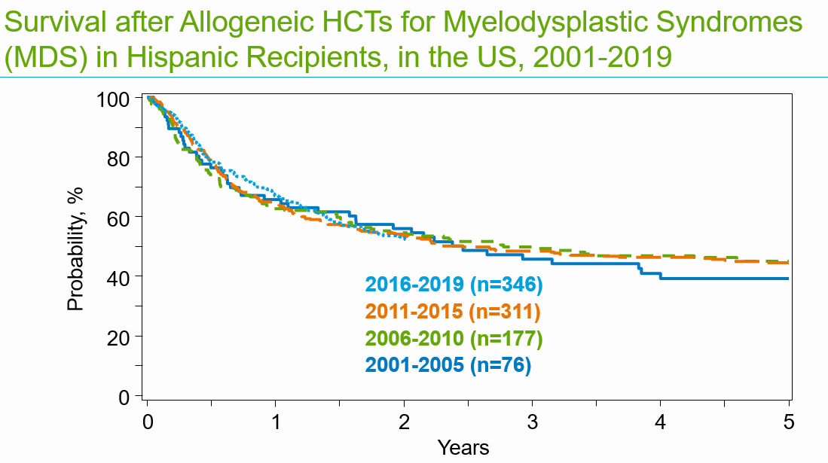
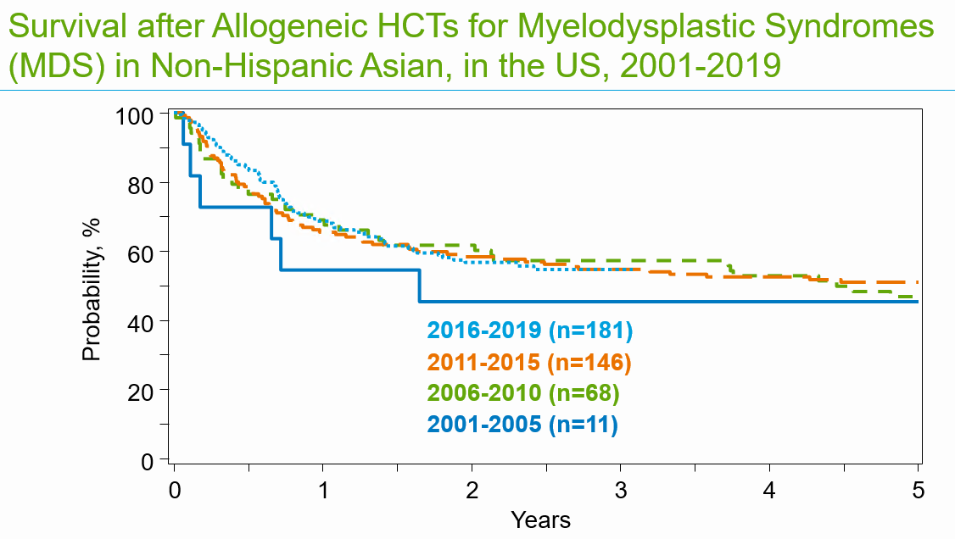
A
B
C
D

Slide 24
Survival after Allogeneic HCTs for Myelodysplastic Syndromes (MDS) in Non-Hispanic White Recipients, in the US, 2001-2019
A
100
80
60
Probability, %
40
2016-2019 (n=3880)
2011-2015 (n=3968)
20
2006-2010 (n=2018)
2001-2005 (n=560)
0
0
1
2
3
4
5
Years

Slide 25
Survival after Allogeneic HCTs for Myelodysplastic Syndromes (MDS) in Non-Hispanic Black or African American Recipients, in the US, 2001-2019
B
100
2016-2019 (n=226)
80
2011-2015 (n=213)
2006-2010 (n=113)
2001-2005 (n=25)
60
Probability, %
40
20
0
0
1
2
3
4
5
Years

Slide 26
Survival after Allogeneic HCTs for Myelodysplastic Syndromes (MDS) in Hispanic Recipients, in the US, 2001-2019
C
100
80
60
Probability, %
40
2016-2019 (n=346)
2011-2015 (n=311)
20
2006-2010 (n=177)
2001-2005 (n=76)
0
0
1
2
3
4
5
Years

Slide 27
Survival after Allogeneic HCTs for Myelodysplastic Syndromes (MDS) in Non-Hispanic Asian, in the US, 2001-2019
D
100
80
60
Probability, %
40
2016-2019 (n=181)
2011-2015 (n=146)
20
2006-2010 (n=68)
2001-2005 (n=11)
0
0
1
2
3
4
5
Years

Slide 28
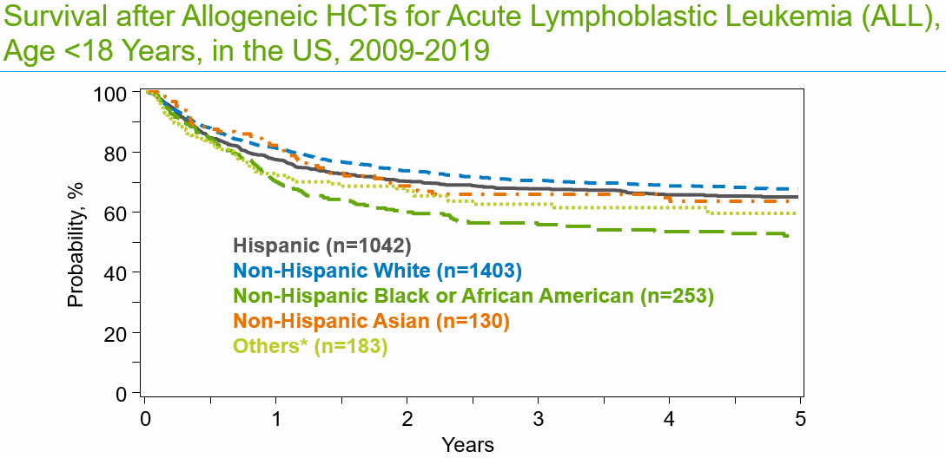
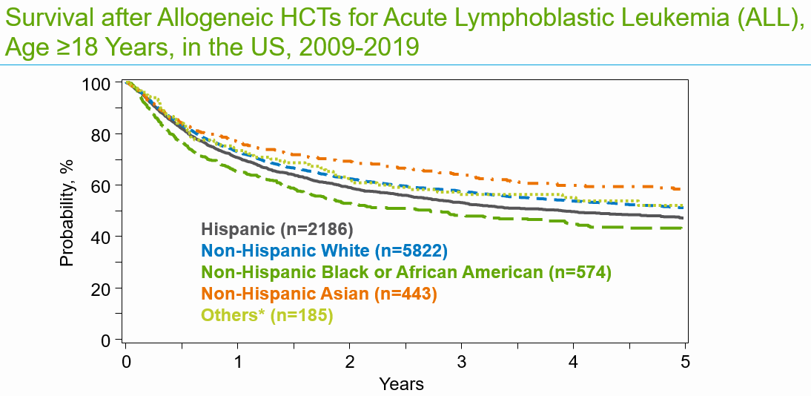
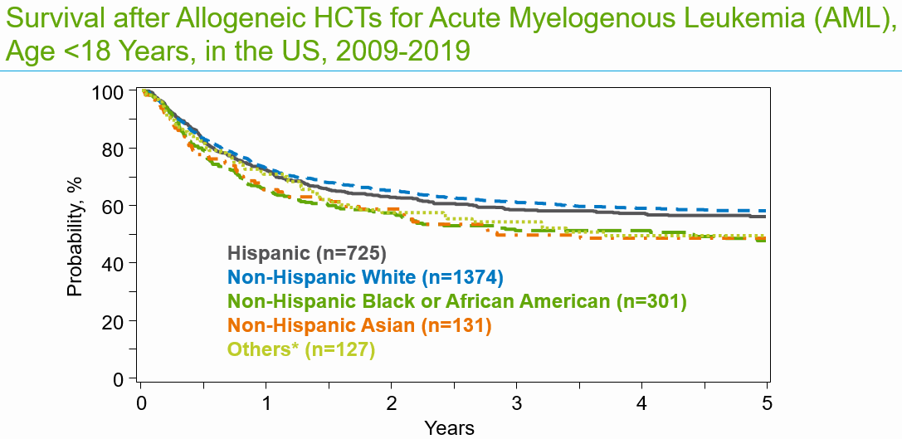
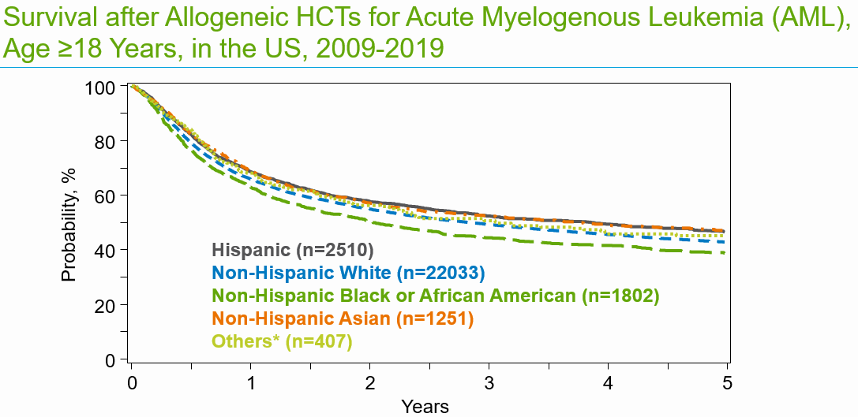
A
B
C
D

Slide 29
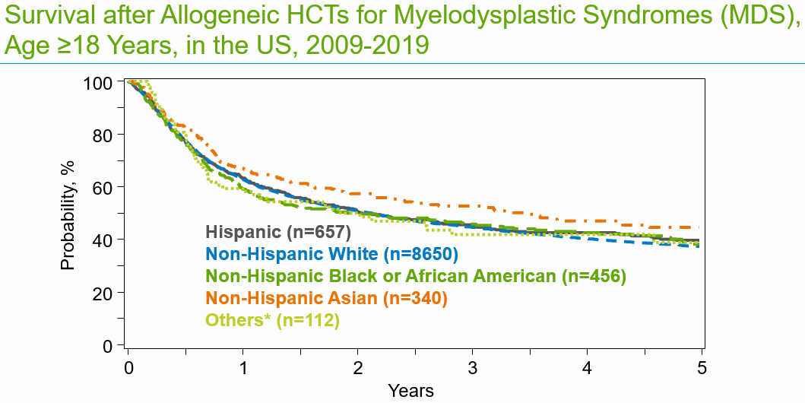
E

Slide 30
Survival after Allogeneic HCTs for Acute Lymphoblastic Leukemia (ALL), Age <18 Years, in the US, 2009-2019
A
100
80
60
Probability, %
Hispanic (n=1042)
40
Non-Hispanic White (n=1403)
Non-Hispanic Black or African American (n=253)
Non-Hispanic Asian (n=130)
20
Others* (n=183)
0
0
1
2
3
4
5
Years
*includes Non-Hispanic Native Hawaiian or other Pacific Islander, American Indian or Alaska Native,
More than one race, and Non-resident of the US
Notes:
data in ppt file ‘SS2021-raw data-part2.’ slide: 39
Slide 107: Among pediatric patients with ALL receiving Allogeneic transplant between 2009 and 2019, the 3-year probabilities (95%CI) of survival following transplant with a Race and Ethnicity of Hispanic, Non-Hispanic White, Non-Hispanic Black or African American, Non-Hispanic Asian and Others were 68% (65-71%), 71% (68-73%), 57% (51-63%), 66% (58-75%), and 63% (56-71%), respectively.
Trend data only is presented and any significant p values reflect global differences between indicated groups and not any specific differences between indicated groups. Caution interpreting these univariate curves is important as adjustment for other relevant factors using multi-variable analyses has not been done.

Slide 31
Survival after Allogeneic HCTs for Acute Lymphoblastic Leukemia (ALL), Age ≥18 Years, in the US, 2009-2019
B
100
80
60
Probability, %
40
Hispanic (n=2186)
Non-Hispanic White (n=5822)
Non-Hispanic Black or African American (n=574)
20
Non-Hispanic Asian (n=443)
Others* (n=185)
0
0
1
2
3
4
5
Years
*includes Non-Hispanic Native Hawaiian or other Pacific Islander, American Indian or Alaska Native,
More than one race, and Non-resident of the US
Notes:
data in ppt file ‘SS2021-raw data-part2.’ slide: 40
Slide 108: Among adult patients with ALL receiving Allogeneic transplant between 2009 and 2019, the 3-year probabilities (95%CI) of survival following transplant with a Race and Ethnicity of Hispanic, Non-Hispanic White, Non-Hispanic Black or African American, Non-Hispanic Asian and Others were 53% (51-56%), 58% (57-59%), 48% (44-53%), 64% (60-69%), and 57% (49-65%), respectively.
Trend data only is presented and any significant p values reflect global differences between indicated groups and not any specific differences between indicated groups. Caution interpreting these univariate curves is important as adjustment for other relevant factors using multi-variable analyses has not been done.

Slide 32
Survival after Allogeneic HCTs for Acute Myelogenous Leukemia (AML), Age <18 Years, in the US, 2009-2019
C
100
80
60
Probability, %
Hispanic (n=725)
40
Non-Hispanic White (n=1374)
Non-Hispanic Black or African American (n=301)
20
Non-Hispanic Asian (n=131)
Others* (n=127)
0
0
1
2
3
4
5
Years
*includes Non-Hispanic Native Hawaiian or other Pacific Islander, American Indian or Alaska Native,
More than one race, and Non-resident of the US

Slide 33
Survival after Allogeneic HCTs for Acute Myelogenous Leukemia (AML), Age ≥18 Years, in the US, 2009-2019
D
100
80
60
Probability, %
40
Hispanic (n=2510)
Non-Hispanic White (n=22033)
Non-Hispanic Black or African American (n=1802)
20
Non-Hispanic Asian (n=1251)
Others* (n=407)
0
0
1
2
3
4
5
Years
*includes Non-Hispanic Native Hawaiian or other Pacific Islander, American Indian or Alaska Native,
More than one race, and Non-resident of the US

Slide 34
Survival after Allogeneic HCTs for Myelodysplastic Syndromes (MDS), Age ≥18 Years, in the US, 2009-2019
E
100
80
60
Probability, %
40
Hispanic (n=657)
Non-Hispanic White (n=8650)
Non-Hispanic Black or African American (n=456)
20
Non-Hispanic Asian (n=340)
Others* (n=112)
0
0
1
2
3
4
5
Years
*includes Non-Hispanic Native Hawaiian or other Pacific Islander, American Indian or Alaska Native,
More than one race, and Non-resident of the US

