Slide 1
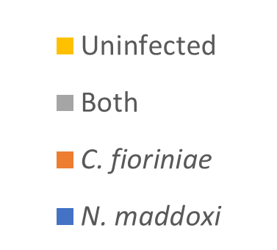
Supplementary Figure 1.
Levels of N. maddoxi and C. fioriniae infection in H. halys adults that were living or dead when collected in April, after overwintering

