Slide 1
Supplementary Figure 4.
Uncropped Western blot images.
Western blots assessed protein expression levels of the following targets in the heart among CdCl₂-exposed and non-exposed mice.
α-actin in (A) males and (B) females
MyBP-C in (C) males and (D) females
SERCA2a in (E) males and (F) females
p- and t-PLB in (G) males and (H) females
All molecular weights are reported in kilodaltons.

Slide 2
A.
male
50-
40-
30-
α-actin
Control
Cd

Slide 3
B.
female
50-
40-
30-
α-actin
Control
Cd

Slide 4
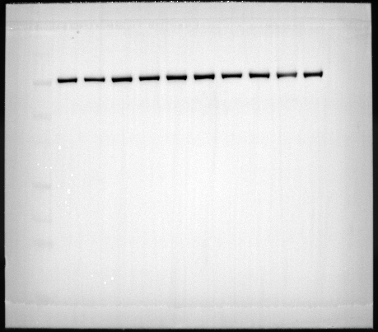
C.
male
160-
110-
MyBP-C
Control
Cd

Slide 5
D.
female
260-
160-
110-
MyBP-C
Control
Cd

Slide 6
E.
male
260-
160-
110-
80-
SERCA2a
Cd
Control

Slide 7
F.
female
260-
160-
110-
80-
SERCA2a
Control
Cd

Slide 8
G.
male
10-
10-
t-PLB
p-PLB
Control
Cd
Control
Cd

Slide 9
H.
female
10-
p-PLB
t-PLB
10-
Control
Cd
Control
Cd

