Slide 1

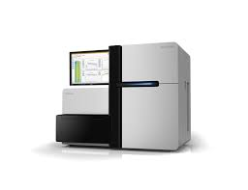
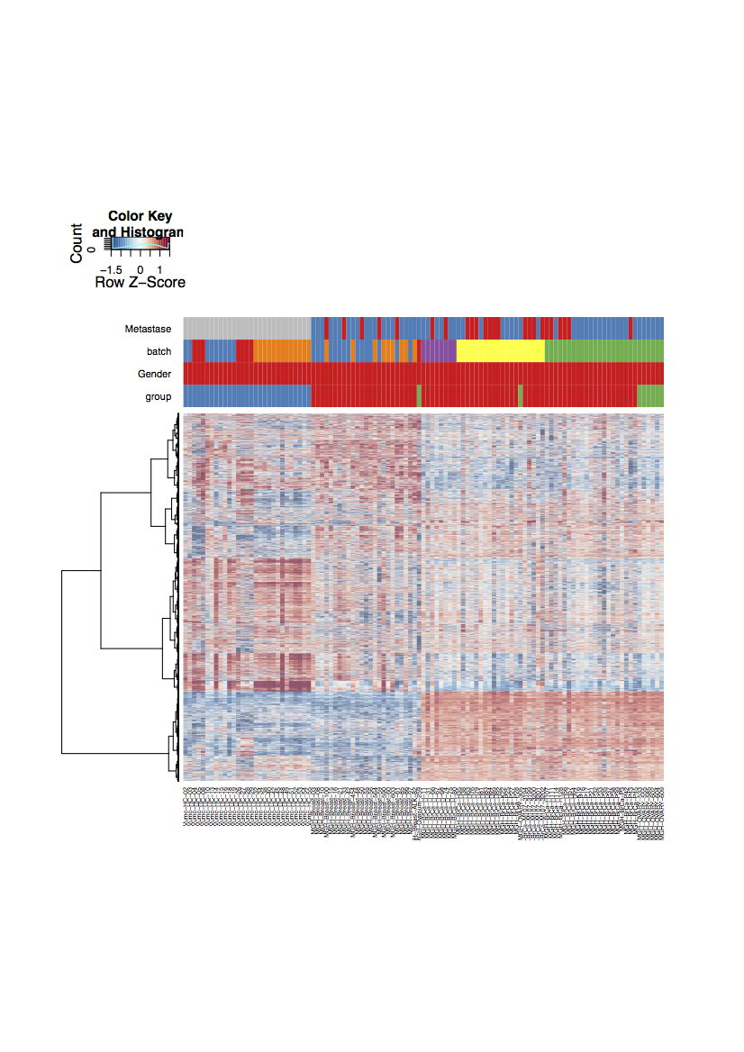

Supplementary Figure S1.
(a)
RNA isolation from TEPs
mRNA library preparation
RNA-seq
RNA-seq data and bioinformatic processing
x₂
hyperplane
x₁
(b)
Total RNA
RNA 6000 picochip
SMARTer amplified cDNA
DNA High Sensitivity chip
Truseq cDNA
DNA 7500 chip
[FU]
[FU]
[FU]
100
150
150
Controls
100
100
50
50
50
0
0
0
50
300
500
1000
10380
35
300
1000
[bp]
[bp]
10380
[FU]
[FU]
[FU]
100
300
80
NSCLC
200
60
50
100
40
0
0
20
0
50
300
500
1000
10380
35
300
1000
[bp]
[bp]
10380
Supplementary Figure S1. ThromboSeq pipeline and quality controls.
(a) Schematic overview of the thromboSeq protocol. Platelets are isolated from whole blood and subjected to RNA isolation. Poly-A RNA is amplified and subjected to Truseq cDNA preparation for sequencing. Pooled samples libraries are sequenced in Illumina Hiseq platform. RNA sequencing data are then analysis by PSO-enhanced ThromboSeq algorithm.
(b) All the steps of the thomboSeq protocol are quality-controlled by Bioanalyzer, representative examples of the results obtained for the total RNA isolated from platelets (RNA 6000 picochip), SMARTer amplified cDNA (High Sensitivity chip), and TruSeq-labeled cDNA ready for sequencing (DNA 7500 chip).

Slide 2
Supplementary Figure S2
(a)
1.0
(b)
0.8
4000
0.6
3000
Pearson’s correlation coefficient
Number of intron-spanning spliced RNA reads in Training and Evaluation series
0.4
2000
Minimal n genes: 1500
0.2
1000
0.0
0
Platelet RNA samples (ordered by the inter-sample LOOCV correlation) in Training and Evaluation series
0
40000
80000
280000
320000
360000
400000
120000
200000
440000
520000
160000
240000
480000
(c)
1.0
(d)
0.8
4000
0.6
3000
Pearson’s correlation coefficient
Number of intron-spanning spliced RNA reads in Validation series
0.4
2000
Minimal n genes: 1500
0.2
1000
0.0
Platelet RNA samples (ordered by the inter-sample LOOCV correlation) in Validation series
0
0
40000
80000
280000
320000
360000
400000
120000
200000
440000
520000
160000
240000
480000
(e)
(f)
(g)
Different isolation locations
Training and Evaluation
Validation
5000
5000
5000
4500
4500
4500
3000
4000
4000
3500
3500
Number of transcript per sample
Number of genes with high-confidence detection
Number of genes with high-confidence detection
3500
3000
3000
3000
2500
2500
2500
2000
2000
2000
AMC, n=9
MGH, n=84
RAD, n= 5
Vienna, n=5
NKI, n=225
PANG, n=2
UMEA, n=10
MAAS, n=73
Utrecht, n= 16
VUMC, n= 447
NSCLC (n=95)
Controls (n=113)
NSCLC (n=304)
Controls (n=254)

Slide 3
Supplementary Figure S2. Filtering, quality control and number of genes identified in the training, evaluation and validation series
(a) Leave-one-out cross-correlation analysis, samples with low intersample correlation (bellow the threshold indicated by the horizontal line) are excluded in the Training and Evaluation series.
(b) Selection of samples with >1500 genes detected for thromboSeq analysis in the Training and Evaluation series.
(c) Leave-one-out cross-correlation analysis, samples with low intersample correlation (bellow the threshold indicated by the horizontal line) are excluded in Validation series.
(d) Selection of samples with >1500 genes detected for thromboSeq analysis in the Validation series.
(e) Distribution of the number of transcripts present in samples in the different blood isolation locations: AMC, MAAS, MGH, NKI, PANG, RAD,UMEA; Utrecht, Vienna, VUMC
(f) Number of genes detected with high-confidence in the platelet RNA samples included in the training and evaluation series.
(g) Number of genes detected with high-confidence in the platelet RNA samples included in the validation series
The boxes (S2e, S2f and S2g) show the interquartile range (IQR), with the median line represented by a horizontal bar inside the box. The whiskers indicate the range of the data.

Slide 4
Supplementary Figure S3. Validation the early-stage samples by the late-stage NSCLC thromboSeq algorithm (Best et al. 2017).
(a)
Detection Scores in Validated samples by 2017 algorithm
(b)
Detection Rate in Validated samples by 2017 algorithm
1.0
100
0.8
75
54%
Detection
NSCLC
0.6
50
Detection Scores
Detection Rate
0.4
6%
0.2
25
0%
Detection
Controls
0.0
0
Stage I
Stage II
Stage III
Stage I
Stage II
Stage III
Supplementary Figure S3. Validation the early-stage samples by the late-stage NSCLC thromboSeq algorithm (Best et al. 2017). (a) Box plots represent the detection scores of the early-stage samples (range 0-1), when validated by the Best et al. 2017 algorithm. Threshold corresponds to 0.338 (red line). The boxes show the interquartile range (IQR), with the median line represented by a horizontal bar inside the box. The whiskers indicate the range of the data.
(b) Detection rate of the early-stage samples, when validated by the Best et al. 2017 algorithm. The bar plot represents detection accuracy with error bars indicating the 95% confidence interval calculated by the binom.test-function in R with Clopper-Pearson intervals implementation.

Slide 5
Supplementary Figure S4
(a)
(b)
120
100
100
80
80
60
Age (in years) per group in
Training and Evaluation series
Gender distribution in
Training and Evaluation series
40
60
20
40
20
0
0
NSCLC
(n=95)
Controls
(n=113)
Female
n=101
Male
n=107
Supplementary Figure S4. Samples selection for training, evaluation and validation series
Boxplot represents the age distribution of the NSCLC and Controls samples included in the training and evaluation series.
(b) Barplot shows the different numbers of males and females in the Training and Evaluation series.

Slide 6
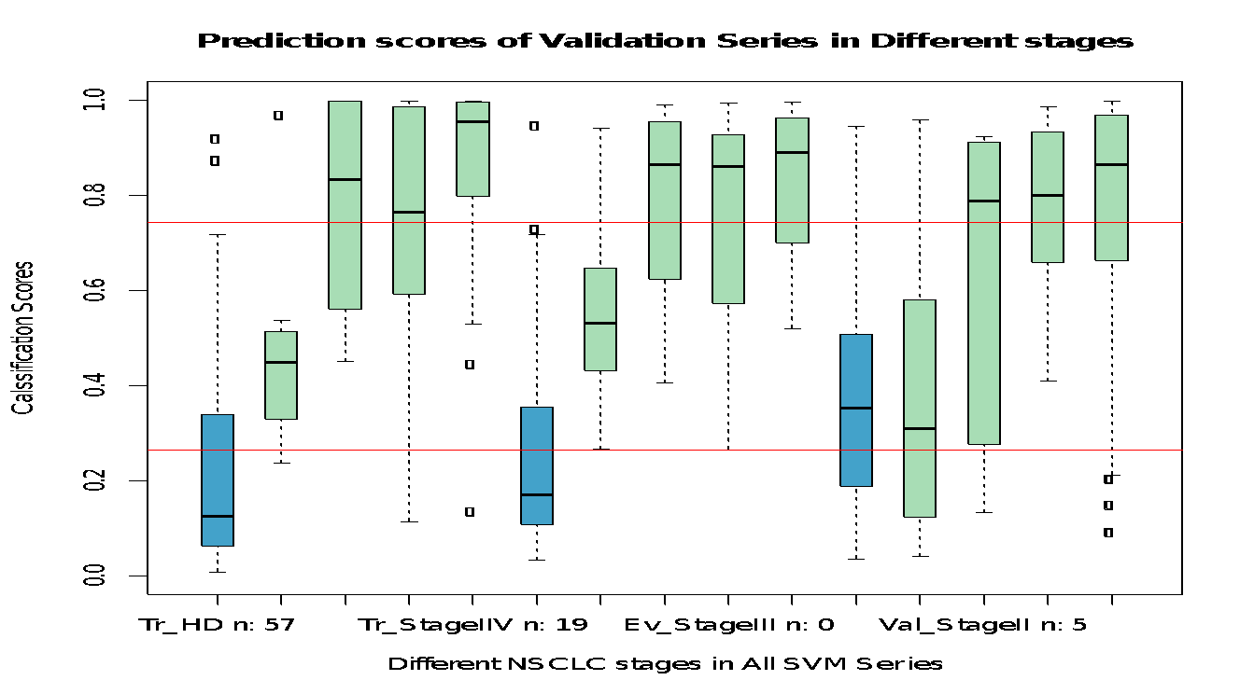
Supplementary Figure S5
Training series
Evaluation series
Validation series
1.0
Detection NSCLC
0.8
HighSpec algorithm
0.6
0.4
Detection Controls
HightSens algorithm
0.2
0.0
Stage I (n=7)
Stage I (n=6)
Stage I (n=10)
Controls (n=57)
Stage III (n=18)
Controls (n=56)
Controls (n=254)
Stage IV (n=19)
Stage III (n=15)
Stage III (n=15)
Stage IV (n=19)
Stage IV (n=274)
Stage II (n=4)
Stage II (n=7)
Stage II (n=5)
Supplementary Figure S5. Predicting scores for the samples among the different series and groups. Classification scores closer to 0.0 corresponds to the detection of Controls (blue bars) and 1.0 to NSCLC (green bars). Specific and Sensitive thresholds are illustrated, 0.744 and 0.263 respectively (red lines).
These box plots represent the detection scores (range 0-1). The boxes show the interquartile range (IQR), with the median line represented by a horizontal bar inside the box. The whiskers indicate the range of the data.

Slide 7
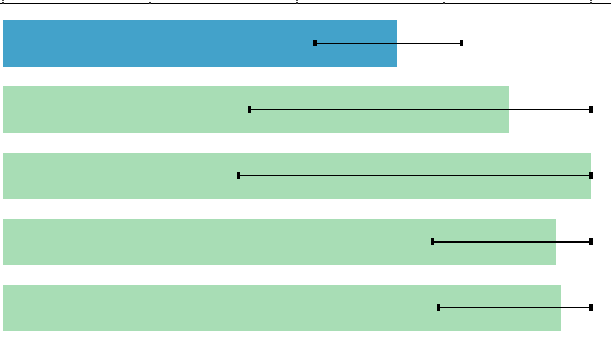
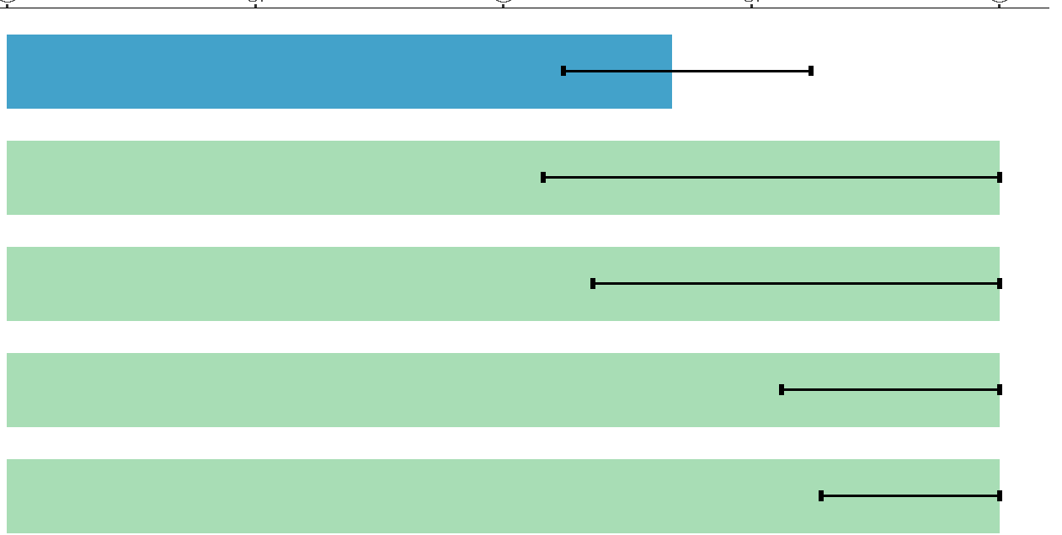
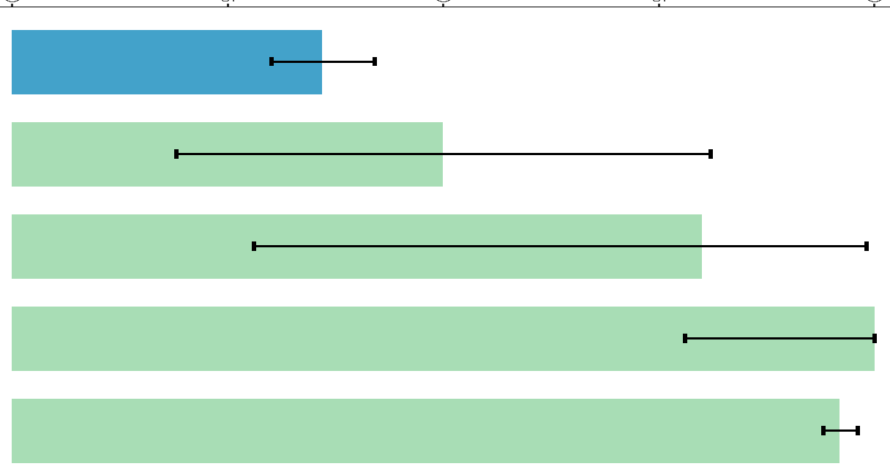
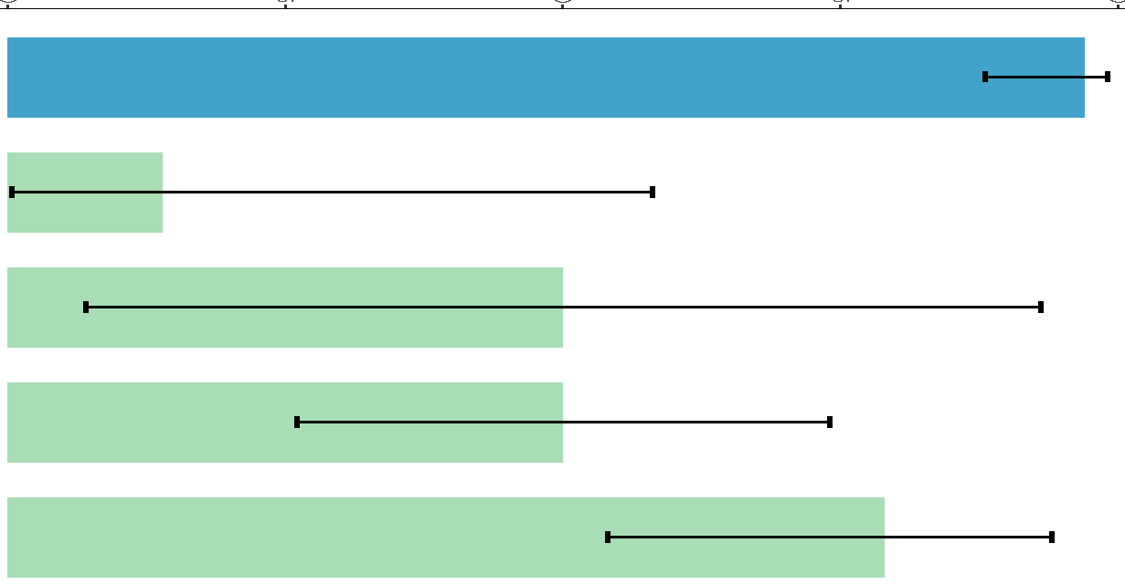
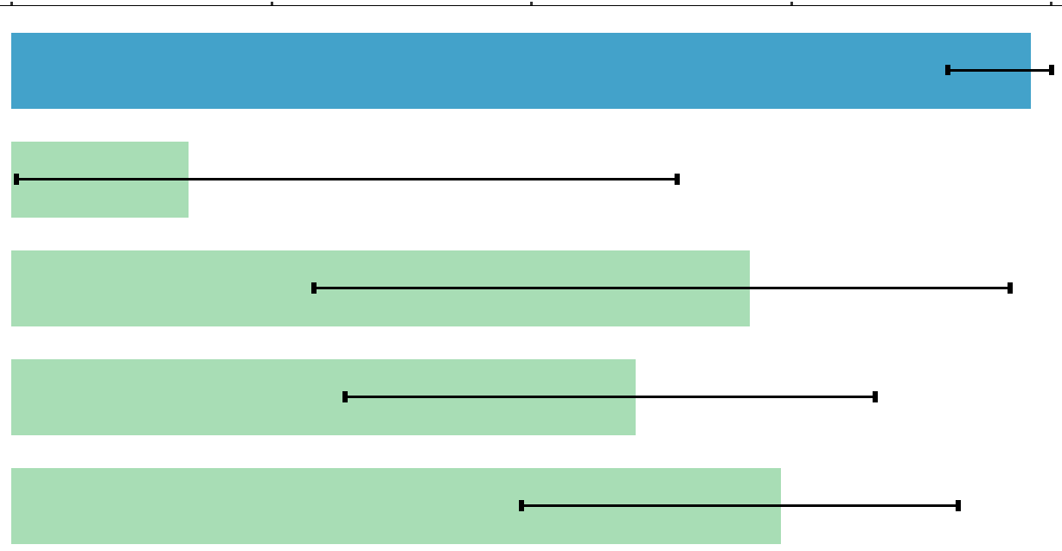
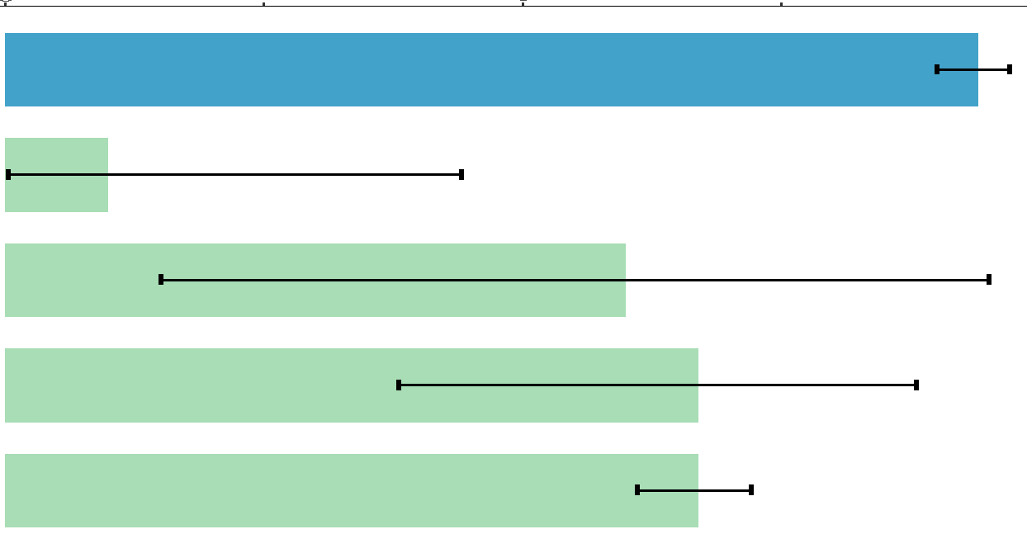
Supplementary Figure S6. Proportion detected in all series (HighSens)
(a)
Actual Class
Training
(b)
Proportion detected in Training series (HighSens)
Markers: 881 | NSCLC | Controls | Total (n)
NSCLC | 45(94%) | 19(33%) | 64
Controls | 3(6%) | 38(67%) | 41
 | 48(100%) | 57(100%) | 105
0
25
50
75
100
Controls
Predicted Class
Stage I
Stage II
Stage III
Stage IV
(c)
(d)
Evaluation
Actual Class
Proportion detected in Evaluation series (HighSens)
Markers: 881 | NSCLC | Controls | Total (n)
NSCLC | 47(100%) | 17(30%) | 64
Controls | 0(0%) | 39(70%) | 39
 | 47(100%) | 56(100%) | 103
0
25
50
75
100
Controls
Predicted Class
Stage I
Stage II
Stage III
Stage IV
(e)
(f)
Validation
Actual Class
Proportion detected in Validation series (HighSens)
Markers: 881 | NSCLC | Controls | Total (n)
NSCLC | 288(95%) | 163(64%) | 451
Controls | 16(5%) | 91(36%) | 107
 | 304(100%) | 254(100%) | 558
0
25
50
75
100
Controls
Predicted Class
Stage I
Stage II
Stage III
Stage IV
Supplementary Figure S7. Proportion detected in all series (HighSpec)
(a)
Proportion detected in Training series (HighSpec)
Training
Actual Class
(b)
25
50
75
100
Markers: 881 | NSCLC | Controls | Total (n)
NSCLC | 27(56%) | 2(4%) | 29
Controls | 21(44%) | 55(96%) | 76
 | 48(100%) | 57(100%) | 105
0
Controls
Stage I
Predicted Class
Stage II
Stage III
Stage IV
(c)
(d)
Evaluation
Actual Class
Proportion detected in Evaluation series (HighSpec)
Markers: 881 | NSCLC | Controls | Total (n)
NSCLC | 29(62%) | 1(2%) | 30
Controls | 18(38%) | 55(98%) | 73
 | 47(100%) | 56(100%) | 103
0
25
50
75
100
Controls
Stage I
Predicted Class
Stage II
Stage III
Stage IV
(f)
(e)
Actual Class
Proportion detected in Validation series (HighSpec)
Validation
0
25
50
75
100
Markers: 881 | NSCLC | Controls | Total (n)
NSCLC | 197(65%) | 15(6%) | 212
Controls | 107(35%) | 239(94%) | 346
 | 304(100%) | 254(100%) | 339
Controls
Predicted Class
Stage I
Stage II
Stage III
Stage IV

Slide 8
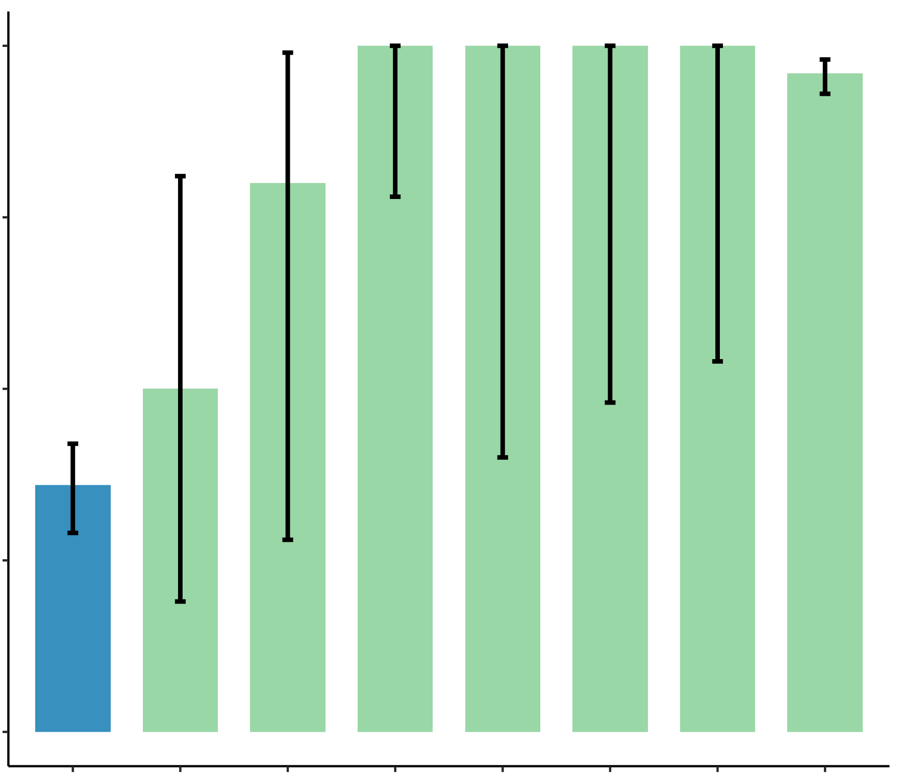
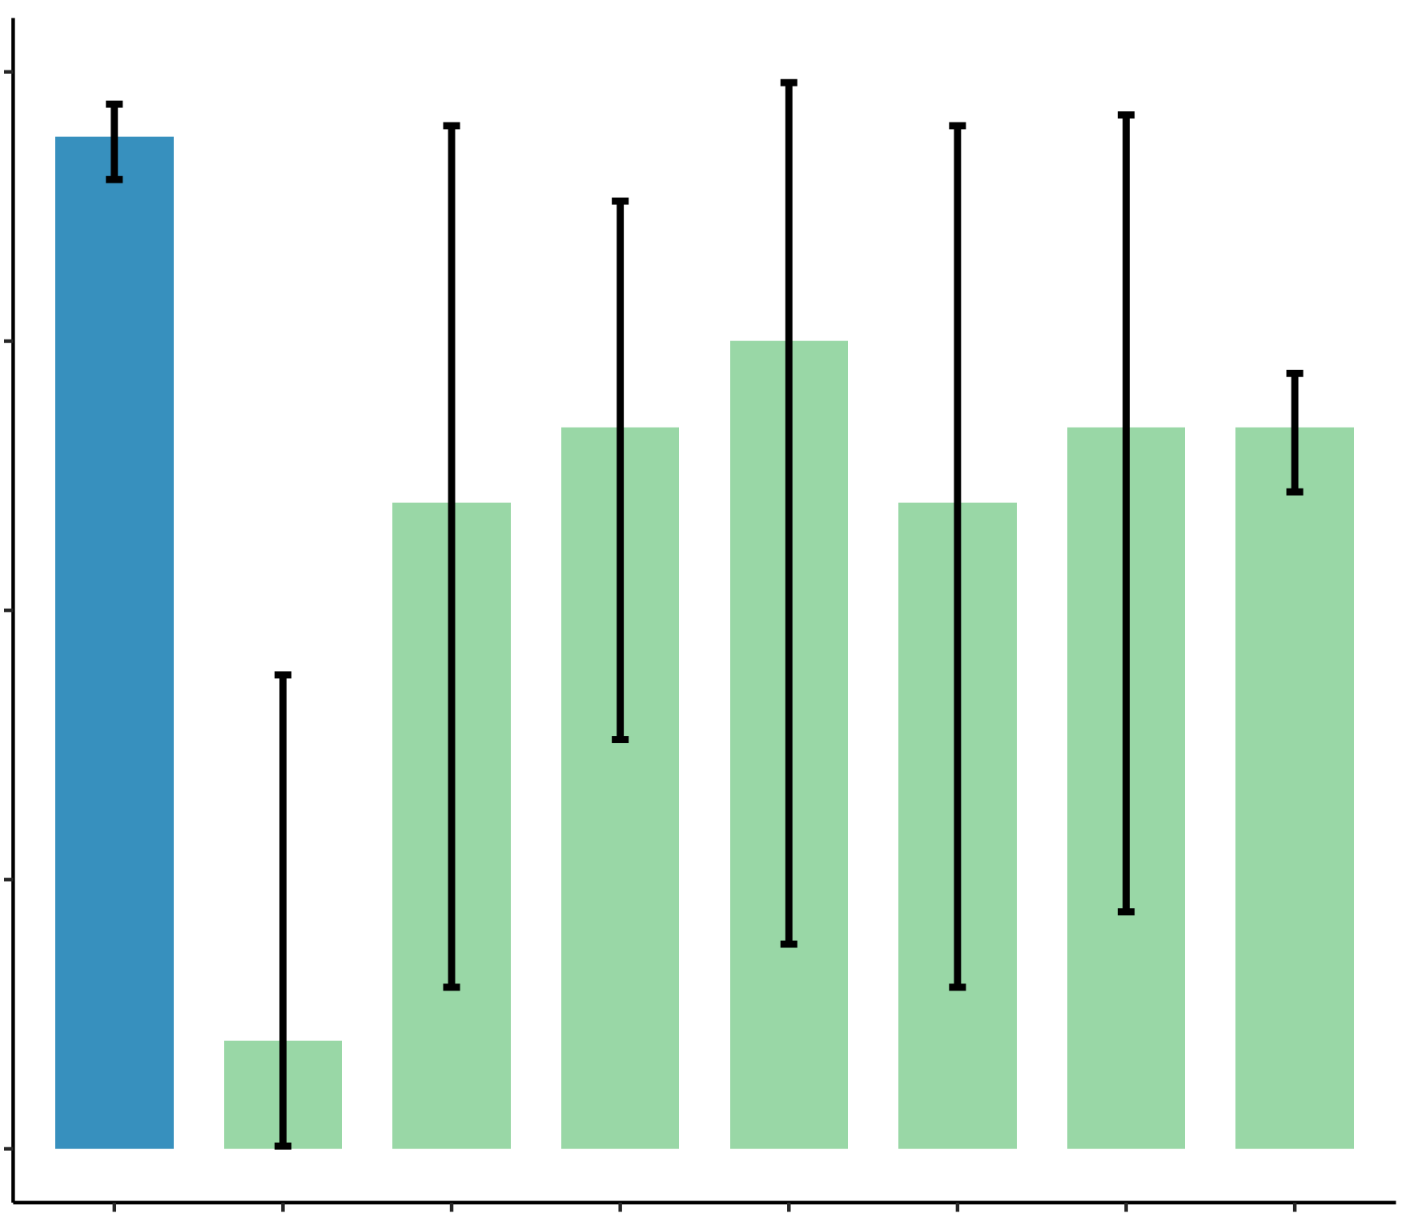
Supplementary Figure S6. Detection of samples in all series (HighSens)
Confusion matrices and detected samples using the HighSens algorithm, in the Training (a, b), Evaluation (c, d) and Validation (e, f) series. NSCLC, non-small cell lung cancer; Controls, asymptomatic individuals.
Supplementary Figure S7. Detection of samples in all series (HighSpec)
Confusion matrices and detected samples using the HighSpec algorithm, in the Training (a, b), Evaluation (c, d) and Validation (e, f) series. NSCLC, non-small cell lung cancer; Controls, asymptomatic.
Supplementary Figure S8. Detection rates for different stages (including stage IIIa and IIIb)
Detection Rate in Validation series within all stages (HighSens)
Detection Rate in Validation series within all stages (HighSpec)
100
100
75
75
Detection Rate (%)
50
Detection Rate (%)
50
25
25
0
36%
50%
80%
100%
100%
100%
100%
96%
0
94%
10%
60%
67%
75%
60%
67%
67%
Control
(n: 254)
Stage I
(n: 10)
Stage II
(n: 5)
Stage III(all)
(n: 15)
Stage III
(n: 4)
Stage IIIa
(n: 5)
Stage IIIb
(n: 6)
Stage IV
(n: 274)
Control
(n: 254)
Stage I
(n: 10)
Stage II
(n: 5)
Stage III(all)
(n: 15)
Stage III
(n: 4)
Stage IIIa
(n: 5)
Stage IIIb
(n: 6)
Stage IV
(n: 274)
Supplementary Figure S8. Detection rates for different stages (including stage IIIa and IIIb)
Detection scores of the Controls and the different stages of NSCLC groups, included in the validation series (in HighSpec and HighSens settings). The error bars indicating the 95% confidence interval calculated by the binom.test-function in R with Clopper-Pearson intervals implementation

Slide 9
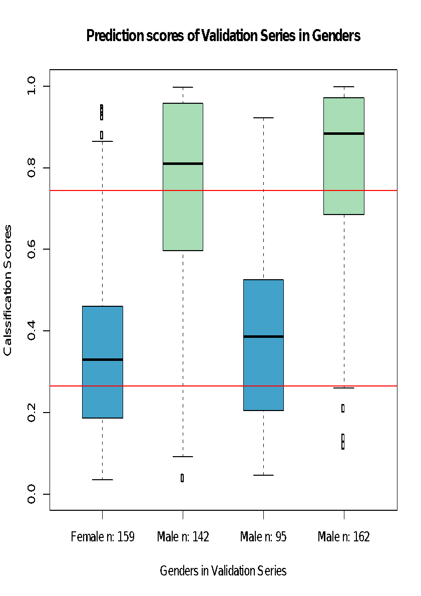
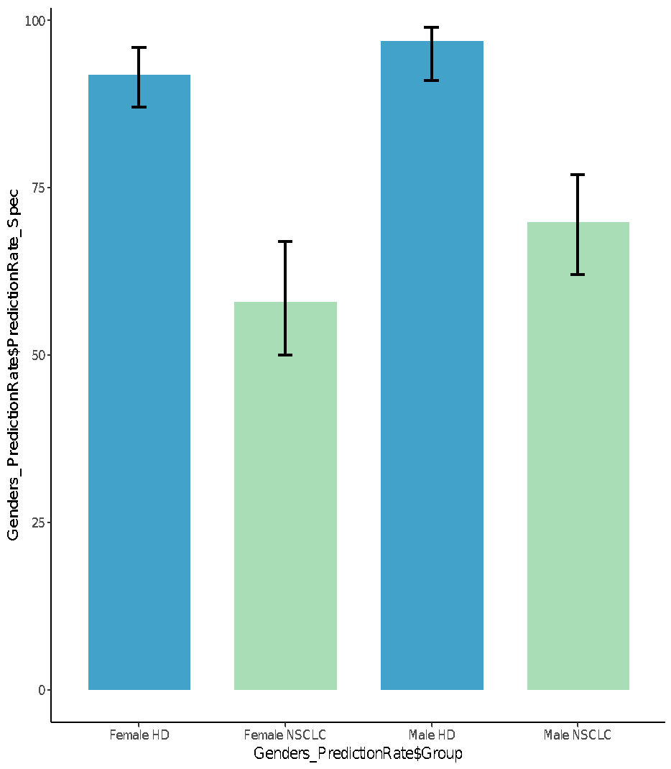
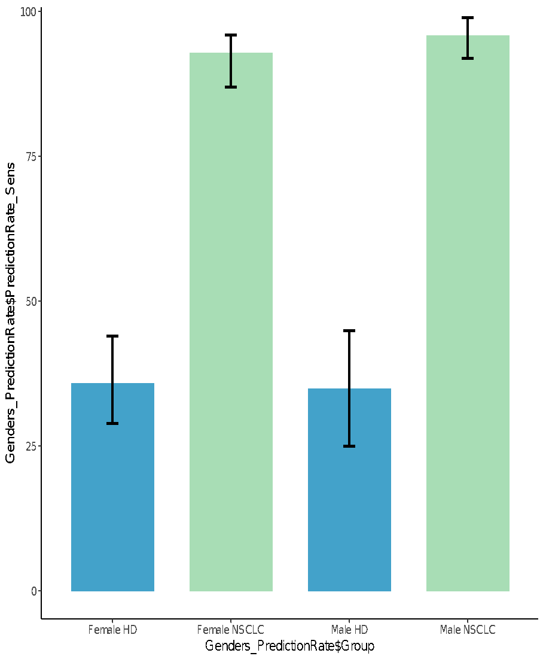
Supplementary Figure S9. Gender detection rate and detection scores in genders
(a)
(b)
(c)
Female
Male
Proportion detected of Genders in
Validation series (HighSpec)
Proportion detected of Genders in
Validation series (HightSens)
1.0
Female
Male
Female
Male
0.8
100
100
HighSpec
75
75
0.6
Detection Scores
50
0.4
50
Detection Rate (%)
Detection Rate (%)
0.2
HighSens
25
25
0.0
0
Controls
(n=159)
NSCLC
(n=141)
Controls
(n=95)
NSCLC
(n=163)
0
Controls
(n=159)
NSCLC
(n=141)
Controls
(n=95)
NSCLC
(n=163)
Controls (n= 95)
NSCLC (n= 141)
NSCLC (n= 163)
Controls (n= 159)
Supplementary Figure S9. Detection scores and detection rates for different genders
(a) Detection scores for female and male genders in the NSCLC and Controls groups, included in the validation series. HighSens and HighSpec thresholds are illustrated, 0.263 and 0.744, respectively (red lines). The box plots represent the detection scores (range 0-1) in NSCLC and Control groups between Females and Males. The boxes show the interquartile range (IQR), with the median line represented by a horizontal bar inside the box. The whiskers indicate the range of the data
(b) Bar plot represents detection accuracy in NSCLC and Control groups between Females and Males (in HighSpec setting). The error bars indicating the 95% confidence interval calculated by the binom.test-function in R with Clopper-Pearson intervals implementation
(c) Bar plot represents detection accuracy in NSCLC and Control groups between Females and Males (in HighSens setting). The error bars indicating the 95% confidence interval calculated by the binom.test-function in R with Clopper-Pearson intervals implementation.

Slide 10
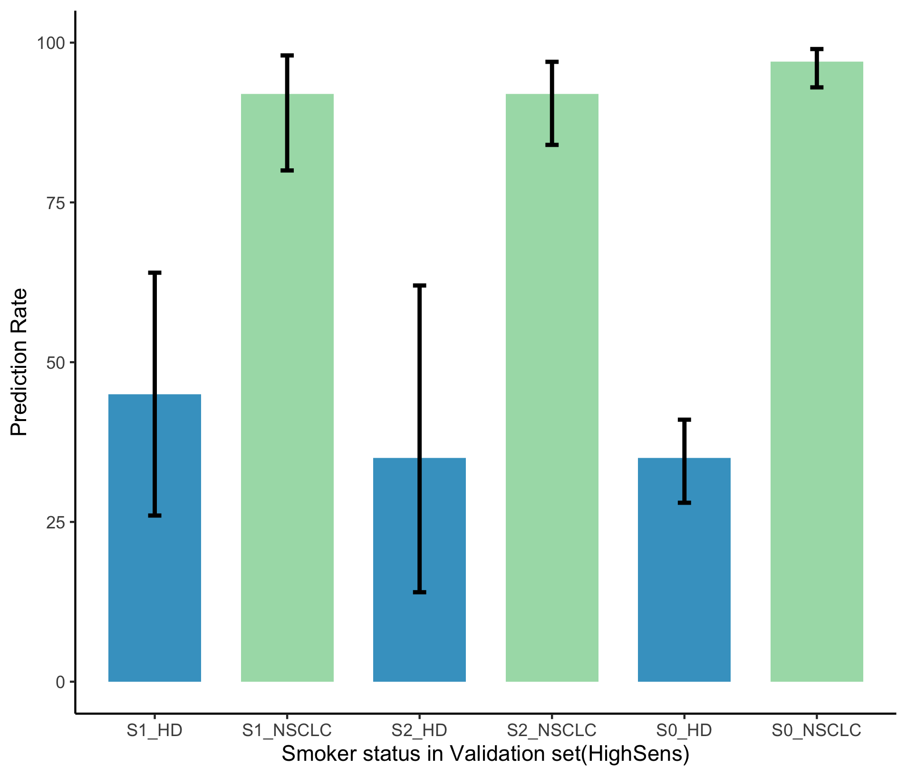
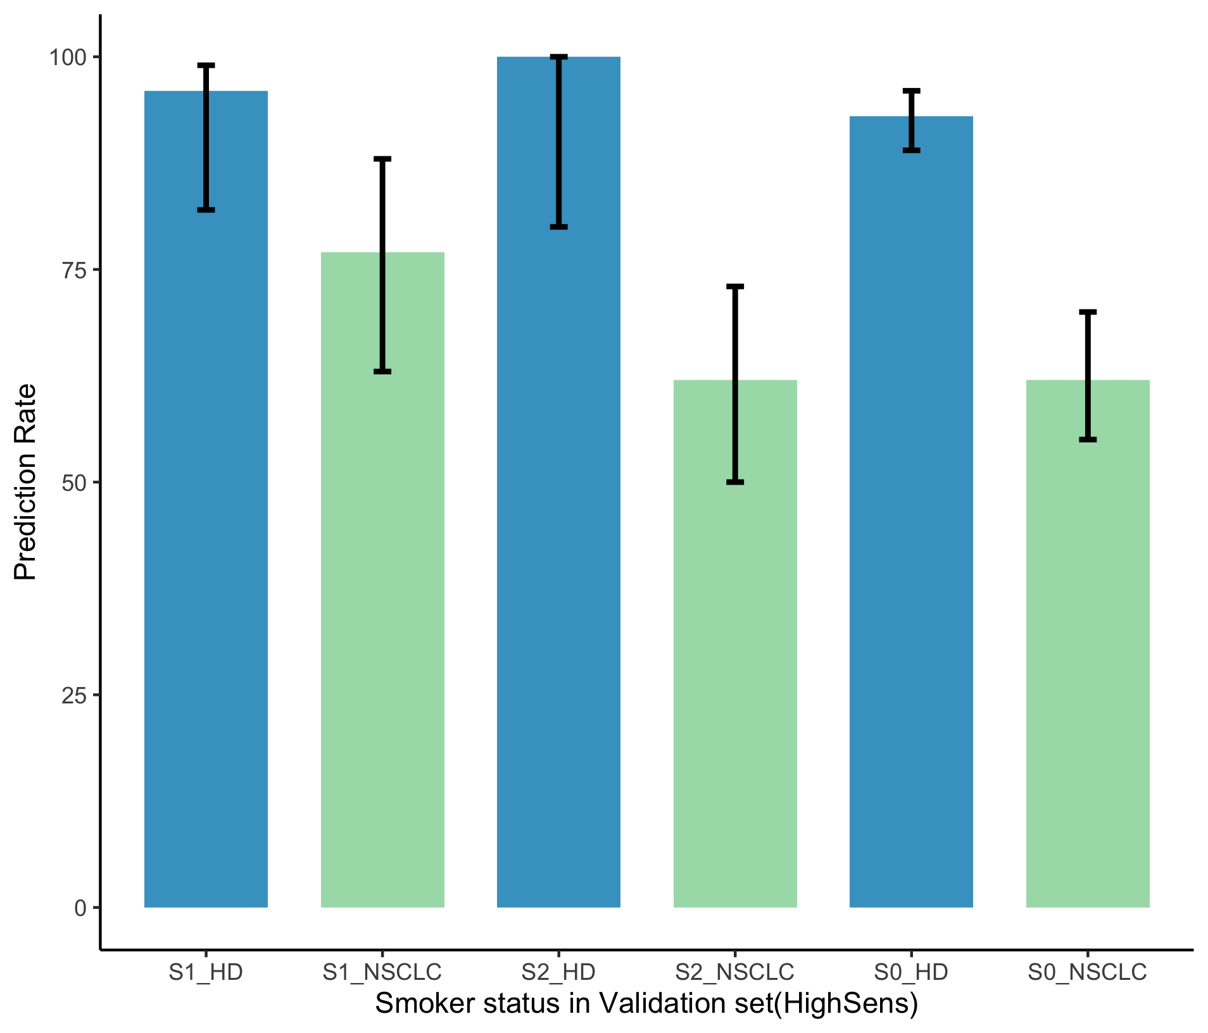
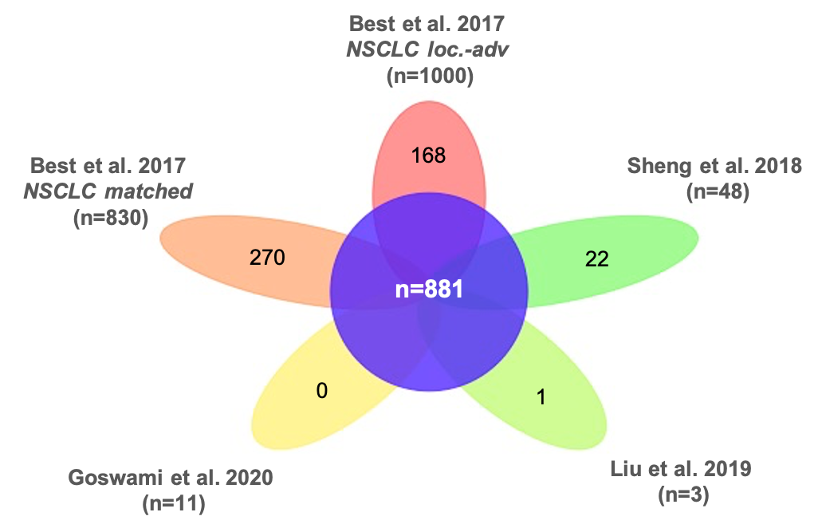
Supplementary Figure S10. Detection rates for different smoking status
Detection rate within different smoking status inValidation serie
(HighSens)
Detection rate within different smoking status inValidation serie
(HighSpec)
100
Smoker
Former Smoker
Never/Unkown
100
Smoker
Former Smoker
Never/Unkown
75
75
Detection rate
Detection rate
50
50
25
25
0
45%
92%
35%
92%
35%
97%
0
96%
77%
100%
62%
93%
62%
Control
(n=29)
NSCLC
(n=48)
Control
(n=17)
NSCLC
(n=79)
Control
(n=208)
NSCLC
(n=177)
Control
(n=29)
NSCLC
(n=48)
Control
(n=17)
NSCLC
(n=79)
Control
(n=208)
NSCLC
(n=177)
Supplementary Figure S10. Detection rates for different smoking status
Detection scores for “smokers”, “former smokers” and “never/unknown” in the NSCLC and Control groups, included in the validation series (in HighSpec and HighSens settings). The error bars indicating the 95% confidence interval calculated by the binom.test-function in R with Clopper-Pearson intervals implementation
Supplementary Figure S11. Overlay of swarm RNA biomarker panel with panels from other studies
Best et al. 2017 NSCLC loc.-adv (n=1000) | Sheng et al. 2018 NSCLC (n=48) | Liu et al. 2019 NSCLC (n=3)
ARL2 | ARL2 | HLA-B
COL6A3 | COL6A3
HLA-B | HPSE
HPSE | IFITM3
IFITM3 | KLHDC8B
KLHDC8B | NUDT4
NUDT4 | PDHB
PDHB | PPP1R12C
PPP1R12C | TBL1X
SMPD1 | TPM2
TBL1X | ZNF346
TPM2 | SMPD1
ZNF346
SMPD1
Supplementary Figure 11. Overlay of swarm RNA biomarker panel with panels from other studies
Flower plot illustrating the overlay of the current platelet RNA biomarker panel (n=881) with the panels from other NSCLC studies published. List of biomarkers from the NSCLC thromboSeq panels overlapping with the panels of Sheng et al. and Liu et al. studies.

