Slide 1
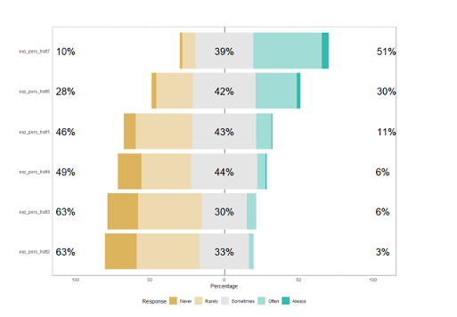
Supplementary Figure 2
Never Sometimes Always
Patients are concerned being discriminated
Patients struggle to speak about their gender identity
Patients struggle to face their oncological issues
Communication with patients is difficult
Patients ask too many questions
Patients are challenging to treat
Multiple items could be selected

