Slide 1
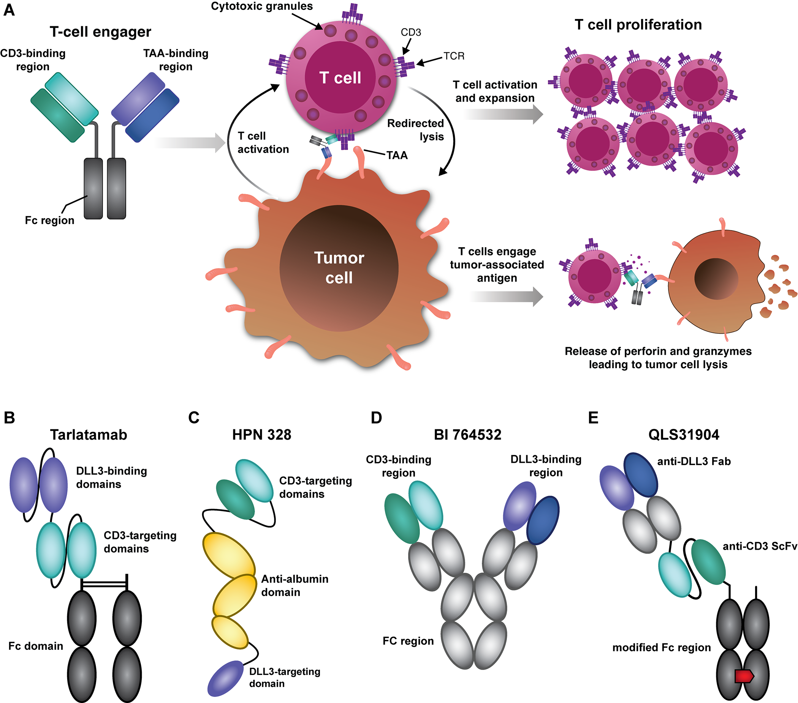

General mechanism of action of T-cell engagers (A) and structure of various DLL3-targeting TCEs in clinical development (B-E).
Completed and ongoing clinical trials of DLL3-targeting T-cell engagers for SCLC

