Slide 1
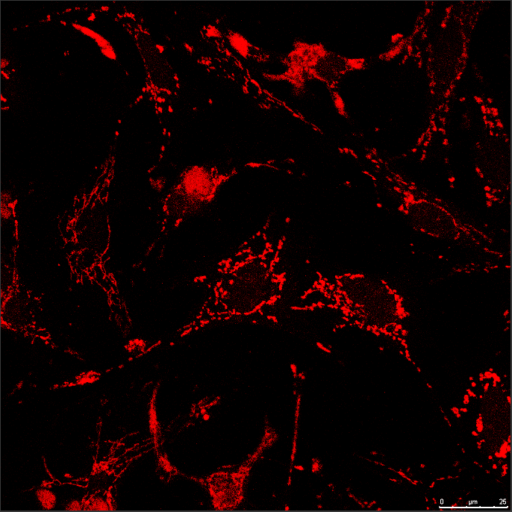
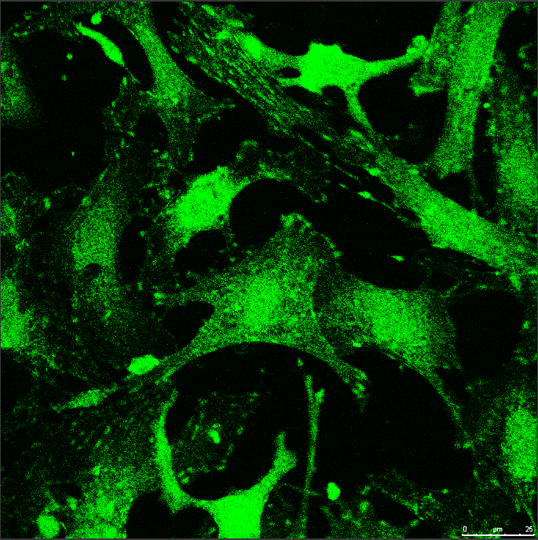
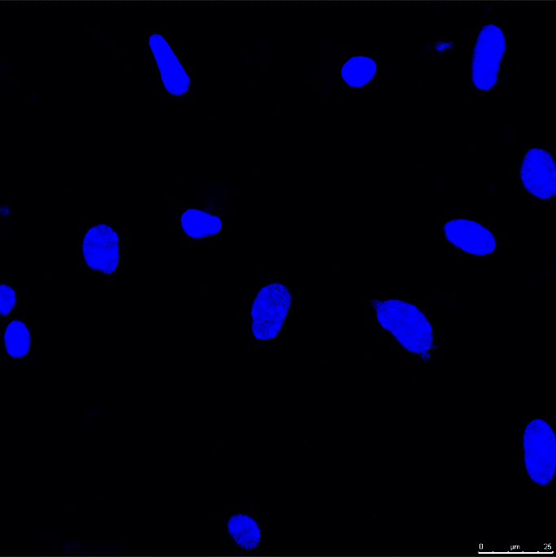
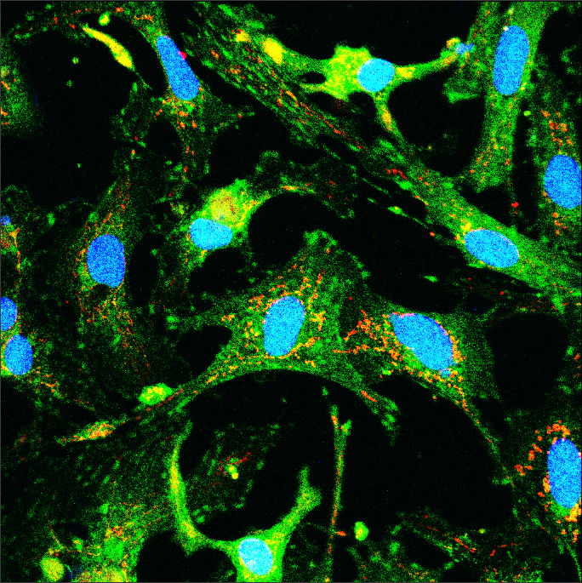
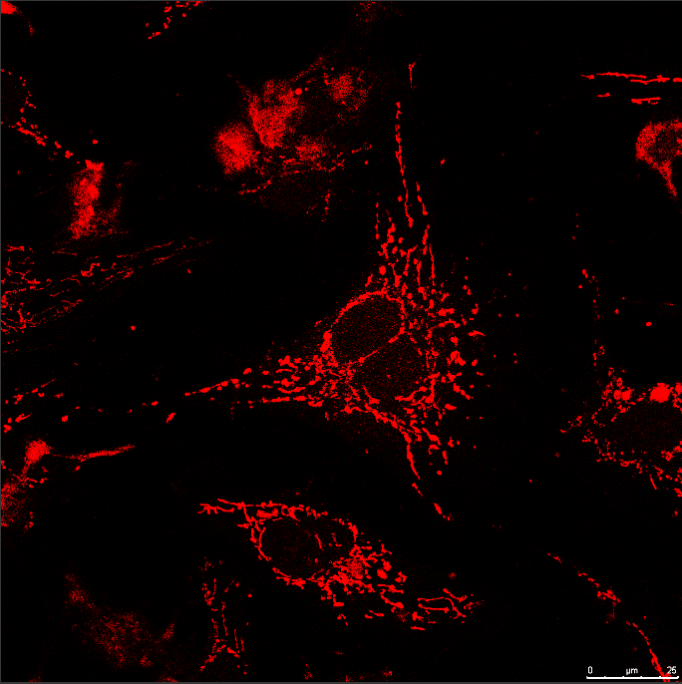
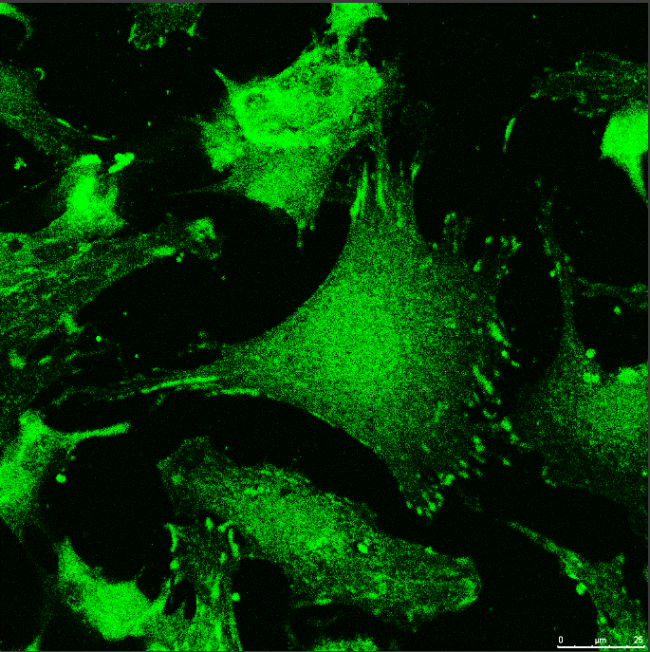
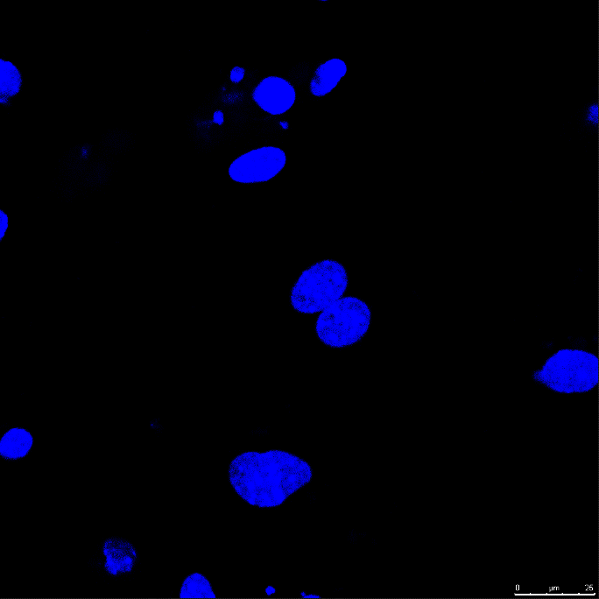
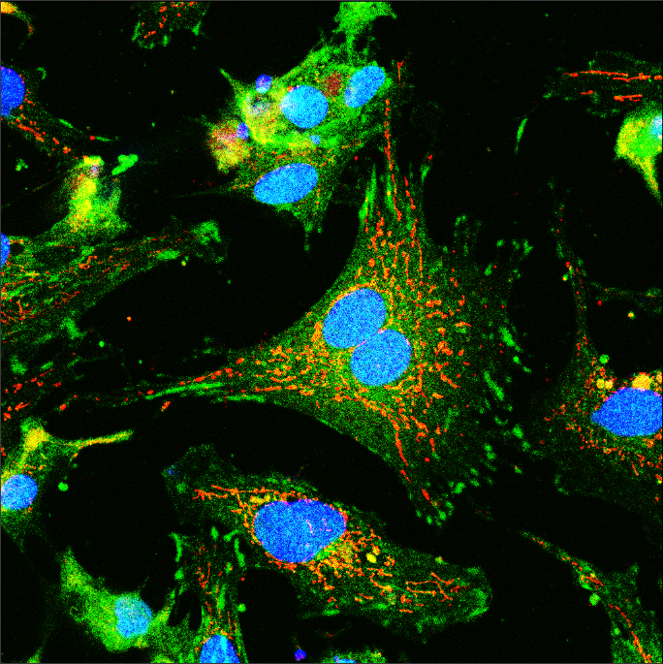



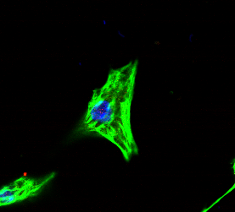
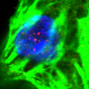
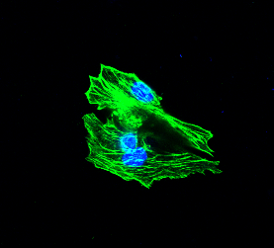
Supplementary Fig. 1
a
Mitotracker
TMEM11
DAPI
Merge
b
KDa
c
25
KDa
TMEM11
TMEM11
25
GAPDH
35
GAPDH
35
Brain
Liver
Muscle
Heart
CM
CF
d
e
f
CTRL
TMEM11
KI67⁺ CMs (%)
2.0
P <0.0001
AuroraB⁺ CMs (%)
0.15
P <0.0001
1.5
0.10
pH3/cTNT/ DAPI
1.0
0.5
0.05
0.0
0.00
CTRL
TMEM11
CTRL
TMEM11

