Slide 1
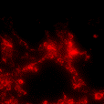
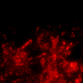
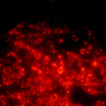



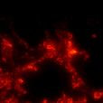
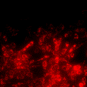
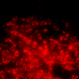


Supplementary Fig. 2
TMEM11-shNC
TMEM11-shRNA
shNC
a
Control
b
Control
TMEM11
J-aggregates
J-aggregates
Monomer
Monomer
Merge
Merge
cells (%)
TUNEL-positive
c
d
6
ns
ns
KDa
Caspase 3
25
4
LC3
25
2
GAPDH
35
0
Control
TMEM11-shNC
TMEM11-shRNA
Control
TMEM11-shNC
TMEM11-shRNA

