Slide 1
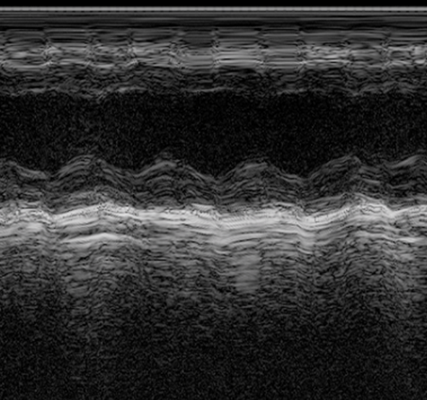
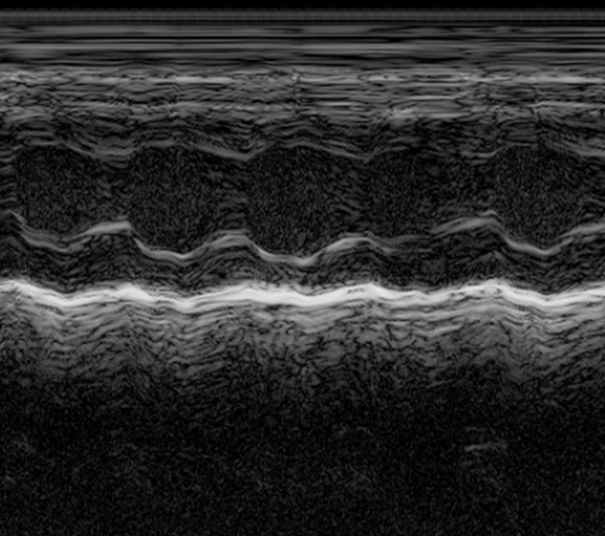




Supplementary Fig. 4
a
b
MI
Myocardial
Histology
WT
TMEM11 KO
Infarction
Echo
Collection
Day:
56
0
WT or TMEM11 KO mice
c
d
e
MI
KDa
100
P <0.0001
25
KDa
EF (%)
80
TMEM11
TMEM11
25
60
GAPDH
35
GAPDH
35
40
MI
Sham
TAC
20
Sham
0
WT
TMEM11 KO

