Slide 1
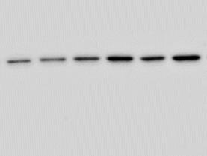
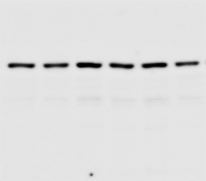

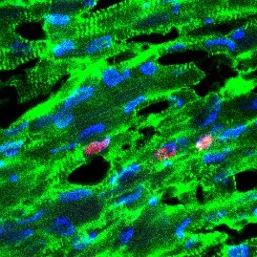
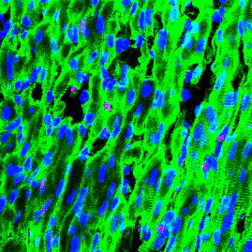
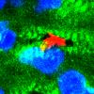
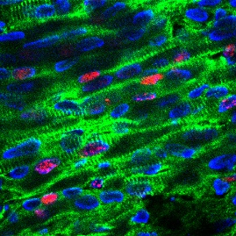


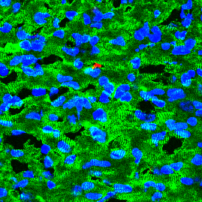
Supplementary Fig. 5
a
b
c
d
KDa
TMEM11
25
GAPDH
35
ns
2.0
ns
1.5
ns
100
8
P <0.0001
1.5
1.0
EF (%)
75
Bnp mRNA levels
Myh7 mRNA levels
6
1.0
50
TMEM11/GAPDH
0.5
4
0.5
25
2
0.0
0.0
0
(fold of control)
0
WT
WT
WT
WT
Tg
TMEM11 Tg
TMEM11 Tg
TMEM11 Tg
e
f
g
MI (7 days)
MI (7 days)
MI at P1
Analyzed at P7
WT
TMEM11 Tg
WT
TMEM11 Tg
P = 0.0043
EF (%)
100
Ki67/cTNT/ DAPI
pH3/cTNT/ DAPI
75
50
25
0
WT
TMEM11 Tg

