Slide 1
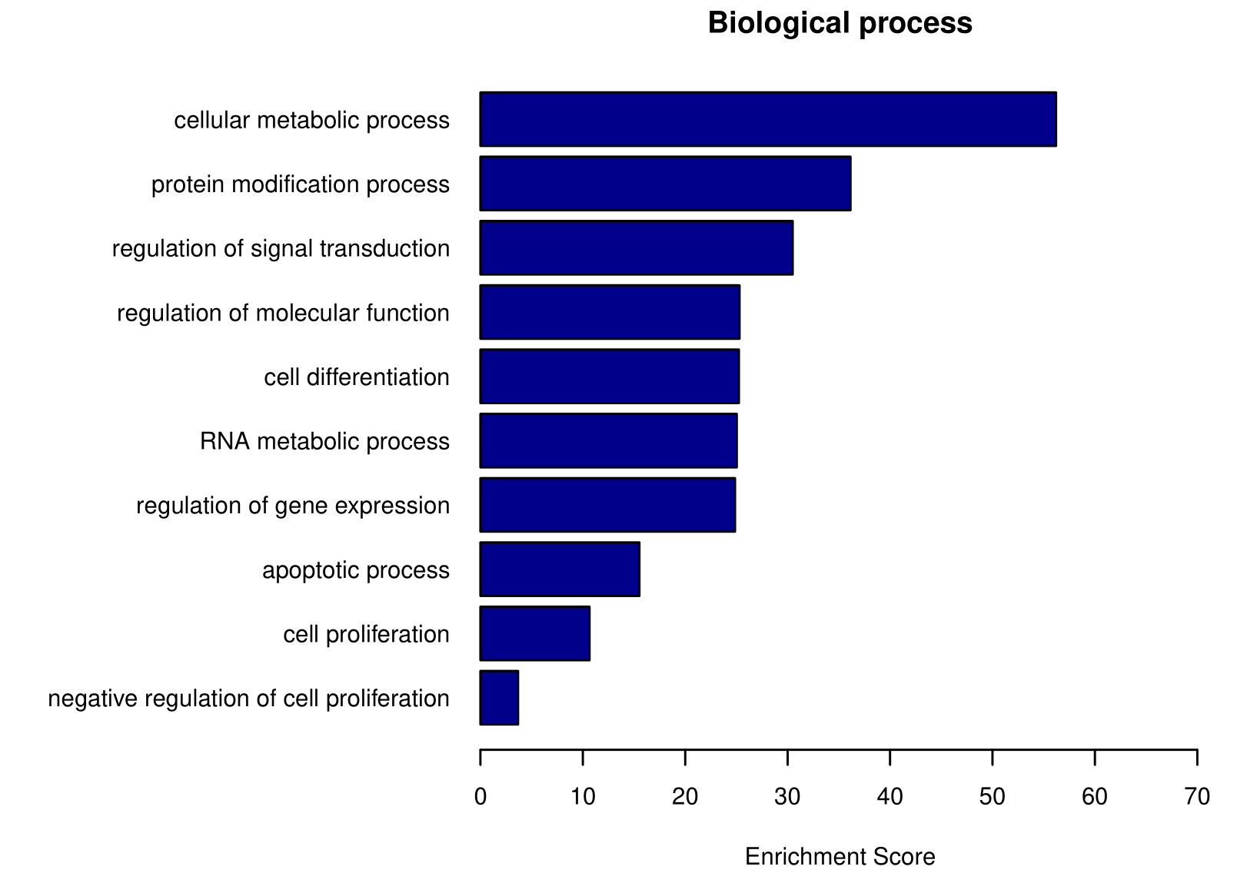
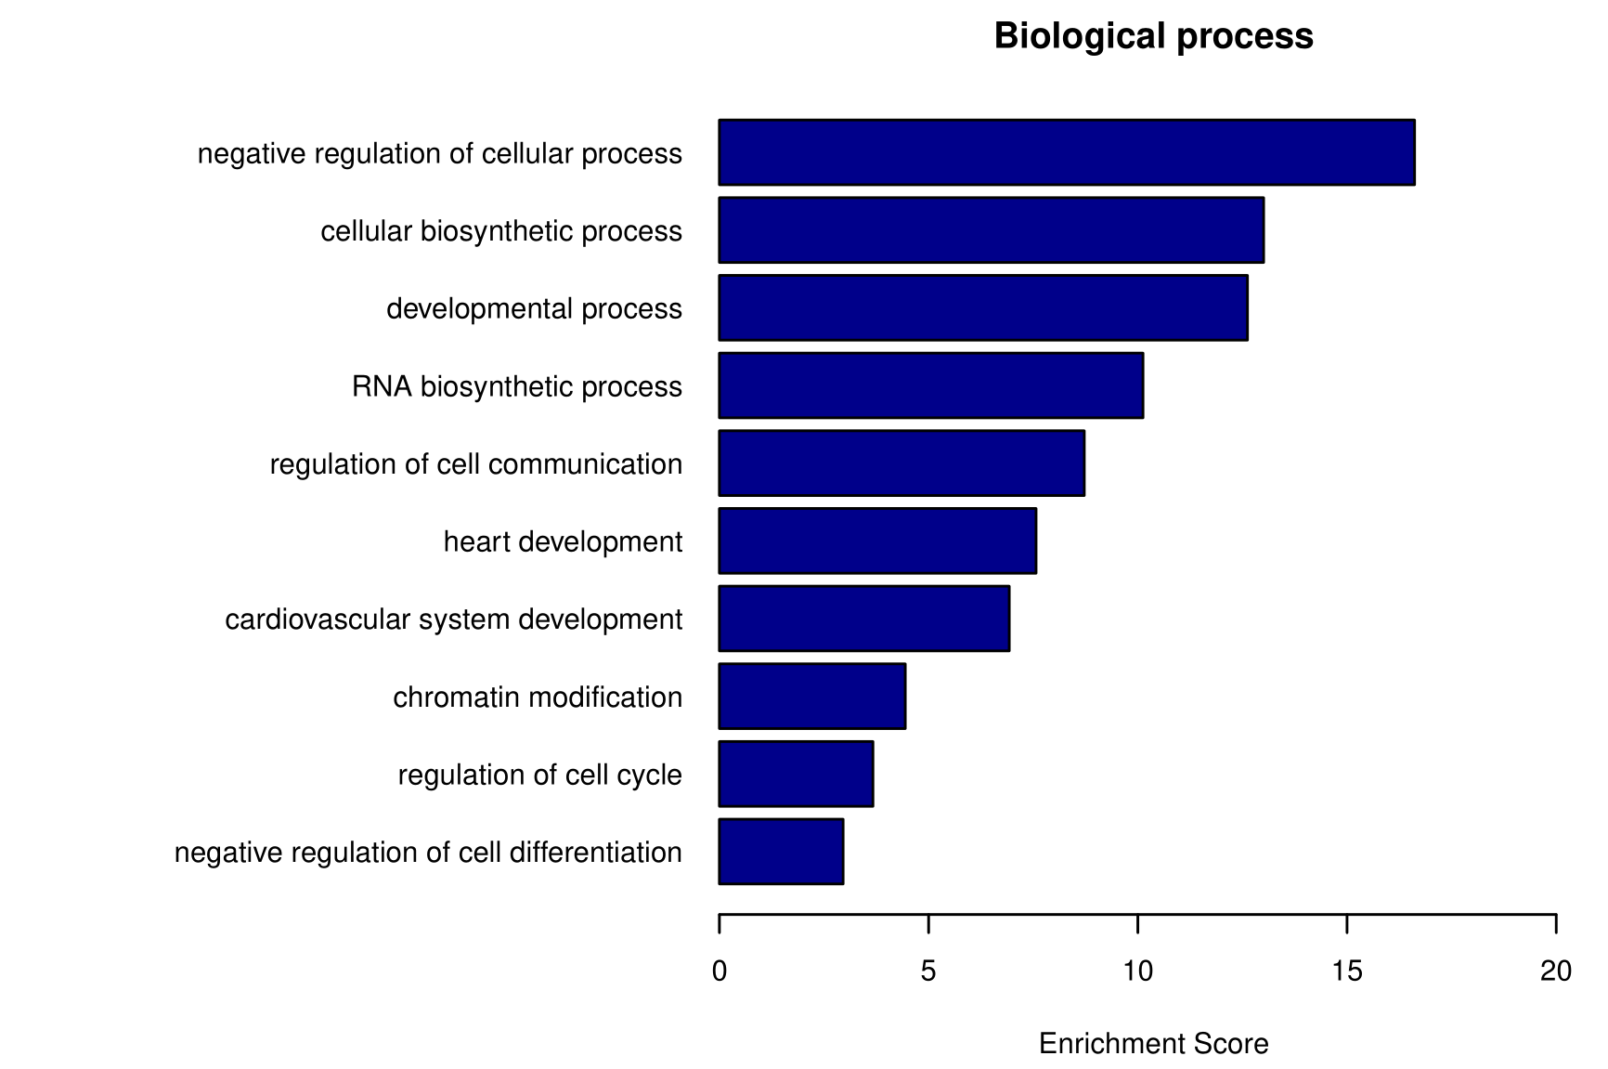
Supplementary Fig. 6
a
8.3e+06
100
90
80
70
60
Relative Intensity (%)
50
40
30
20
10
0
100
200
300
400
500
600
700
800
m/z
b
WT
TMEM11 Tg
c
d
TMEM11 Tg upregulated GO terms
TMEM11 Tg downregulated GO terms
Cellular metabolic process
Negative regulation of cellular process
Protein modification process
Cellular biosynthetic process
Regulation of signal transduction
Developmental process
Regulation of molecular function
RNA biosynthetic process
Cell differentiation
Regulation of cell communication
RNA metabolic process
Heart development
Regulation of gene expression
Cardiovascular system development
Apoptotic process
Chromatin modification
Cell proliferation
Regulation of cell cycle
Negative regulation of cell proliferation
Negative regulation of cell differentiation
0
10
20
30
40
50
60
70
0
5
10
15
20
Enrichment Score
Enrichment Score

