Slide 3
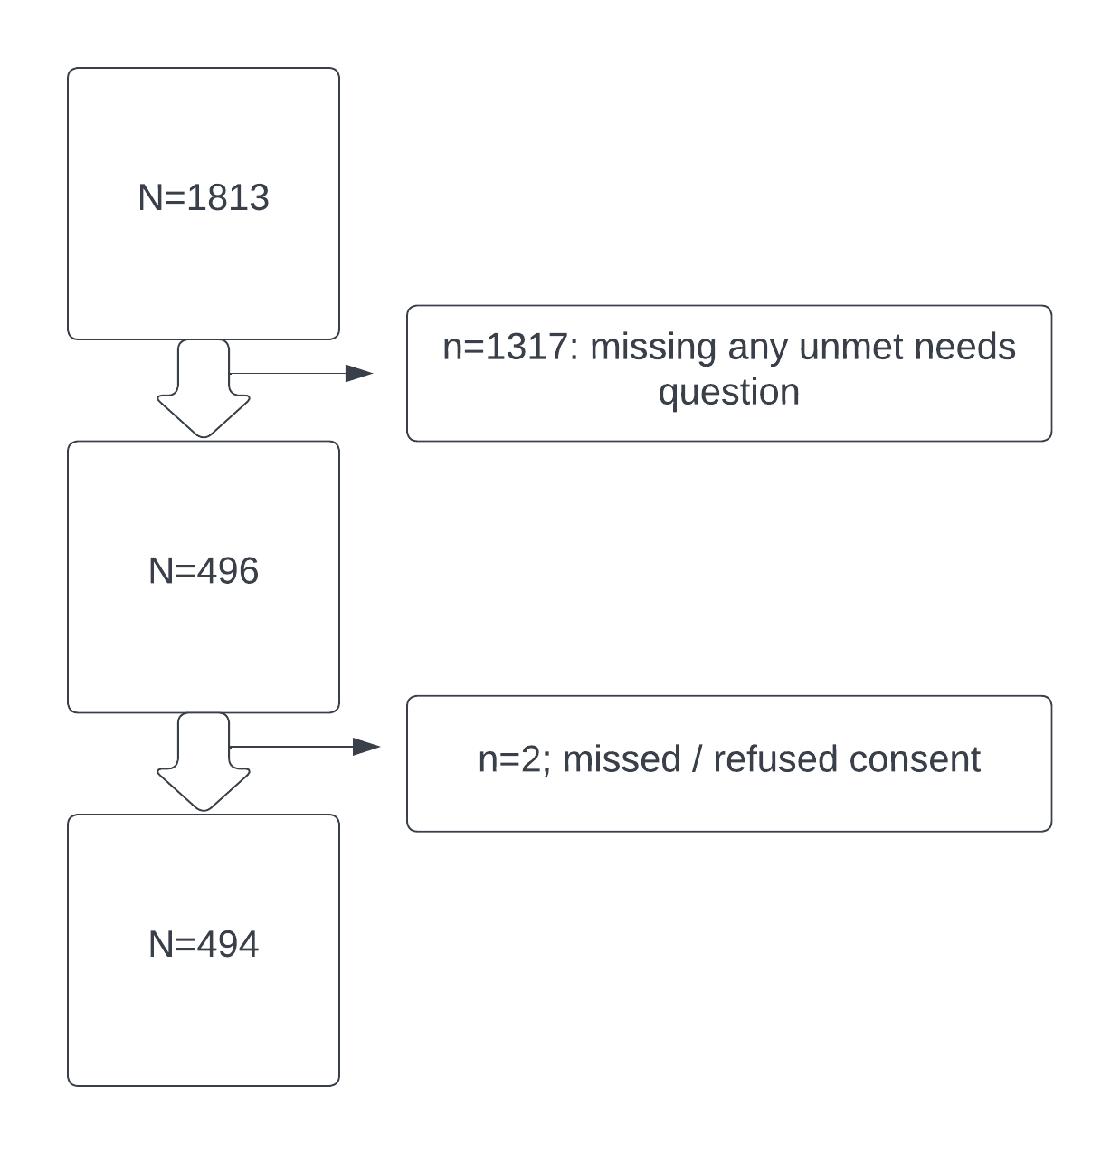
Supplemental
Figure 1

