Slide 1
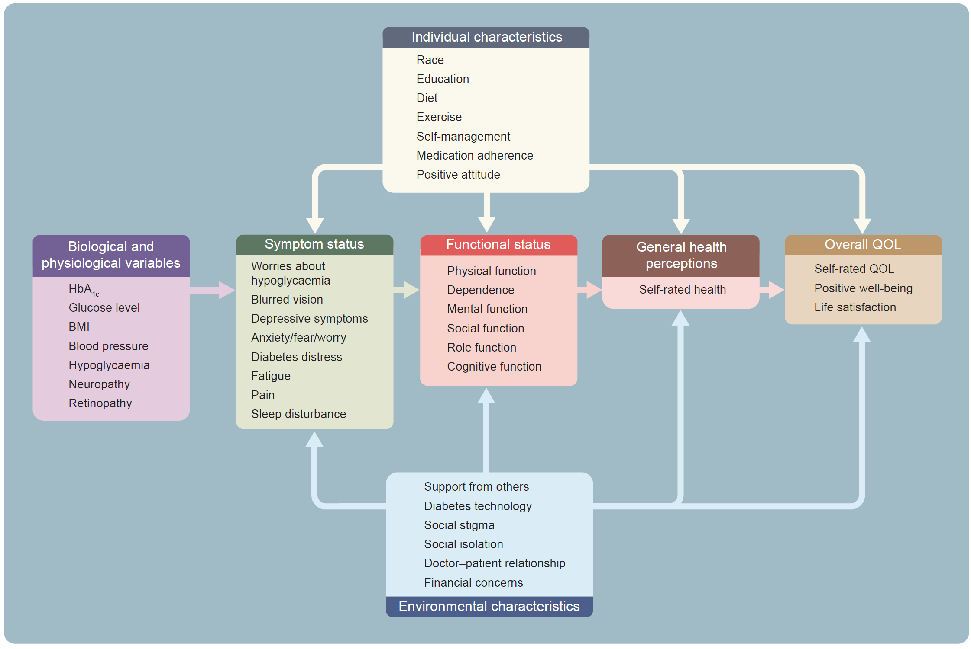
Several examples of relevant health and quality of life outcomes for people with diabetes (list is not exhaustive), placed in the model of Wilson and Cleary
Terwee et al (2023) Diabetologia DOI 10.1007/s00125-023-05926-3
©The Authors 2023. Distributed under the terms of the CC BY 4.0 Attribution License (http://creativecommons.org/licenses/by/4.0/)

