Slide 1
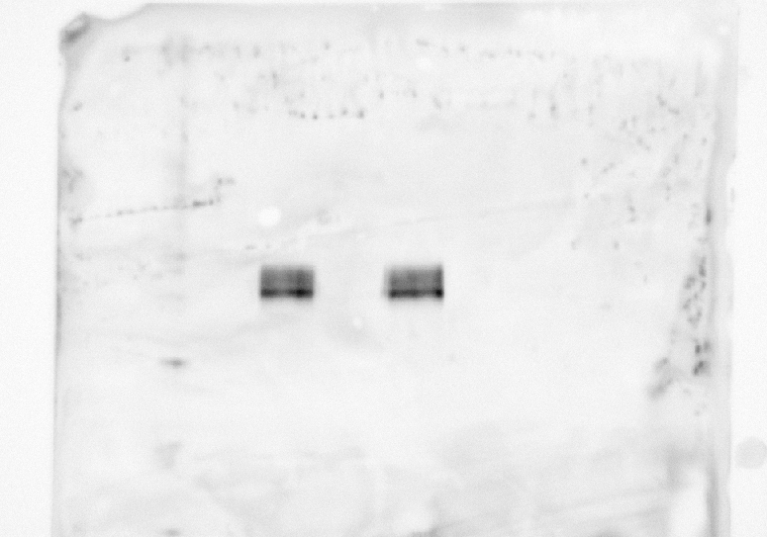
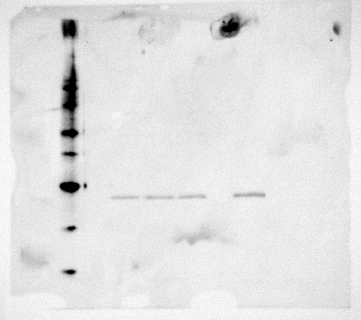
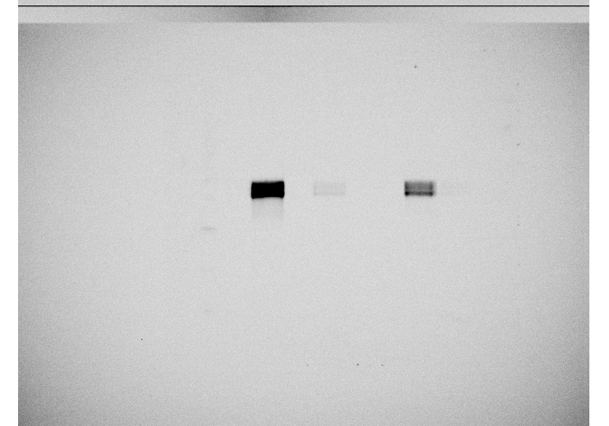
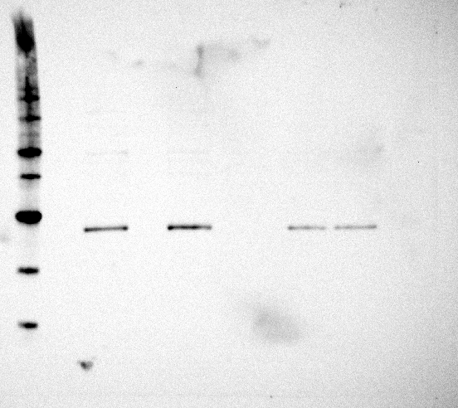
Nptx2/TBP
M-82A
M-82A
CTR
BMP2
CTR
BMP2
M-82D
M-82D
CTR
BMP2
60 kDa
CTR
BMP2
Nptx2
40 kDa
Tbp
40 kDa
30 kDa
20 kDa
M-82C
M-82E
M-82C
M-82E
CTR
BMP2
CTR
BMP2
CTR
BMP2
CTR
BMP2
60 kDa
Nptx2
40 kDa
40 kDa
Tbp
30 kDa
20 kDa
Original WB files: Validation of top 35 most up or downregulated protein
Analysis of Nptx2 protein expression by Western blotting. Nptx2 antibody (ab277523, Abcam) detects a band of approximately 50-60 kDa
(predicted molecular weight: 47 kDa). Tbp antibody (#8515, Cell Signal) detects a band of approximately 35-45 kDa. Four independent
experiments were conducted, N=4.

Slide 2
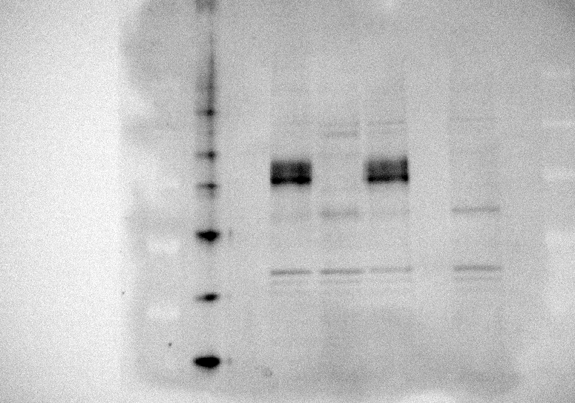
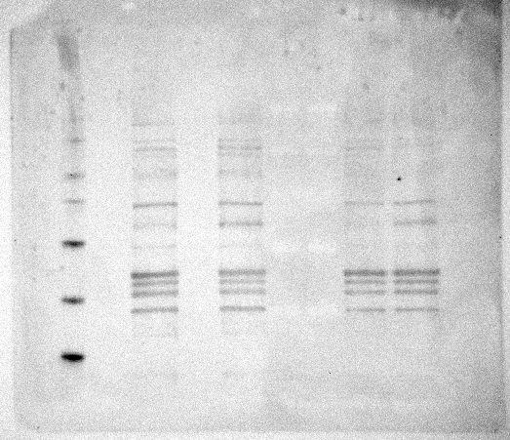
Syt7/TBP
M-82A
M-82D
M-82A
CTR
BMP2
CTR
BMP2
CTR
BMP2
M-82D
CTR
BMP2
40 kDa
Syt7
40 kDa
Tbp
30 kDa
30 kDa
20 kDa
20 kDa
M-82C
M-82E
M-82C
M-82E
CTR
BMP2
CTR
BMP2
CTR
BMP2
CTR
BMP2
50 kDa
Syt7
40 kDa
40 kDa
Tbp
30 kDa
30 kDa
20 kDa
20 kDa
Original WB files: Validation of top 35 most up or downregulated protein
Analysis of Syt7 protein expression by Western blotting. Syt7 antibody (MA5-27654, Invitrogen) detects a band of approximately 45 kDa .
Tbp antibody (#8515, Cell Signal) detects a band of approximately 35-45 kDa. Four independent experiments were conducted, N=4.

