Slide 1
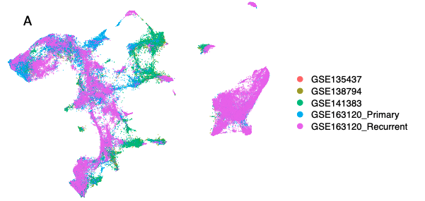
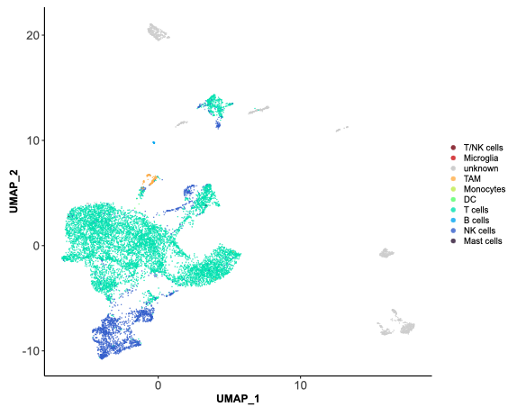
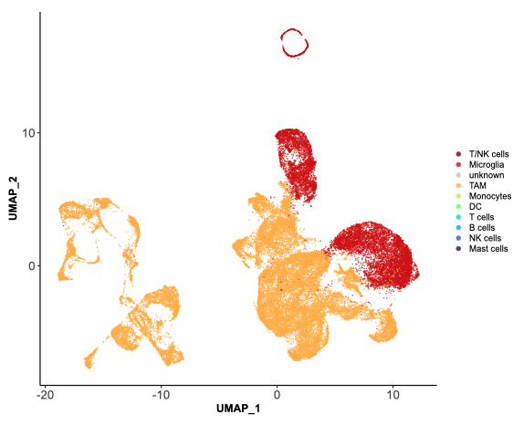
B
Figure S1. A. The UMAP projection of single GBM immune cells amalgamated from 4 independent studies, following batch correction. The top repeats the middle left panel of Figure 1B but the mappings for each individual dataset are then shown separately below. GSE163120 was split in two and processed independently owing to samples being sequenced on different platforms. B. The result of isolation and subclustering of T and NK cells (Left) and TAM and Microglia (right). TAM: Tumour Associated Macrophages

Slide 2
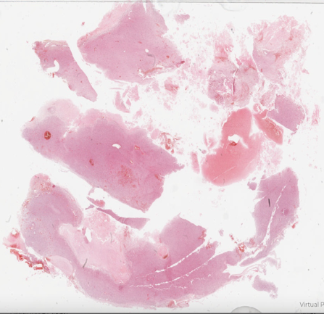

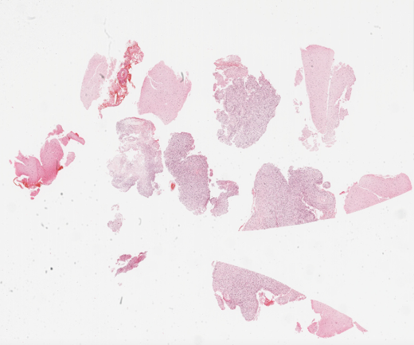
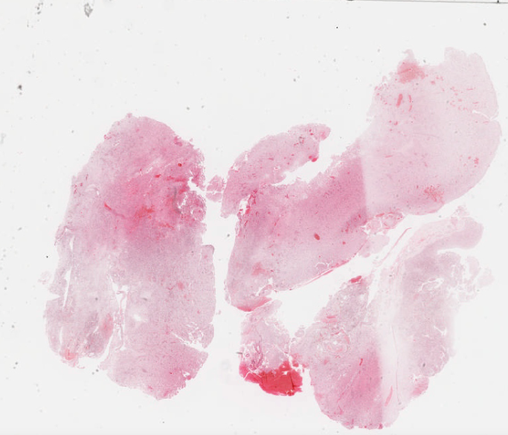
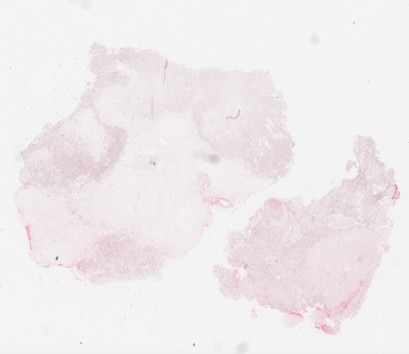

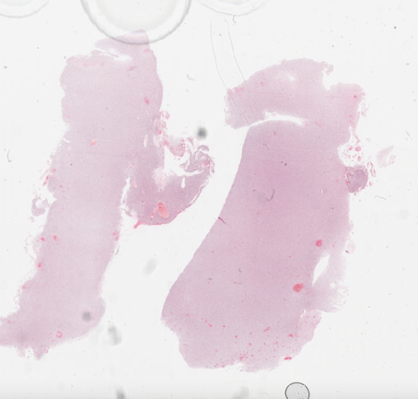
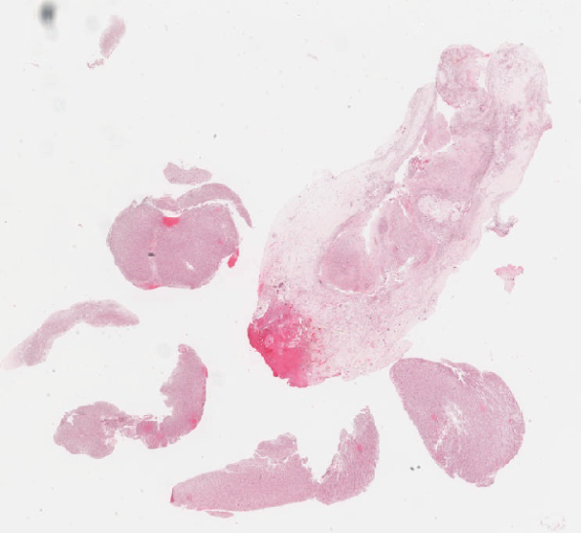
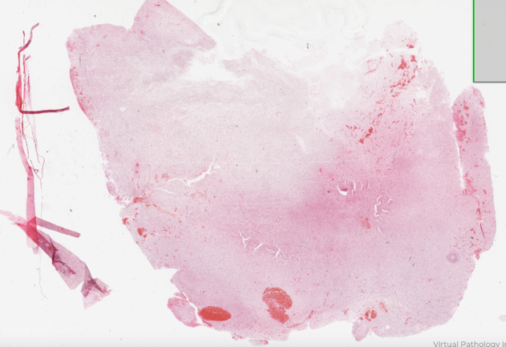
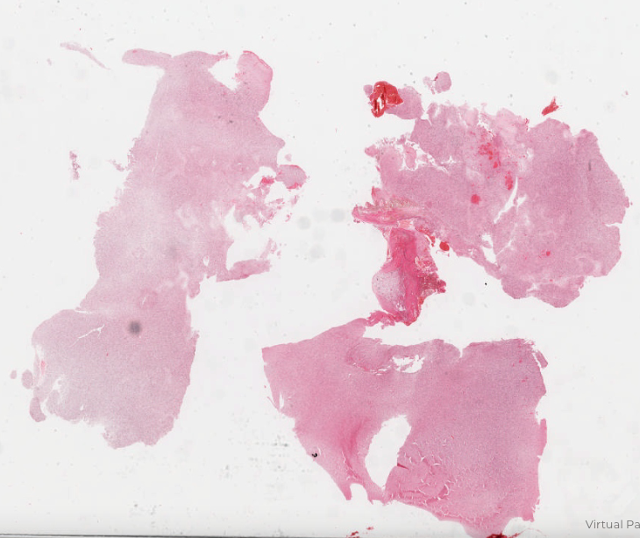
Figure S2. H&E stained FFPE sections of the five primary (P) and matched recurrent (R) IDHwt GBM tumours used in tool validation. Black circles denote the areas that were macrodissected from consecutive slides, and from which RNA was extracted for bulk sequencing. Blue squares demarcate the 2mm² regions that underwent characterization by imaging mass cytometry. Top left to bottom right these samples are: 64P and 64R, 67P and 67R, 71P and 71R, 82P and 82R and 84P and 84R.

Slide 3
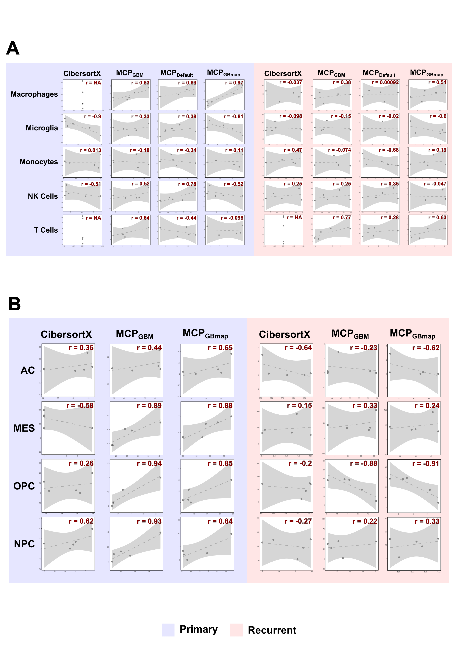
Figure S3. Scatterplots, in primary or recurrent GBM samples separately, of gold standard cell proportions quantified by IMC (y-axis) versus those predicted by gene expression-based methods (annotated across the top) for immune (A) or neoplastic cancer (B) cell types indicated down the side. The Pearson’s correlation coefficient (r) is indicated . The dotted line is the line of best fit and the shaded area denotes the confidence interval. Marker genes for MCPcounter were either default (MCPdefault), GBM-specific according to our research (MCPGBM) or GBM-specific according to GBMap (MCPGBMap) Neoplastic cells are astrocyte-like (AC), oligodendrocyte progenitor-like (OPC), neuronal progenitor-like (OPC) or mesenchymal (MES).

