Slide 1
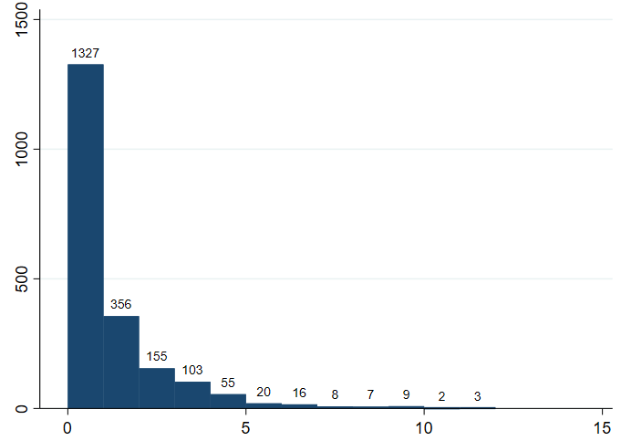
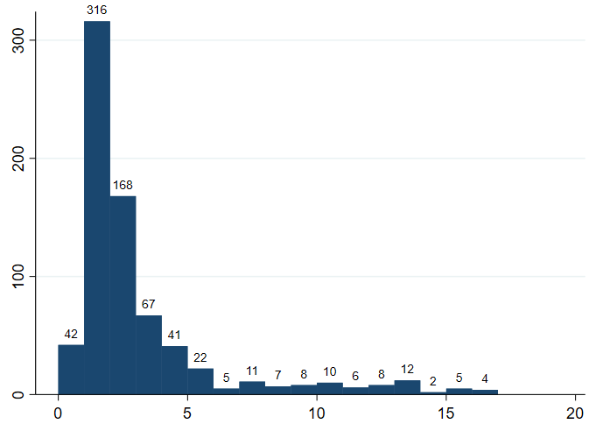
Supplemental Figure 1
a
b
Number of children
Number of exacerbations
Number of exacerbations
Time (in years) between exacerbations

