Slide 1
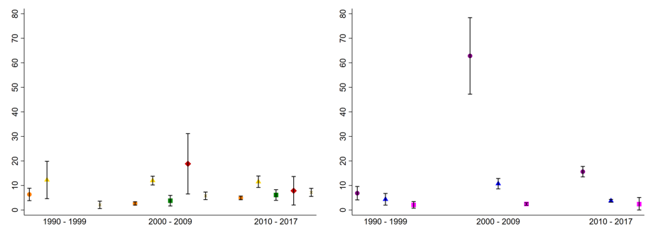
Supplemental Figure 4
ARE incidence rates per 1000 person-years
Non-Hispanic White
Non-Hispanic Black
Hispanic White
Hispanic Black
Other
Decade of birth
2 to 4 years
5 to 9 years
10-18 years
X

