Slide 1
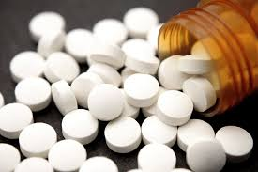

MORPHINE
EQUIVALENTS
During the era of the opioid crisis
Notes:
The objective of this lecture is to present the topic of morphine milligram equivalents, to briefly go over the characteristics and metabolism of opioid medications, and to introduce a visually appealing chart that will help guide Emergency Department (ED) providers in roughly converting between commonly used opioids in the ED, specifically in this crucial time period of the opioid crisis.

Slide 2
analgesia
self-medication
adversity
physical dependence
trauma
socioeconomic status
psychiatric comorbidities
euphoria
medical comorbidities
stress
substance use disorders
addictive qualities
financial strains
availability
Notes:
This slide introduces some of the risk factors for opioid overdose/dependence. This is far from a comprehensive list, but just aims to highlight some of the more common etiologies that lead to opioid overuse.
For example, the desire for analgesia (pain relief) may be so strong that it blinds the user from following the recommended dosages and frequency of use.
Lower socioeconomic status also increases the likelihood of opioid overdose, as a result of lower education attainment, employment status, and income level, among other factors.
In regards to euphoria - opioids used for pain relief have analgesic and depressive central nervous system effects, and have the potential to cause euphoria. Many people can easily become addicted to this feeling of exhilaration, quickly increasing their usage of opioid medication to chase the “high,” and building tolerance to these medications, thus requiring increasing dosages to reach the same level of euphoria.
Examples of psychiatric comorbidities that increase the risk of developing opioid dependence include depression, anxiety disorder, personality disorder, PTSD, and substance use disorder, among others.
https://www.researchgate.net/profile/Nalini_Sehgal/publication/230626397_Prescription_Opioid_Abuse_in_Chronic_Pain_A_Review_of_Opioid_Abuse_Predictors_and_Strategies_to_Curb_Opioid_Abuse/links/552338c20cf2f9c1305463b1/Prescription-Opioid-Abuse-in-Chronic-Pain-A-Review-of-Opioid-Abuse-Predictors-and-Strategies-to-Curb-Opioid-Abuse.pdf
https://www.ncbi.nlm.nih.gov/pmc/articles/PMC7313902/

Slide 3
OPIOID ABUSE EPIDEMIC
GENERAL STATISTICS
IN 2018,
>100 million Americans suffer from chronic pain that affects patient well-being, level of functioning, and quality of life
Approximately 70% of drug overdose deaths in the United States involved opioids
Over 100 Americans die every day from opioid overdose
ACCORDING TO THE CDC
Notes:
Long-term opioid use often begins with treatment of acute pain. Clinicians should prescribe the lowest effective dose of immediate-release opioids and should prescribe no greater quantity than needed for the expected duration of pain severe enough to require opioids.
According to the CDC, greater than 100 million Americans have some source of chronic pain that affects their well-being, level of functioning, and quality of life. They often end up turning to and becoming dependent on pain medication as their primary source of relief. This leads to over 100 Americans dying each day as a result of this dependency and subsequent opioid overdose. In the year 2018 alone, approximately 70% of deaths caused by drug overdose in the United States involved opioid usage.
https://www.drugabuse.gov/drug-topics/opioids/benzodiazepines-opioids#Reference
https://www.cdc.gov/mmwr/volumes/69/wr/mm6911a4.htm

Slide 4
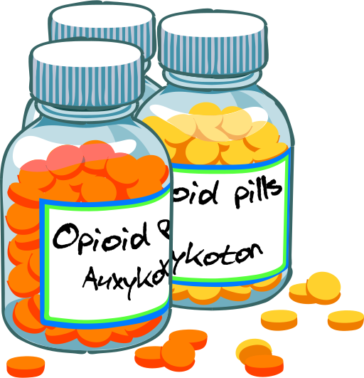
PURPOSE
To understand how to safely convert pain medication dosages
Provide insight on how to standardize the opioid prescribing process
Notes:
The objective of this educational lecture is to explain how to correctly and safely convert between various pain medications and standardize a method to do so. We will be focusing specifically on the more commonly used drugs in the emergency department.

Slide 5
The amount of morphine an opioid dose is equal to when prescribed
Often used as a gauge of the abuse and overdose potential of the amount of opioid that is being given at a particular time
MORPHINE MILLIGRAM EQUIVALENTS (MME)
CDC Guideline For Prescribing Opioids For Chronic Pain
Notes:
First, we have to define the term “morphine milligram equivalents.” This term refers to the amount of morphine that an opioid dose is equal to when prescribed. The number of morphine milligram equivalents is often used as a reference or standardized gauge of a medication’s potential to be abused as a mechanism of overdose. Specifically, it is possible to “add up” the total morphine milligram equivalents a patient may be taking, even though they are using multiple different opioids at different dosages. For example, if a patient is receiving both Dilaudid (or hydromorphone) and oxycodone during their visit to the emergency department, both Dilaudid and oxycodone can be converted into their respective morphine milligram equivalents, then added up to give you a total.
But not only is the chart and the idea of morphine milligram equivalents useful for calculating a sum of the pain medications a patient is using, you can also use the chart as a guide to switch a patient to an equivalent dose of a different pain medication. For instance, if a patient is receiving a certain dose of IV morphine, but you wish to transition the patient to an oral medication to go home with, you can easily use the morphine equivalents guide to convert that dose to an oxycodone tablet.
https://www.cdc.gov/drugoverdose/pdf/guidelines_at-a-glance-a.pdf

Slide 6
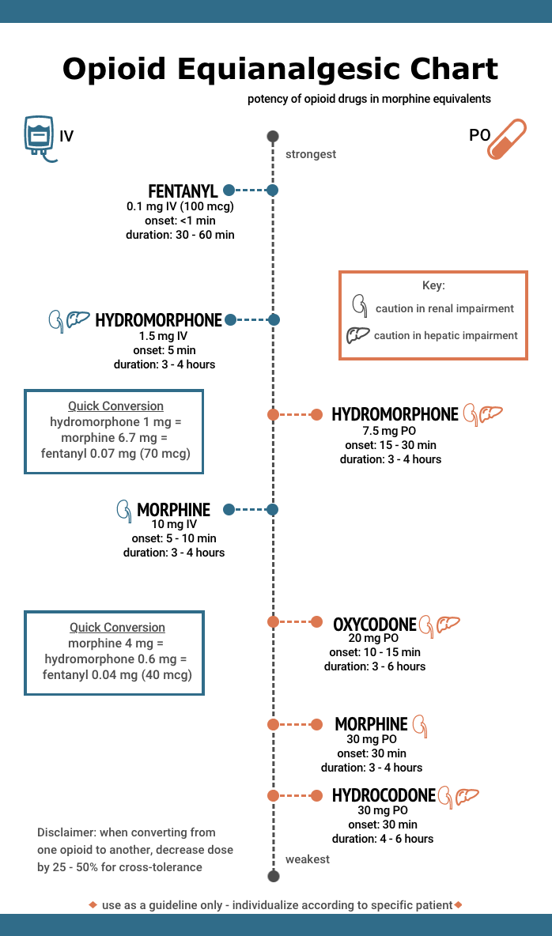
The Morphine Equivalents Chart
Includes:
equivalent dosing with common IV and PO opiate medications utilized in the ED
icons for hepatic and renal metabolism
quick conversions between medications
https://infogram.com/opioid-equinalgesic-1hnq418vgnxd63z?live
Notes:
This is a picture of the actual infographic that will be placed in various spots throughout the UCI emergency department physician room for reference. As you can see, the chart is split up vertically, with the pain medications that are offered as IV on the left and in blue, and the PO pain medications on the right in orange. The medications are ordered from top to bottom by the strongest to the weakest pain medications. There are also icons of both a kidney and liver that represent medications that are cautioned against in patients with renal or hepatic failure or impairment.
In this case, morphine milligram equivalents are determined with the dosage of 30 milligrams of PO morphine as the baseline. In other words, 30 mg of PO morphine is the reference to which other pain medications are compared. Under each opioid, the chart lists the dosage of each medication that is equivalent to 30 milligrams of PO morphine. For example, 0.1 mg of IV fentanyl is equal to 30 milligrams of PO morphine, and so on. The chart also details the onset and duration of action for each pain medication. Please note that there is a disclaimer at the bottom left of the chart that states, when converting from one opioid to another, decrease the dose by 25-50% to account for cross-tolerance, specifically in patients who have had long-term use of opioids.

Slide 7
OPIOID EQUIANALGESIC CHART (TABLE FORMAT)
Opioid | Oral (mg) | IV (mg)
Morphine | 30 (IR*) | 10
Hydrocodone | 30 | -
Oxycodone | 20 (IR*) | -
Hydromorphone | 7.5 | 1.5
Fentanyl | - | 0.1
*IR = immediate release
Notes:
This is a simplified chart to more clearly explain the same idea of morphine equivalents. At the top, you can see that 30 mg of PO morphine (immediate release) is equal to 10 mg of IV morphine. In the same way, you can extrapolate the chart and understand that 30 mg of PO morphine is equal to 30 mg of PO hydrocodone, and 7.5 mg of PO hydromorphone (Dilaudid) is equal to 20 mg of PO oxycodone.

Slide 8
QUICK MME GUIDE FOR COMMON ORAL (PO) OPIOIDS IN THE ED
Common PO Opioids | Total MME per single dose of 5-325 mg
Hydrocodone/Acetaminophen (Norco, Vicodin)* | 5
Oxycodone/Acetaminophen (Percocet)* | 7.5
*Norco and Percocet contain 325 mg acetaminophen per tablet, Vicodin contains 300 mg acetaminophen per tablet
Notes:
Earlier in the lecture, we discussed the concept of morphine milligram equivalents (MME). Hydrocodone and oxycodone with acetaminophen are common oral opioids used in the ED. This table here provides a quick reference for how much morphine equivalents per day a single dose of a 5-325mg tablet (a common x1 dose) would equal.

Slide 9
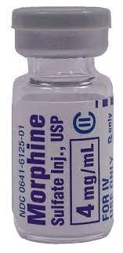
MORPHINE (IV)
Onset of Action: 5 - 10 mins
Duration of Action: 3 - 4 hrs
Metabolism: Hepatic glucuronidation to active metabolites (M6G and M3G)
Equianalgesic conversion:
10 mg (baseline)
Morphine is used as the baseline to which all other equivalents are converted
Note: caution in patients with renal impairment
Notes:
Moving on to some pharmacokinetic information for our opioids:
Morphine acts as our baseline standard for all opioid ratio-conversions. For example, 10mg of IV morphine serves as the typical equivalent dose to other parenteral opioid options such as hydromorphone or fentanyl, as shown in the chart earlier. It is commonly given orally or intravenously, although other routes can be used. With the IV form, the onset of action is generally around 5-10 minutes and lasts for 3-4 hours.

Slide 10
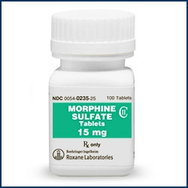
MORPHINE (PO)
Onset of Action: ~30 mins
Duration of Action: 3 - 6 hrs
Metabolism: Hepatic glucuronidation to active metabolites (M6G and M3G)
Equianalgesic conversion:
30 mg
Note: caution in patients with renal impairment
Notes:
With oral morphine, the onset of action is around 30 minutes with a duration of 3-6 hours. The typical equianlagesic conversion dose is 30 mg.
One of the key things to remember about morphine in regards to patient safety is that it should typically be avoided in patients with renal failure (not necessarily a contraindication though). Morphine is hepatically metabolized into two main active metabolites, morphine-3-glucuronide (M3G) and morphine-6-glucuronide (M6G) which are excreted in the urine. These metabolites can still exert a physiologic effect and even be more potent than the parent compound. Thus, with renal failure, these metabolites can accumulate in the body causing an increased sensitivity to morphine and increasing the risk of adverse effects such as respiratory depression.

Slide 11
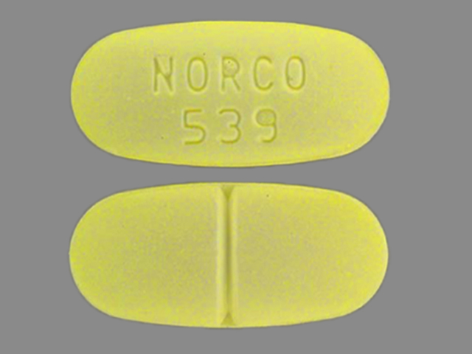
HYDROCODONE (PO)
Onset of Action: ~30 mins
Duration of Action: 4 - 6 hrs
Metabolism: Hepatic (via CYP2D6)
Equianalgesic conversion:
30 mg
Note: caution in patients with renal and hepatic impairment
Notes:
Hydrocodone is a commonly used oral opioid (typically in combination with acetaminophen). Its onset of action and duration is similar to oral morphine. The rough conversion between oral morphine and hydrocodone is about 1:1, seeing as 30 mg of oral morphine is equivalent to 30 mg of oral hydrocodone. As with other opioids, use with caution in patients with renal and hepatic impairment.

Slide 12
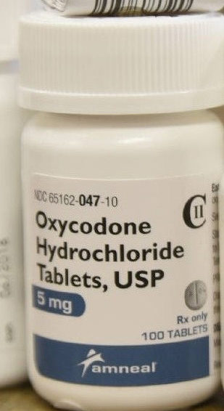
OXYCODONE (PO)
Onset of Action: 10 - 15 mins
Duration of Action: 3 - 6 hrs
Metabolism: Hepatic (via CYP3A4 and 2D6)
Equianalgesic conversion:
20 mg
Note: caution in patients with renal and hepatic impairment
Notes:
Oxycodone is another oral agent and has a slightly faster onset of action of 10-15 minutes compared to the other oral opioids. The duration of action is around 3-6 hours. It is hepatically metabolized so there are similar warnings with use in patients with some liver or renal impairment.

Slide 13
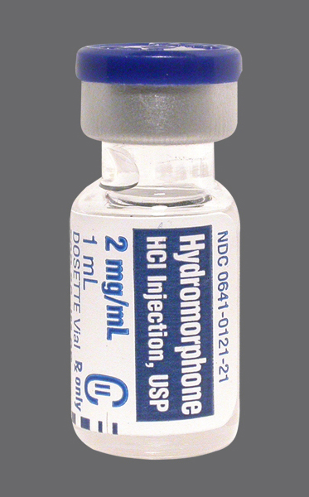
HYDROMORPHONE (IV)
Onset of Action: 10 - 15 mins
Duration of Action: 3 - 6 hrs
Metabolism: Hepatic via glucuronidation to active metabolite (H3G)
Equianalgesic conversion:
1.5 mg
Note: caution in patients with renal and hepatic impairment
Notes:
Hydromorphone comes in both intravenous and oral formulations. It has an onset of action of 10-15 minutes and can last 3-6 hours. It is hepatically metabolized to hydromorphone-3-glucuronide (H3G), which has no analgesic or sedative effects, but could potentially have some neuroexcitatory effects. However, accumulation of this metabolite hasn’t really shown any clinical significance as of yet so it can be relatively safe to use in patients with renal impairment. Ideally, one would just start at lower and less frequent dosing. The equivalent IV dose to IV morphine is 1.5 mg.

Slide 14
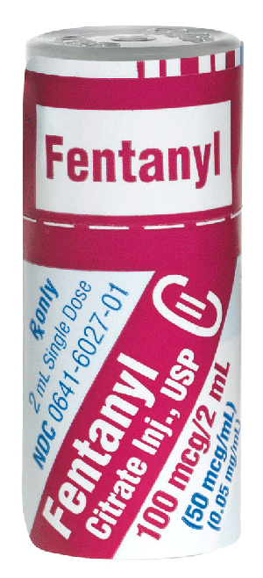
FENTANYL (IV)
Onset of Action: < 1 min
Duration of Action:
30 - 60 mins
Metabolism: Hepatic (via CYP3A4)
Equianalgesic conversion:
0.1 mg (100 mcg)
Note: safe for patients with renal and hepatic impairment
Notes:
The final opioid mentioned today is IV fentanyl. The onset of action is very rapid, usually under a minute. The duration is between 30-60 minutes. It is hepatically metabolized, but the metabolite is both inactive and non-toxic. Thus, this may be a good option if opioids are needed in a patient with liver or kidney failure. The equivalent dose to IV morphine is 0.1mg, or 100 mcg. Fentanyl is typically dosed in “mcg” so be very cognizant of the units when ordering this medication due to potential risks to patient safety.

Slide 15

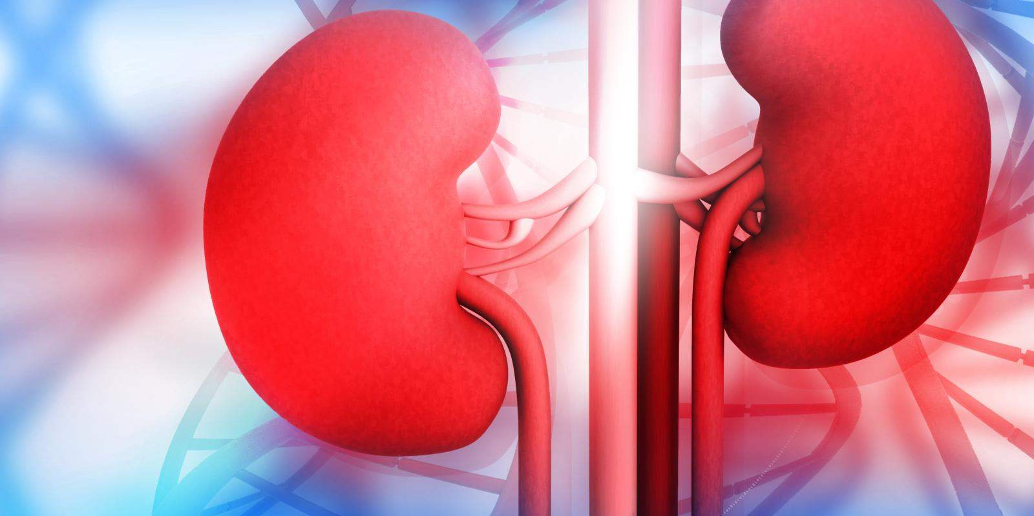
PATIENTS WITH RENAL OR
HEPATIC INSUFFICIENCY
Typically select IV fentanyl or hydromorphone
Risk of accumulation of morphine active metabolites in insufficiency
Notes:
There are some recommendations when treating patients with liver failure or insufficiency. Keep in mind, the safer opioid medication options for pain control in patients with hepatic insufficiency are IV fentanyl or hydromorphone. This is because there is a high risk of accumulation of morphine in patients with liver & renal insufficiency because the parent compound and metabolites cannot be metabolized or cleared at a normal rate, increasing risk of toxicity.
://www.ncbi.nlm.nih.gov/pmc/articles/PMC2704133/

Slide 16
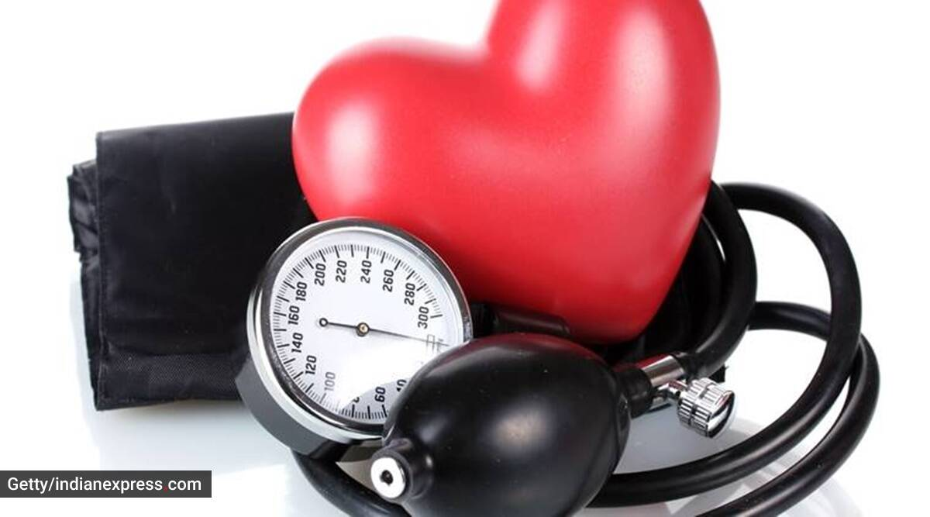
PATIENTS WITH
HEMODYNAMIC INSTABILITY
Shorter-acting agents such as fentanyl are preferred
Morphine also causes more histamine release which could exacerbate hypotension
Notes:
In the same way that there are preferred medications for those with hepatic insufficiency, there are also specific opioid medications that are preferred over others for patients exhibiting hemodynamic instability. Particularly, shorter-acting agents such as fentanyl are preferred. Also note that morphine actually provokes histamine release, which could exacerbate a patient’s hypotension.

Slide 17
CONSIDERATIONS TO KEEP IN MIND
Use the lowest possible effective dosage
Decrease dosages by 25 - 50%* of the calculated MME when converting between different opioids in chronic opioid users to account for cross-tolerance
Keep in mind patient age, condition, history, and clinical situation
CDC Calculating Total Daily Dose of Opioids For Safer Dosage
*As recommended by the American Academy of Family Physicians
Notes:
When opioids are used, the lowest possible effective dosage should be prescribed to reduce risks of opioid use disorder and overdose.
However, keep in mind that when you are converting between opioid prescriptions in chronic opioid users, the dosage of the new opioid should be decreased by 25 - 50%* of the calculated morphine milligram equivalents of the current opioid regimen to avoid unintentional overdose caused by incomplete cross-tolerance and individual differences in opioid pharmacokinetics.
Also make sure to always keep in mind the big picture when treating patients with opioid medications. Take into account a patient’s age, presenting condition or chief complaint, full history, and clinical situation when prescribing opioids.
https://www.cdc.gov/drugoverdose/pdf/calculating_total_daily_dose-a.pdf

Slide 18
APPLICATION OF
THE MORPHINE EQUIVALENTS CHART
An 80 kg cancer patient with pain is taking oxycodone extended release (Oxycontin ER) 20 mg PO BID. What would be the equivalent daily dose of morphine PO immediate release?
Equivalents: 20 mg oxycodone PO = 30 mg morphine PO
40 mg oxycodone PO
X mg morphine PO
20 mg oxycodone PO
30 mg morphine PO
=
60 mg morphine PO daily, split up between 4 doses
*don’t forget to decrease by 25-50% if patient is a chronic opioid user
Notes:
Here is an example question that shows how to use the method of morphine milligram equivalents to convert between medications, specifically oxycodone and morphine.
The case is as follows: An 80 kg cancer patient is taking 20 mg of oxycodone ER (Oxycontin) twice a day. If you were to convert this dosage to oral morphine immediate release, what is the equivalent daily dose that you would need to give to your patient to achieve the same amount of pain relief?
With the chart, you would be able to determine that 20 mg of oral oxycodone is equivalent to 30 mg of oral morphine.
In that case, next you would format your equation in the same way that is done on the screen, with the patient’s dosage of oxycodone as the numerator, over x amount of morphine and set that equal to the equivalent dosages of the medications. When you solve for X, you will see that 20x = 1,200, so X = 60 milligrams of oral morphine. Also note (as is also delineated on the infographic), when you convert between one opioid and another, remember to decrease the equivalent dosage by 25-50% to account for cross-tolerance if the patient is a chronic opioid user.

Slide 19
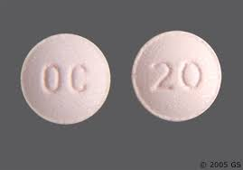
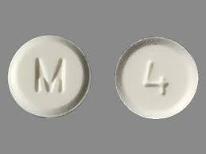
CALCULATING TOTAL DAILY DOSE OF OPIOIDS
The morphine equivalents chart can also be used to help calculate the total dosage of opioids a patient is taking per day.
Example: the previously mentioned cancer patient is on oxycodone ER (Oxycontin) 20 mg PO BID, and hydromorphone (Dilaudid) 4 mg PO q4-6 hours PRN for breakthrough pain. He reports taking 3 Dilaudid tablets a day.
To calculate this patient’s daily dose of opioids, convert both oxycodone and hydromorphone to their respective oral MMEs and add them together.
Notes:
Not only can you use the morphine equivalents chart to convert between various opioids, but you can also calculate a patient’s total daily dose of opioids. This method was adapted from the CDC handout for calculating total daily dose of opioids for safer dosage.
For instance, let’s consider the cancer patient mentioned in the previous slide, but now he’s taking both Oxycontin 20 mg PO BID and Dilaudid 4 mg PO q4-6 hours as needed for breakthrough pain. He states to you that he usually takes 3 tablets of Dilaudid PRN a day to help control his pain.
To calculate his total daily dose of opioids, convert both total doses of oxycodone and hydromorphone to oral MMEs and add them together.

Slide 20
CALCULATING TOTAL DAILY DOSE OF OPIOIDS CONT.
The patient is taking 40 mg oxycodone ER PO and 12 mg Dilaudid PO total per day.
40 mg oxy PO 20 mg oxy PO 12 mg Dilaudid PO 7.5 mg Dilaudid PO
x¹ 30 mg morphine PO x² 30 mg morphine PO
x¹ = 60 mg morphine PO x² = 48 mg morphine PO
x¹ + x² = 60 + 48 = 108 mg morphine PO
The patient is taking a total of 108 MMEs daily for pain.
=
=
CDC Calculating Total Daily Dose of Opioids For Safer Dosage
Notes:
To do so, first determine the total amount of oxycodone and total amount of Dilaudid that the patient is taking. If he is taking 20 mg of oxycodone BID, that comes out to a total of 40 mg oxycodone. Additionally, because he reports taking 3 tablets of Dilaudid 4 mg as needed for breakthrough pain, he takes a total of 12 mg Dilaudid PO per day.
You can then convert both those doses to morphine milligram equivalents. You can refer to the infographic to find the conversion rates.
The conversion rate for oxycodone is 20 mg oxycodone PO to 30 mg morphine PO. By solving for x¹, you find that 40 mg oxycodone PO equates to 60 mg of oral morphine.
The conversion rate for oral Dilaudid is 7.5 mg Dilaudid PO to 30 mg morphine PO. By solving for x², you find that 12 mg Dilaudid PO equates to 48 mg of oral morphine.
You would then sum x¹ and x² and find that the patient is taking a total dose of 108 morphine milligram equivalents daily for pain.

Slide 21
CALCULATING TOTAL DAILY DOSE OF OPIOIDS CONT.
However, keep in mind that the 60 MME taken through oxycodone is split between two extended release doses, and 48 MME is split between 3 Dilaudid doses.
He is not taking 108 MME at once for pain.
In conclusion, the patient is taking 30 MME BID through his Oxycontin regimen, plus an additional 16 MME PRN (3 times a day) through Dilaudid for breakthrough pain.
Notes:
Please note that the patient is not taking 108 morphine milligram equivalents at once for pain control. He is taking 30 equivalents each time he takes his Oxycontin, and 16 equivalents each time he takes his Dilaudid as needed.
In conclusion, the patient is taking 30 morphine milligram equivalents twice a day through his Oxycontin regimen, plus an additional 16 morphine milligram equivalents, three times a day, through his Dilaudid prescription to address his breakthrough pain.

Slide 22
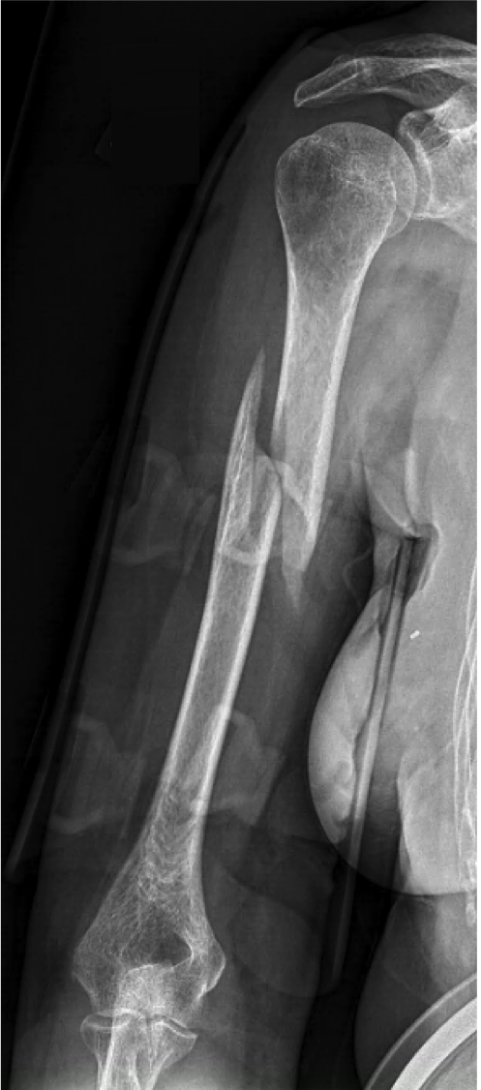
TREATMENT IN THE EMERGENCY DEPARTMENT
In the previous slide, the patient was on chronic oxycodone ER 20 mg BID and 3 tablets of Dilaudid 4mg PO, for a total of
108 MMEs per day.
Questions:
If that same patient visited the emergency room with new arm pain after falling and breaking his humerus (non-operative), how would you go about treating his pain?
What initial dose do you give him for pain control?
Notes:
Now, we can apply the infographic information and conversion techniques that we’ve learned to a real-world clinical scenario in the emergency department.
Keep in mind, the patient was on a chronic opioid regimen that amounted to 108 morphine milligram equivalents per day.
If that same patient came to see you in the emergency room, complaining of new right arm pain after falling and breaking his humerus (a non-operative fracture), how would you go about treating his pain?
Consider, what initial dose do you give him for pain control?

Slide 23
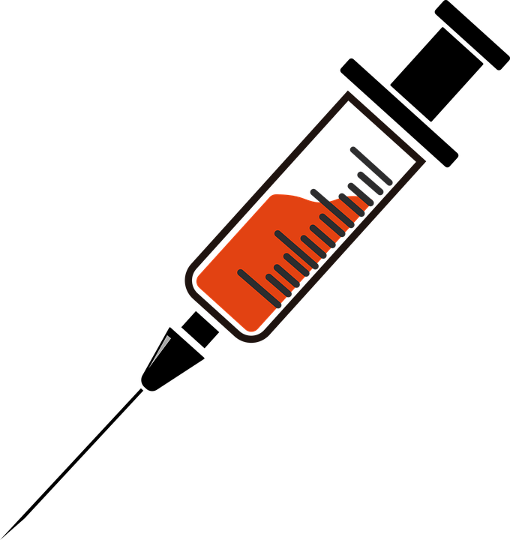

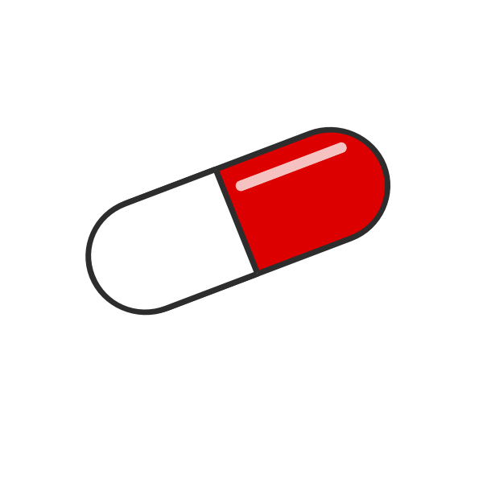
TREATMENT IN THE EMERGENCY DEPARTMENT
There are three options to consider when dosing acute pain in an opioid-tolerant patient:
Convert home PO regimen to IV regimen → give a one-time IV PRN dose and monitor
Continue home PO regimen and add an IV option
Increase the dosage of home PO regimen (15 mg instead of 10 mg)
Notes:
There are three different routes that you can choose to take when addressing acute pain in a patient who is opioid-tolerant.
The first option is to convert the patient’s home oral regimen to an IV dose, then give a one-time IV dose as needed and monitor the patient’s response.
The second option would be to continue the patient on his/her home oral regimen and add an IV option as necessary.
The last option is to increase the patient’s home oral dosage. For example, you could consider increasing to 15 mg of oxycodone if a patient was taking 10 mg at home.

Slide 24
TREATMENT IN THE EMERGENCY DEPARTMENT
Practice: Convert patient’s 108 MMEs home regimen to morphine IV or Dilaudid IV.
Equivalents: 30 mg morphine PO = 10 mg morphine IV
108 mg morphine PO
x mg morphine IV
30 mg morphine PO
10 mg morphine IV
=
36 mg morphine IV
Equivalents: 30 mg morphine PO = 1.5 mg Dilaudid IV
108 mg morphine PO
x mg Dilaudid IV
30 mg morphine PO
1.5 mg Dilaudid IV
=
5.4 mg Dilaudid IV
Notes:
So, for this patient with the humerus fracture, we previously calculated that he is on a total of 108 morphine milligram equivalents daily at home.
In the emergency department, we could consider transitioning him to an IV medication. In this slide, we show two examples of IV medications that you could consider and show how to convert the patient’s dosage to equivalent doses of IV morphine or IV Dilaudid.
As you can see on the slide, 30 mg of oral morphine is equal to 10 mg of IV morphine. So solving for that equation, we see that 108 mg of morphine PO is equal to 36 mg of morphine IV.
You can also consider using Dilaudid to treat the patient’s pain. 30 mg of oral morphine is equal to 1.5 mg of IV dilaudid, so 108 mg of morphine PO is equal to 5.4 mg of IV Dilaudid.

Slide 25
TREATMENT for OPIATE NAIVE PATIENTS
For opioid-naive patients in the ED, the recommended 1 time dose of IV morphine for pain control is 0.05-0.1 mg/kg.
80 kg patient x 0.05 mg/kg Morphine IV = 4 mg Morphine IV*
80 kg patient x 0.1 mg/kg Morphine IV = 8 mg Morphine IV*
*Usual repeat dosing is 4-8 mg Morphine IV q4-6 hours as needed for pain relief
Notes:
Note, for an opioid-naive patient in the ED, the recommended one-time dose of IV morphine used to address pain is 0.05-0.1 mg/kg.
Using that guideline, an 80 kg patient would be given between 4 mg and 8 mg of IV morphine q4-6 hours as needed for pain relief.

Slide 26
TREATMENT for OPIATE TOLERANT PATIENTS
However, the original patient is an opioid-tolerant. His at-home regimen is equivalent to 36 mg morphine IV or 5.4 mg Dilaudid IV.
36 mg morphine IV/4 doses= *9 mg Morphine IV per dose (q6)
5.4 mg Dilaudid IV/4 doses = *1.35 mg Dilaudid IV per dose (q6)
*Decrease by 25-50% (for chronic opiate users)
Therefore, you may consider a one-time dose of 8 mg morphine IV or 1 mg Dilaudid IV. These doses adjust for cross-tolerance in an opioid-tolerant patient. If your ED prefers to schedule doses, you can schedule as q4-6 instead of the one-time dose.
Notes:
However, this patient has a past medical history of cancer and therefore is a chronic opioid user, so you must consider tolerance. These patients will require more pain control.
As you can see on this slide, to determine a one time IV pain medication dose, you can take the dose of the new IV medication that is equivalent to the amount that the patient is taking at home and divide by 4. In this case, we are choosing to use either morphine IV or Dilaudid IV. Doing so results in a single dose of 9 mg morphine IV or 1.35 mg Dilaudid IV. Therefore, you can consider a one-time dose of 8 mg morphine IV or 1 mg Dilaudid IV to treat the patient’s pain. The doses have been decreased slightly in order to adjust for cross-tolerance in this chronic opioid user. After giving that single dose, you can monitor the patient’s pain and continue to titrate the medication accordingly. If your ED prefers to schedule doses, you can schedule as q4-6 instead of the one-time dose.

Slide 27


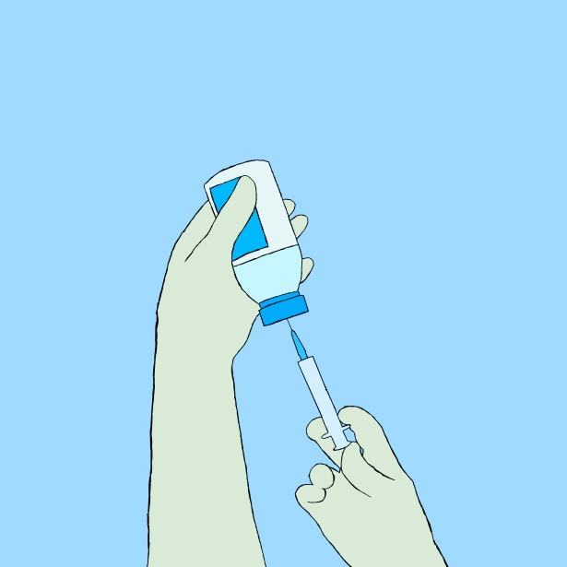
SINGLE DOSING OF OPIOIDS IN THE ED
and conversion to PO medication upon discharge
For patients experiencing pain…
Step 1: single dose of opioid
Step 2: reassess pain
Step 3: titrate subsequent doses as necessary
*first dose is dependent on institution and
whether patient is opioid-naive or opioid-tolerant
Notes:
In general, if a patient is experiencing pain, providers will often give a single dose of opioids in the ED, reassess the patient for pain relief, and titrate subsequent doses as necessary. The first dose is dependent on the institution and whether the patient is opioid-naive or opioid-tolerant.
The morphine equianalgesic chart can be used to convert to an appropriate dose of oral pain medication when a patient is being discharged. In chronic opioid users, total MME can be calculated and the home regimen may be adjusted.

Slide 28
SUGGESTED INITIAL OPIOID DOSES IN THE ED FOR ACUTE PAIN*
Opioid-Naive | Medication | Opioid Tolerant**
0.05 - 0.1 mg/kg IV x 1, Typically repeat q4h prn | IV morphine | 0.1 - 0.2 mg/kg IV x 1, Typically repeat q4h prn
0.0075 - 0.015 mg/kg IV x 1 Typically repeat q2-4h prn | IV hydromorphone | 0.0225 - 0.03 mg/kg IV x 1 Typically repeat q2-4h prn
0.5 - 1 mcg/kg IV x 1 Typically repeat q30 - 60 min | IV fentanyl | 1.5 - 2 mcg/kg IV x 1 Typically repeat q30 - 60 min
15 mg PO x 1 Typically repeat q4h prn | PO morphine IR | 30 - 60 mg PO x 1 Typically repeat q4h prn
10 mg PO x 1 Typically repeat q4h prn | PO oxycodone IR | 30 mg PO x 1 Typically repeat q4h prn
5-325 mg PO x 1 Typically repeat q4h prn | PO hydrocodone/acetaminophen | 10-325 mg PO x 1 Typically repeat q4h prn
* Doses may vary based on patient’s clinical situation and on institution practice
**FDA defines opioid tolerant as someone who has been taking for >1 week on a daily basis: 60 mg oral morphine, 30 mg oral oxycodone, 8 mg oral hydromorphone or an equianalgesic dose of another oral opioid
Notes:
This table shows some initial opioid doses for acute pain treatment and administration frequencies for a standard adult patient. It is split into two columns: opioid naive versus opioid tolerant. Please note that these doses merely act as suggestions and do not preclude clinical judgment nor institution practice. To define opioid tolerant, we used the FDA definition of a patient who has been taking at least 60 mg oral morphine, 30 mg of oral oxycodone, 8 mg of oral hydromorphone or an equianalgesic dose of another oral opioid on a daily basis for more than 1 week.

Slide 29


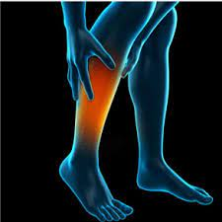
CLINICAL SCENARIO #1
A 54-year-old man is brought in by EMS as a trauma following a motor vehicle accident. Past medical history is significant for a gunshot wound to his right leg thirty years ago, for which he takes oxycodone daily. After administration of 100 mcg of fentanyl, the patient states that he has had no pain relief. What medication should be used to help control his pain, and at what dosage?
Notes:
Let’s go over a few more clinical scenarios. In this first scenario, a 54-year-old man is brought in by EMS as a trauma following a motor vehicle accident. Past medical history is significant for a gunshot wound to his right leg thirty years ago, for which he takes oxycodone daily. After administration of 100 mcg of fentanyl, the patient states that he has had no pain relief. What medication should be used to help control his pain, and at what dosage?

Slide 30
CLINICAL SCENARIO #1
In this case, the MME chart would be helpful in converting the 100 mcg dose of fentanyl to an equivalent dose of another opioid medication such as Dilaudid.
0.1 mg fentanyl IV 0.1 mg fentanyl IV
x 1.5 mg Dilaudid IV
x = 1.5 mg Dilaudid IV
In conclusion, you could consider giving the patient either another dose of 100 mcg of IV fentanyl and monitor response, or you could escalate to an equivalent dose of 1.5 mg IV Dilaudid and monitor his response. Using your clinical judgment, you would titrate dosage based on patient relief, then sum up the total MME needed to control his pain and create a chronic pain regimen for the patient upon discharge.
=
Notes:
Consider that the patient’s pain was not relieved at all by the 100 mcg of fentanyl. In this case, you could use the morphine milligram equivalents chart and choose a different opioid medication to test out whether a switch in medication could help address his pain. According to the infographic, 0.1 mg of fentanyl IV is equivalent to 1.5 mg of Dilaudid IV.
When you convert 100 mcg of fentanyl IV to Dilaudid IV, you find that the equivalent dose is 1.5 mg of Dilaudid IV.
In that case, you could try giving the patient the equivalent dosage of 1.5 mg of Dilaudid IV and monitor his response. Clinically, you could also consider repeating the same dose of 100 mcg of IV fentanyl and monitor his response. Throughout the patient’s ED stay, you will continue to judge his clinical response, and titrate dosage based on patient relief.
Upon discharge, you can then sum up the total morphine milligram equivalents needed to control his pain and create a chronic pain regimen for him.

Slide 31

CLINICAL SCENARIO #2
A 47-year-old woman comes to the ED for abdominal pain. You give her one dose of 4 mg IV morphine for pain. When you reassess her, she continues to complain of 10/10 pain and is asking for stronger medication. You decide to give her a dose of Dilaudid. What dose of Dilaudid must you exceed in order to achieve better pain relief, if 4 mg IV morphine did not alleviate her pain?
Notes:
The second clinical scenario is as follows: A 47-year-old woman comes to the ED for abdominal pain. You give her one dose of 4 mg IV morphine for pain. When you reassess her, she continues to complain of 10/10 pain and is asking for stronger medication. You decide to give her a dose of dilaudid. What dose of dilaudid must you exceed in order to achieve better pain relief, if 4 mg IV morphine did not alleviate her pain?

Slide 32
CLINICAL SCENARIO #2
To calculate the dose of Dilaudid you must exceed to achieve better pain relief, first calculate the equivalent dosage of 4 mg IV morphine to Dilaudid.
4 mg morphine IV 10 mg morphine IV
x 1.5 mg Dilaudid IV
x = 0.6 mg Dilaudid IV
You must exceed 0.6 mg of Dilaudid IV in order to achieve better pain relief.
=
Notes:
The first step would be to calculate the equivalent dosage of 4 mg of morphine IV to Dilaudid IV. According to the infographic, 10 mg of morphine IV is equivalent to 1.5 mg of Dilaudid IV. Therefore, x equals 0.6 mg of Dilaudid IV. So, you must exceed 0.6 mg of Dilaudid IV when providing the patient with a stronger medication in order to achieve better pain relief.

Slide 33
SURVEY
Residents, please fill out this survey one more time, this time with the help of the chart.
https://forms.gle/rhx7Zuwu9vwQGmiv7
Should only take about 5 minutes.
Thank you for your attention!
Notes:
Thank you for your time and attention!

