Slide 1
Supplement Figure 1

Slide 2
Supplement Figure 2

Slide 3
Supplement Figure 3

Slide 4
Supplement Figure 4

Slide 5
Supplement Figure 5

Slide 6
Supplement Figure 6

Slide 7
Supplement Figure 7

Slide 8
Supplement Figure 8

Slide 9
Supplement Figure 9

Slide 10
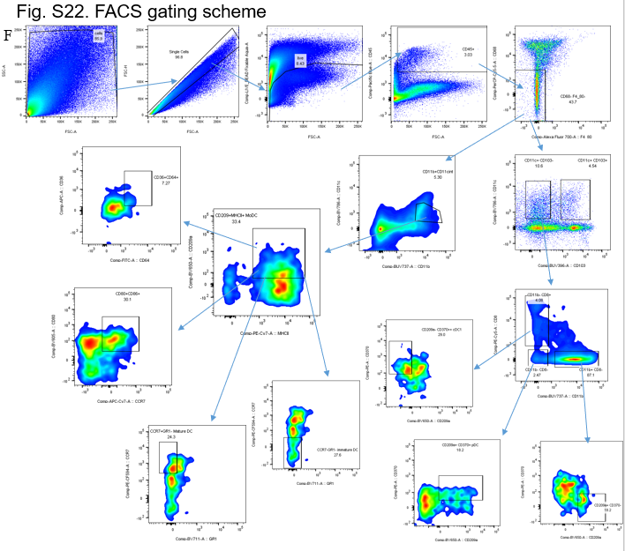
Supplement Figure 10

Slide 11
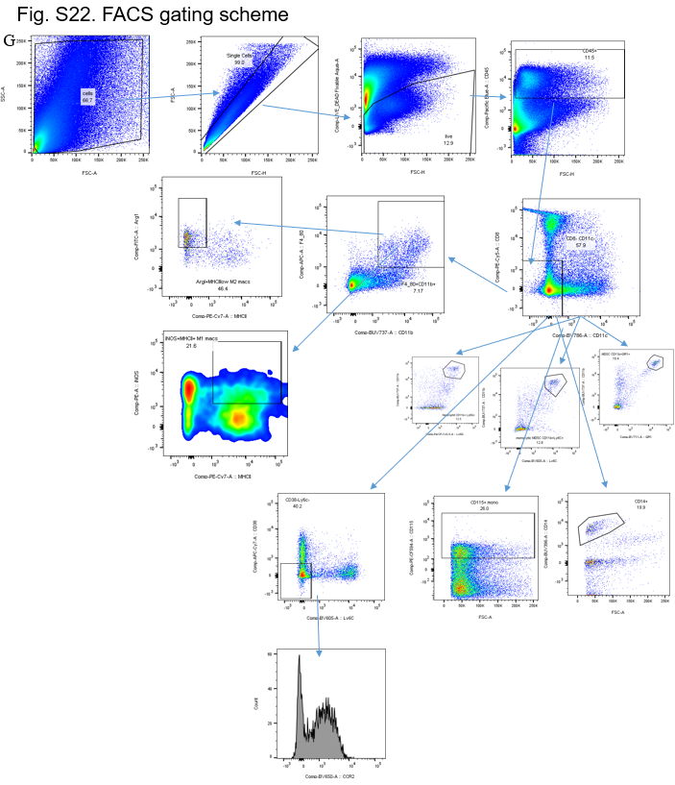
Supplement Figure 10

