Slide 1
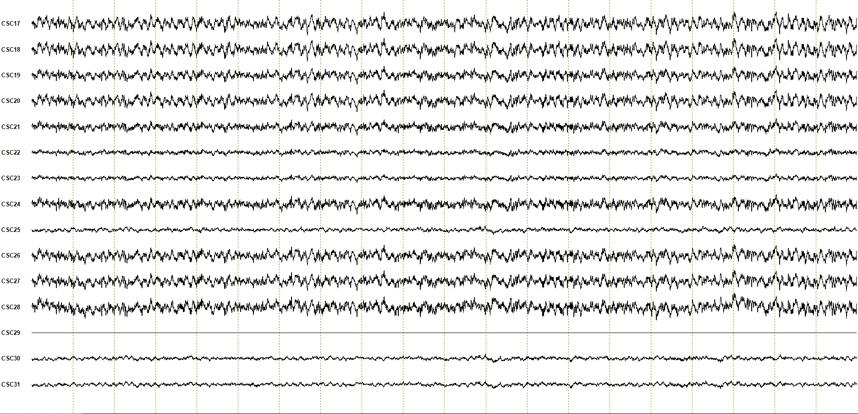
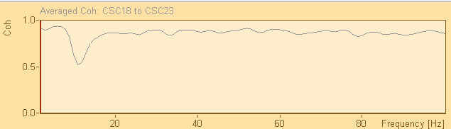
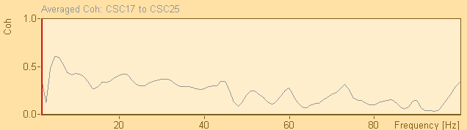
Hippocampus Electrodes
1
2
3
4
5
6
7
8
9
10
11
12
1
2
3
4
5
6
7
8
9
10
11
12
Hippocampal electrodes 1-10 coherence
X
X
X
Hippocampal electrodes 6-10 coherence
Medial Septum Electrodes
1
2
Suppl. Fig. 1B

