Slide 1
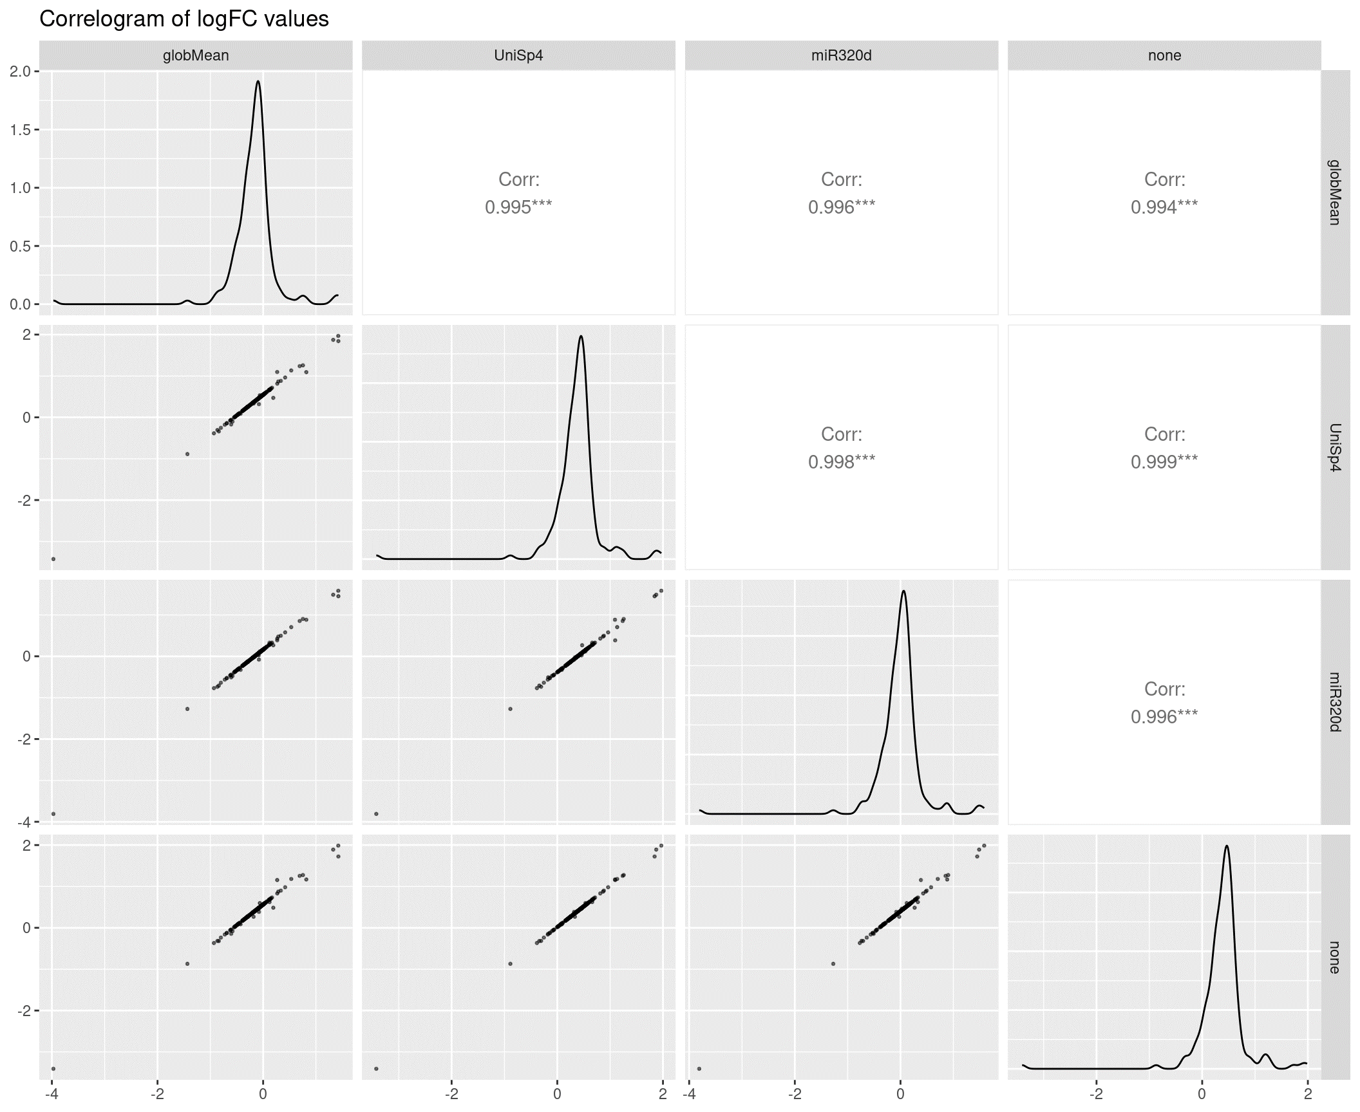
Suppl Figure 3: Normalization
A
B
 | Spike-In |  | GM |  | miR-320d
miRNA Candidate | logFC | p-value | logFC | p-value | logFC | p-value
hsa-miR-101-3p | 0.96 | 0.01 | 0.42 | 0.03 | 0.58 | 0.00
hsa-miR-135a-5p | 1.13 | 0.01 | 0.53 | 0.13 | 0.71 | 0.07
hsa-miR-143-3p | 0.66 | 0.01 | 0.11 | 0.59 | 0.28 | 0.34
hsa-miR-223-3p | 0.57 | 0.01 | 0.03 | 0.84 | 0.19 | 0.36
hsa-miR-410-3p | 1.87 | 0.01 | 1.33 | 0.08 | 1.49 | 0.05
hsa-miR-495-3p | -3.43 | 0.01 | -3.97 | 0.00 | -3.81 | 0.00
A) The log2 fold changes (LFCs) obtained prior to normalization (none), as well as after spike-in (UniSp4), global mean (globMean), and endogenous reference miRNA (miR-320d) normalization were correlated and distribution was analyzed.
B) The top six miRNAs according to spike-in normalization are compared to GM and miR-320d in terms of logFC and p-value. Bold indicates p<0.1.

