Slide 1
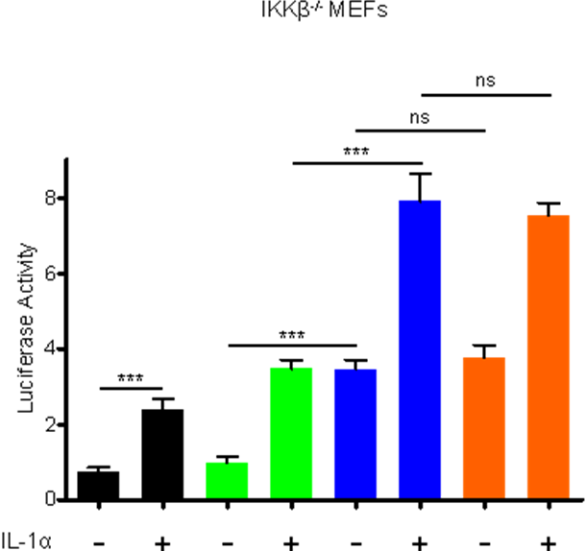
Supplementary Figure 2

