Slide 1
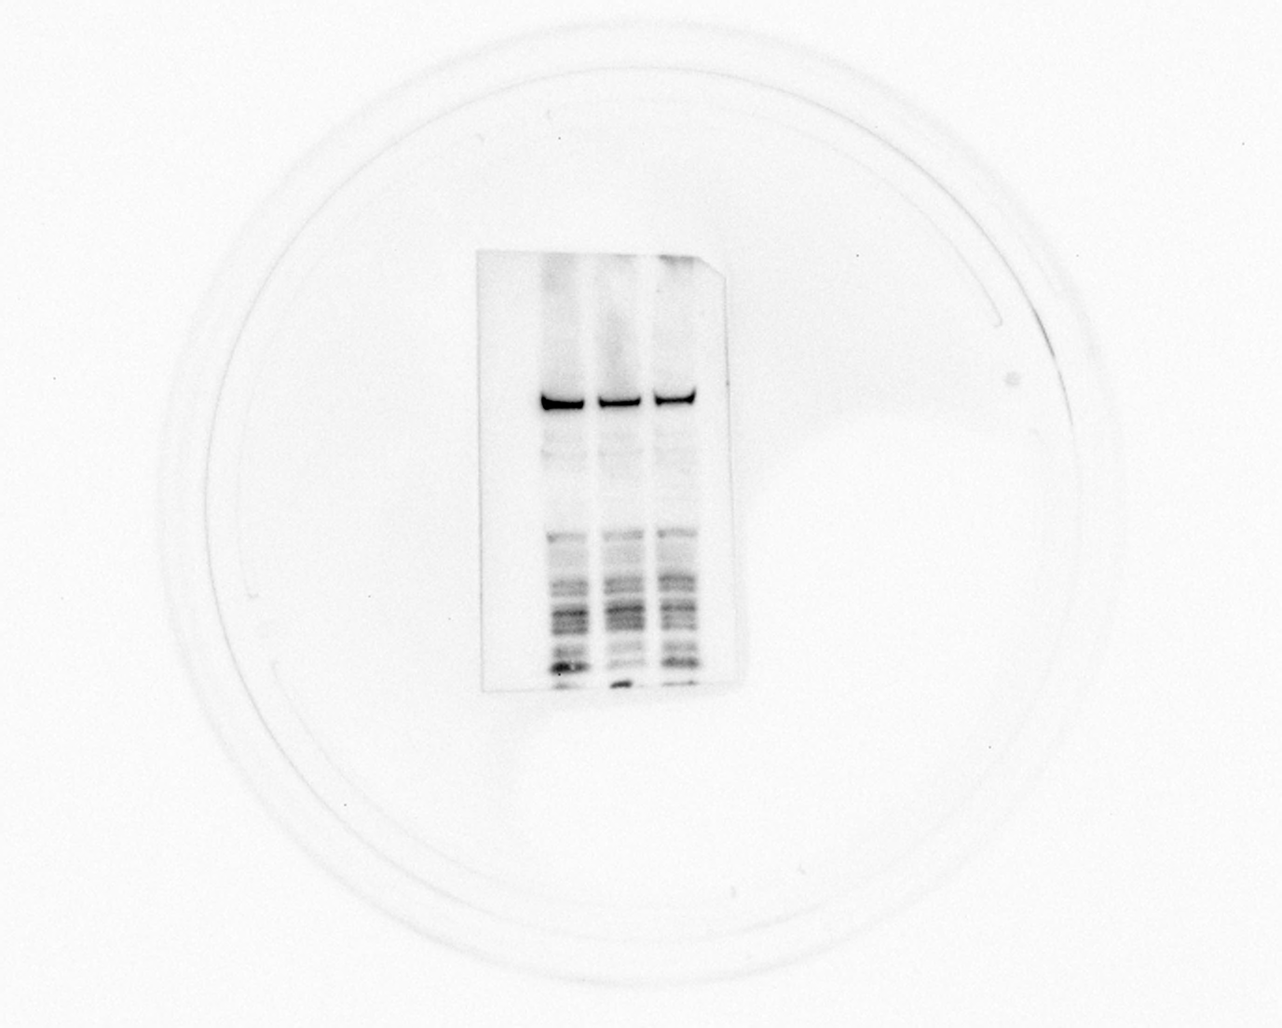
Figure 4C
MMP1

Slide 2
Figure 4C
B-Actin

Slide 3
Figure 4C
MMP1

Slide 4
Figure 4C
B-Actin

Slide 5
Figure 4C
MMP1

Slide 6
Figure 4C
B-Actin

Slide 7
Figure 4C
MMP1

Slide 8
Figure 4C
B-Actin

