Slide 1
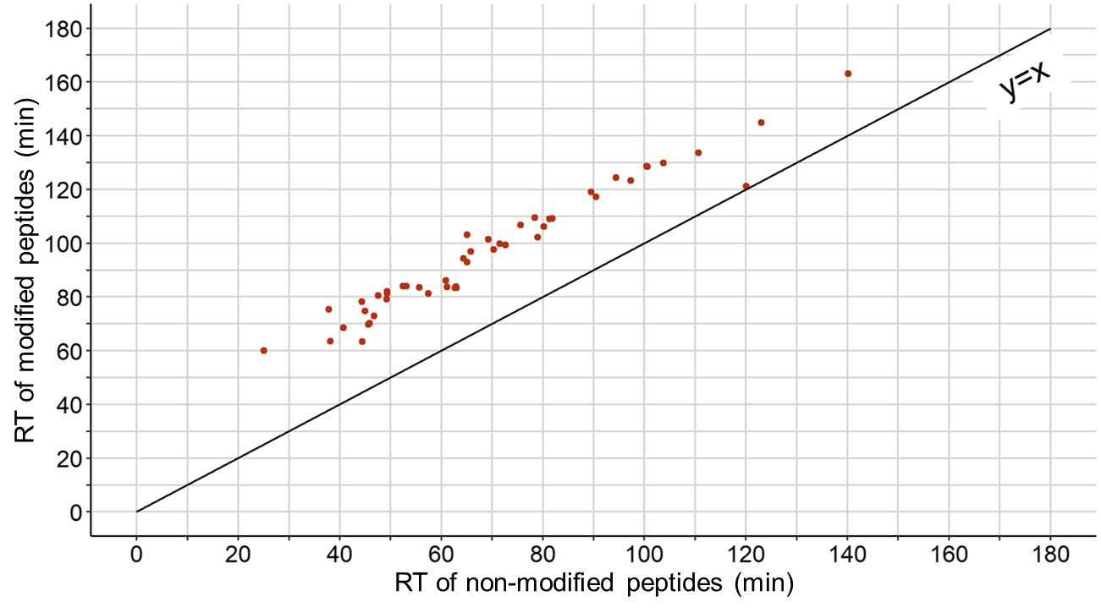
Supplementary Figure S1A
A. Malonyl and non-malonyl peptide pairs

Slide 2
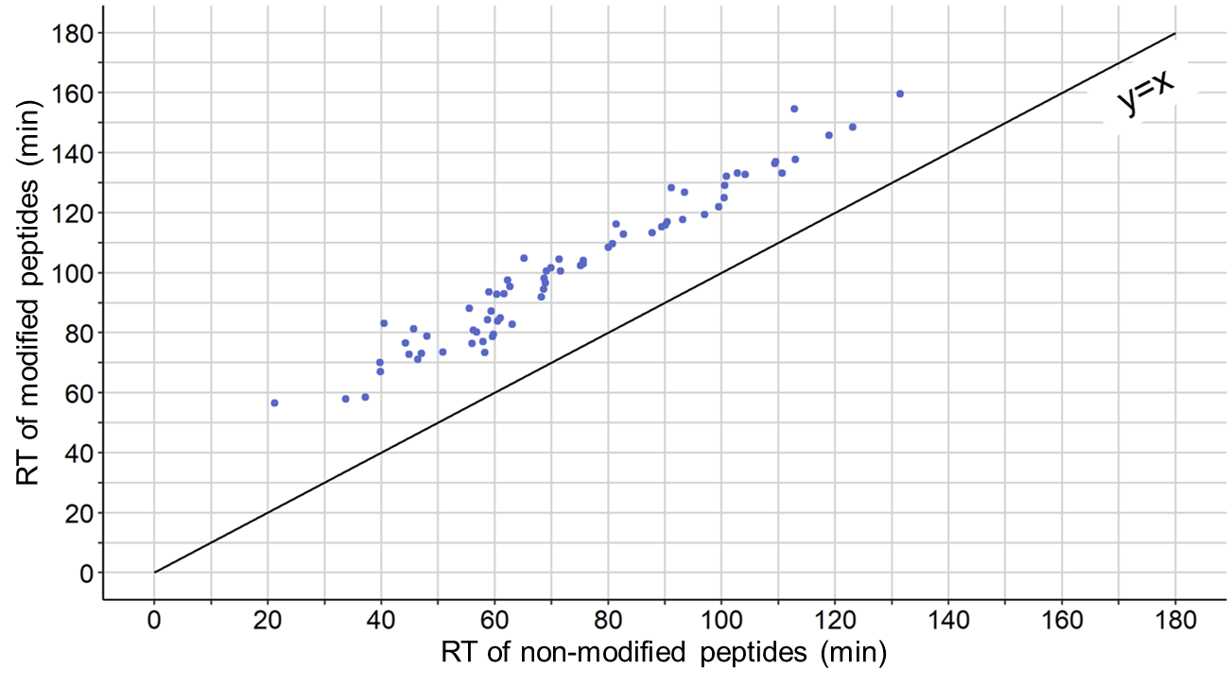
Supplementary Figure S1B
B. Succinyl and non-succinyl peptide pairs

Slide 3
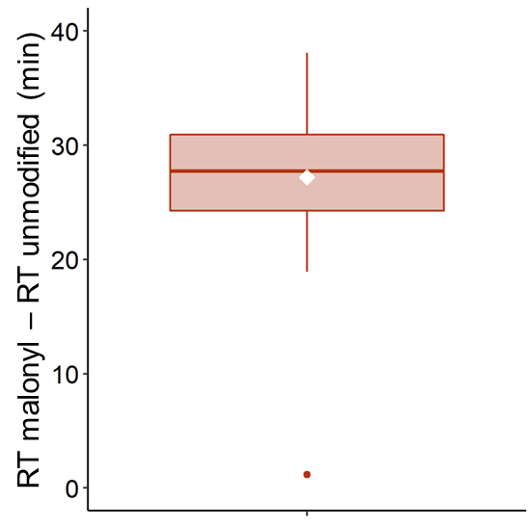
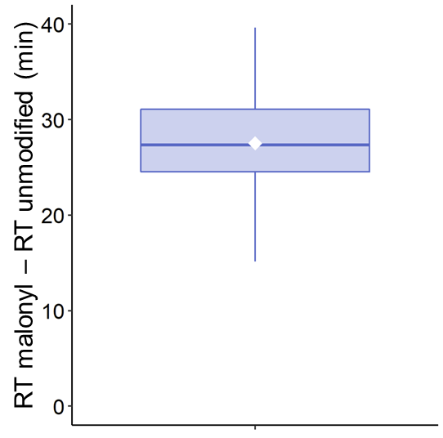
Supplementary Figure S1 C-D
C. Difference of RT between malonyl and non-malonyl pairs
D. Difference of RT between succinyl and non-succinyl pairs
RT (malonyl) – RT (unmodified)
RT (succinyl) – RT (unmodified)

Slide 4
Supplementary Figure S1. Effect of acylation modification on peptide retention time. To assess the difference in retention time between acylated peptides and their non-acylated counterparts, and to limit technical and computational variabilities, peptide sequences, for which both modified and non-modified forms were quantified in the same enrichment datasets, were selected. This revealed 69 pairs for the succinyl dataset and 48 pairs for the malonyl dataset. (A-B) Comparison of retention time obtained for the malonylated (A) and succinylated (B) peptides and their non-modified counterparts. The regression y = x is plotted, highlighting that the more hydrophobic acylated peptides eluted later that the non-acylated forms. (C-D) Boxplots showing the difference of retention time for the malonylated and non-malonylated pairs (C), as well as for the succinylated and non-succinylated pairs (D). The white diamond corresponds to the average value, which equaled 27 min for malonyl and 28 min for succinyl.

