Slide 1
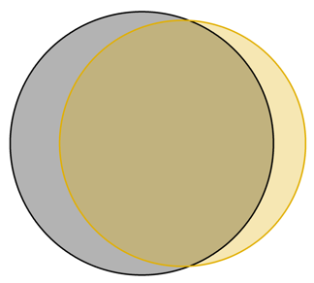
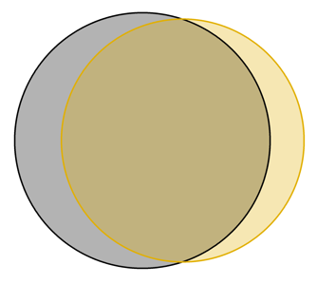
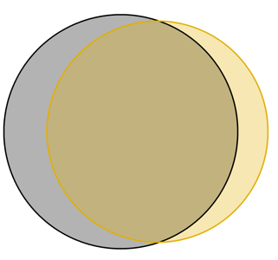
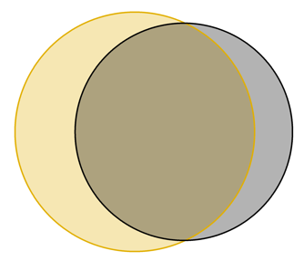
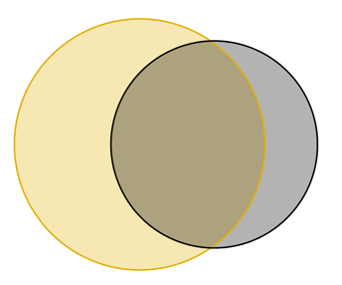
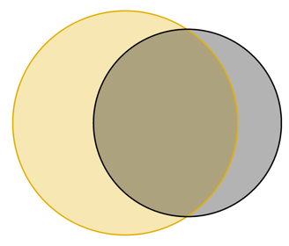
Supplementary Figure S2
A. All quantifiable succinylated protein groups
B. All quantifiable succinylated peptides
C. All quantifiable succinylated sites
DDA library
directDIA
DDA library
directDIA
DDA library
directDIA
166
477
84
603
1,846
365
521
1,569
298
D. SIRT5-regulated succinylated protein groups
E. SIRT5-regulated succinylated peptides
F. SIRT5-regulated succinylated sites
DDA library
directDIA
DDA library
directDIA
DDA library
directDIA
41
164
85
125
310
330
106
298
280

Slide 2
Supplementary Figure S2. Benchmarking of library-based vs library-free DIA-MS workflows for succinylome analysis. Succinyl DIA-MS data were searched against a sample-specific DDA succinyl library (black) or using a spectral library-free strategy (yellow). (A-C) Venn diagrams showing the overlap of all quantifiable succinylated protein groups (A), peptides (B), and sites (C) obtained using both strategies. (D-E) Venn diagrams showing the overlap of all succinylated protein groups (D), peptides (E), and sites (F) obtained using both strategies and that were significantly altered in SIRT5-KO vs WT mouse brains. The samples enriched for succinylated peptides were acquired in DDA mode on the same nanoLC-Orbitrap Eclipse platform, using the same chromatographic gradient as described in the Methods section. A DDA spectral library was generated in Spectronaut using the Pulsar search engine and default settings except that lysine succinylation was added as variable modifications and four missed cleavages were allowed. Finally, the succinyl DIA dataset was searched using this newly generated DDA library and the same FASTA file and settings as for the directDIA search. The differential expression analysis was performed similarly as described in the Methods section. This resulted in the quantification of 2,449 succinylated peptides, corresponding to 2,090 unique lysine succinylation sites, from 643 succinylated protein groups (Table S5). The SIRT5-KO vs WT comparison revealed that 435 succinylated peptides, corresponding to 404 unique lysine succinylation sites, from 205 succinylated protein groups were significantly altered (q-value < 0.05 and absolute Log₂(SIRT5-KO vs WT) > 0.58). Both DDA library-based and library-free searches showed a high overlap of protein groups, peptides, and sites that were quantified and significantly altered. More precisely, the DDA library-based search resulted in slightly higher numbers of quantified succinylated protein groups (82 more), peptides (238 more), and sites (223 more). However, with respect to the SIRT5-KO vs WT comparison, the directDIA search leaded to slightly more significantly altered protein groups (44 more), peptides (205 more), and sites (174 more). In addition, the SIRT5-KO vs WT fold-change values of the 310 common significantly altered succinylated peptides obtained with the library-free directDIA workflow on the one hand and the DDA library-based workflow on the other hand were compared. This comparison of directDIA (SIRT5-KO vs WT) vs DDA library-based (SIRT5-KO vs WT) showed a median ratio value of 1.14. Altogether, the results demonstrated that both DDA library-based and library-free directDIA strategies lead to similar identification performances, although more discrepancy is observed regarding quantification. This can reveal that library-based workflows can still be more efficient, more particularly for low abundant modified peptides, as demonstrated for phosphorylated peptides (Bekker-Jensen et al., 2020, Nat Commun, 11(1), 787). However, directDIA circumvents the need to generate a spectral library, making this strategy easier to implement and featuring its sample preservation and time efficiency attributes.

