Slide 1
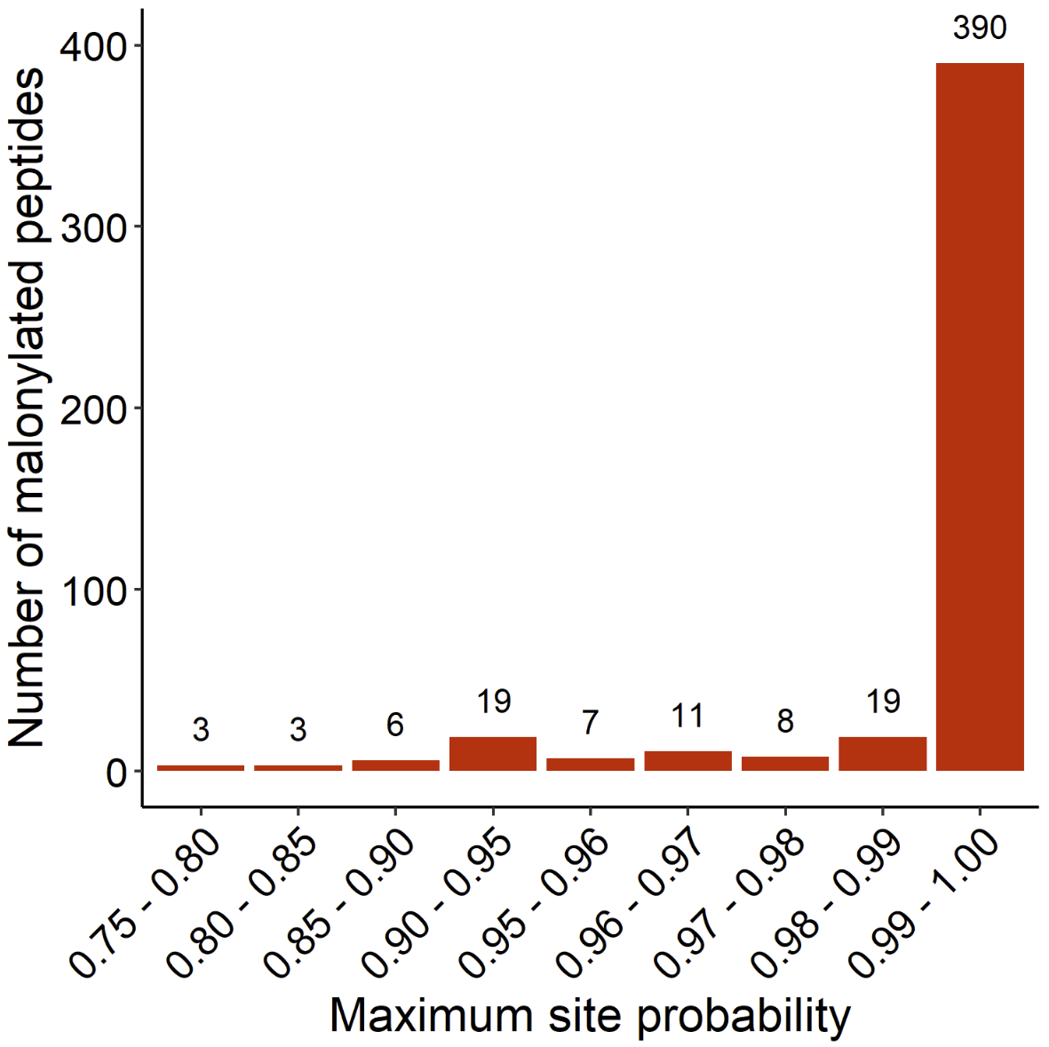
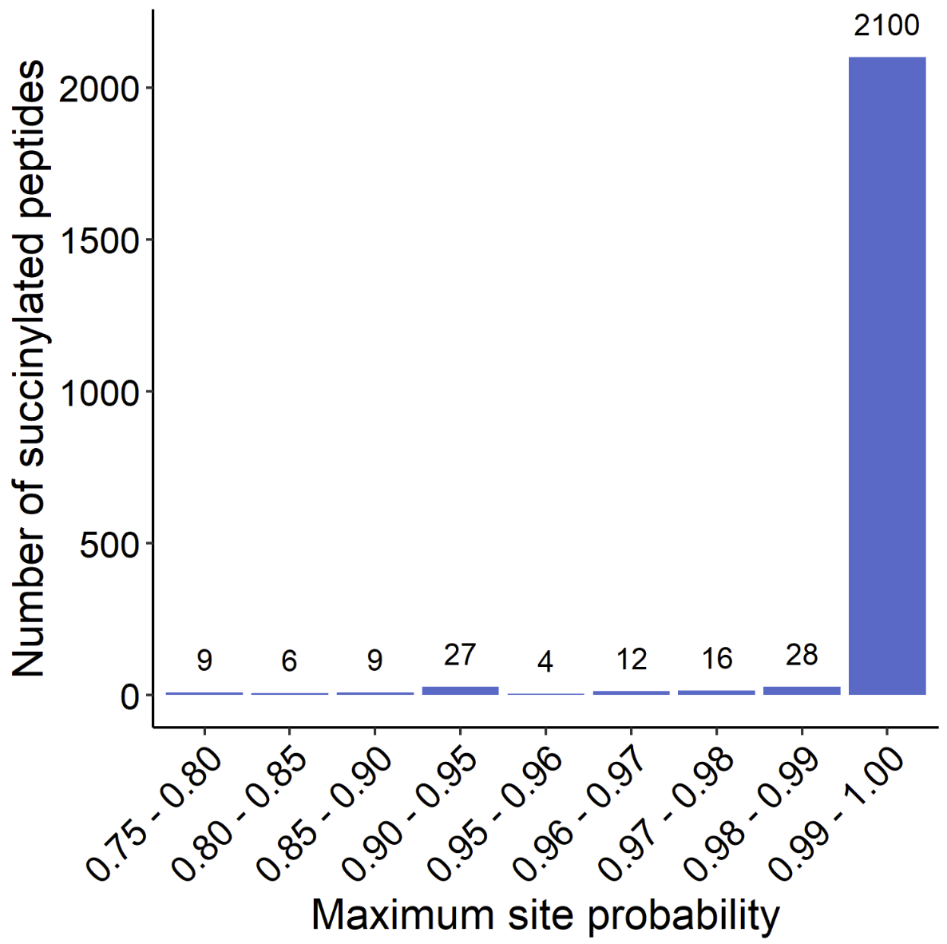
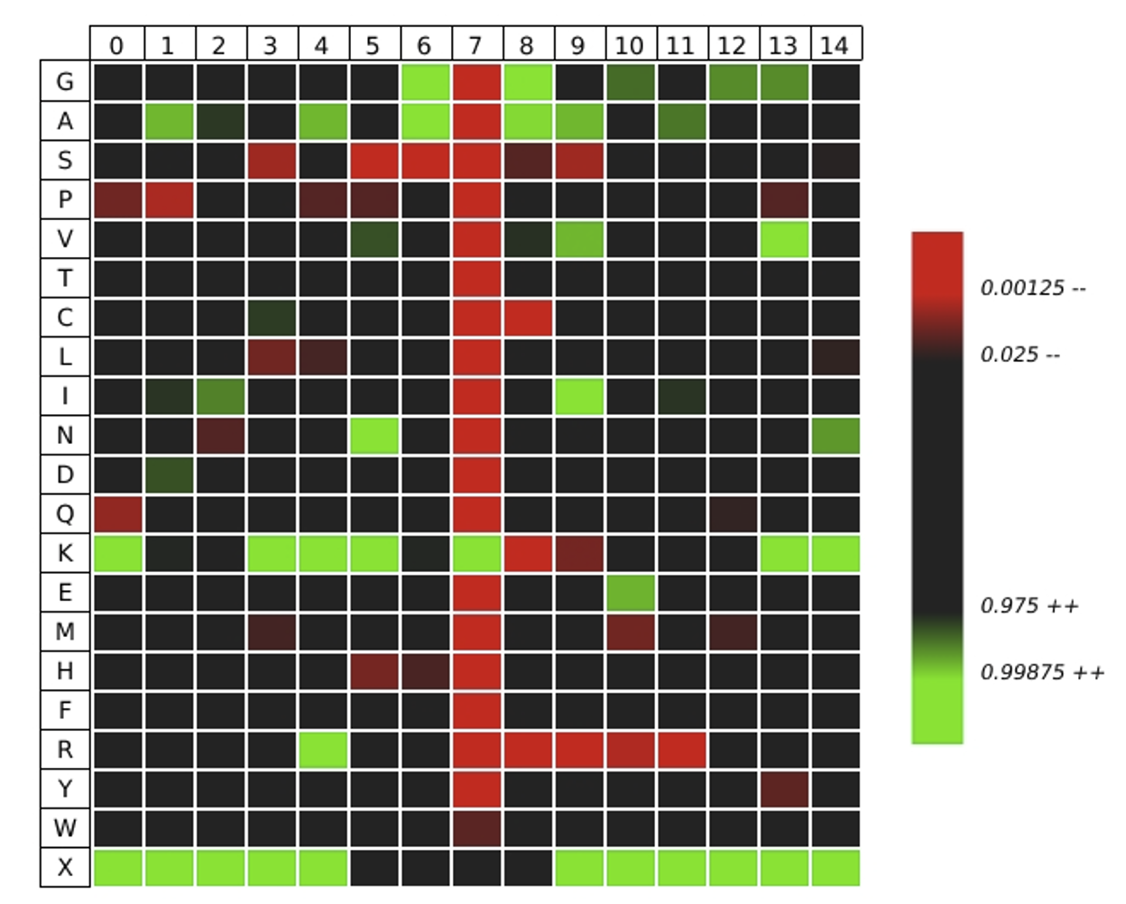
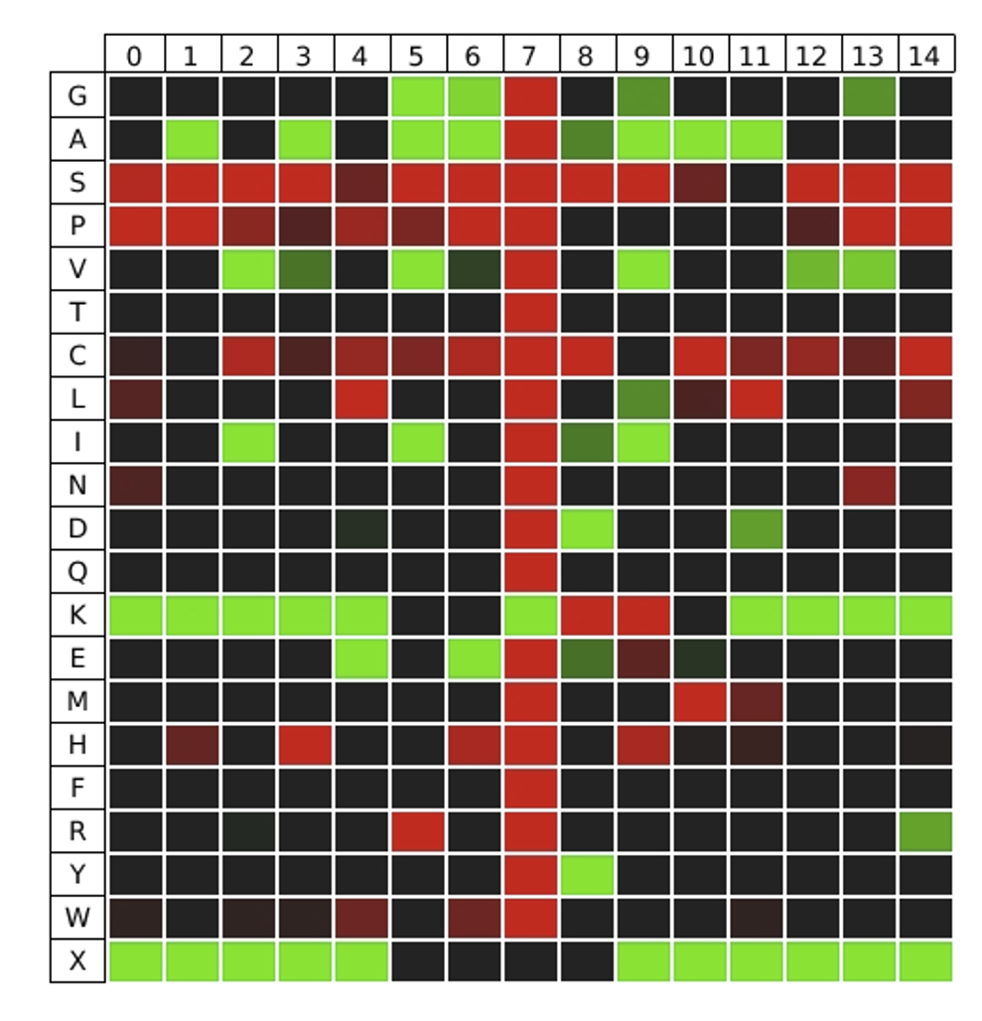
Supplementary Figure S4
A. Maximum lysine malonyl site
probability distribution
B. Maximum lysine succinyl site
probability distribution
390
2100
3
3
6
19
7
11
8
19
9
6
9
27
4
12
16
28
C. iceLogo heatmap for lysine malonyl sequences
D. iceLogo heatmap for lysine
succinyl sequences
-7
-6
-5
-4
-3
-2
-1
K
+1
+2
+3
+4
+5
+6
+7
-7
-6
-5
-4
-3
-2
-1
K
+1
+2
+3
+4
+5
+6
+7

Slide 2
Supplementary Figure S4. Investigation of malonyl and succinyl site scoring and sequences. (A-B) Distribution of the maximum lysine malonyl (A) and succinyl (B) site probability obtained over the entire dataset (8 DIA files) for all quantifiable modified peptides. (C-D) iceLogo heatmaps (Colaert et al., 2021, Nat Methods, 6, 786–787) of 15 amino acid-long sequences representing the preference of each amino acid residue in the seven positions downstream and upstream the malonylated (C) or succinylated (D) lysine residue. Green indicates higher preference, red lower preference, and black no preference. Sequences corresponding to all quantified modified peptides were used. Common residue preferences were observed for the malonylated and succinylated sequences. Indeed, nonpolar, hydrophobic glycine and alanine residues were preferred to surround the lysine residue, as previously shown (Park et al., 2013, Mol Cell, 50(6), 919-390; Colak et al., 2015, Mol Cell Proteomics, 14(11), 3056-3071), while lysine was detected at more down- and up-stream positions, but excluded at positions +1 and +2. Polar, uncharged serine and proline residues were excluded around the acceptor lysine residue, which was even stronger for succinyl sequences, as reported for human brain succinylome (Yang et al., 2022, Nat Commun, 13(1), 159), human fibroblast and mouse liver malonylomes (Colak et al., 2015, Mol Cell Proteomics, 14(11), 3056-3071). Regarding the specificity of malonylated sequences, the positively charged arginine residue had a high probability to be present at position -3, but the lowest probability to be found downstream the lysine residue. The lowest specificity for lysine malonylation motifs may be due to less sequences being identified compared to succinyated sequences. With respect to succinylated sequences, additional nonpolar, hydrophobic residues had high probability to occur, specifically, valine was found up-stream and isoleucine residue both up- and down-stream, which is in accordance with previous studies (Xu et al., Sci Rep, 6, 30212; Kurmi et al., Cell Rep, 22(6), 1365-1373; Colak et al., 2015, Mol Cell Proteomics, 14(11), 3056-3071). In addition, tyrosine and aspartic acid residues had a high probability to be at position +1 and glutamic acid at positions -3 and -1. On the contrary, histidine residue and polar, uncharged cysteine residues were strongly excluded around the acceptor lysine residue.

