Slide 1
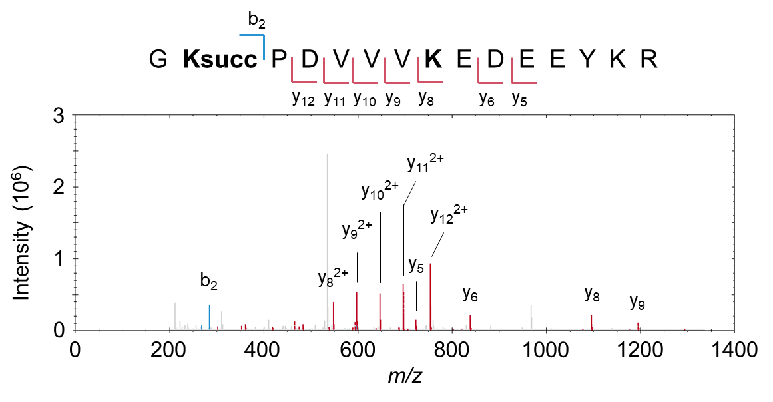
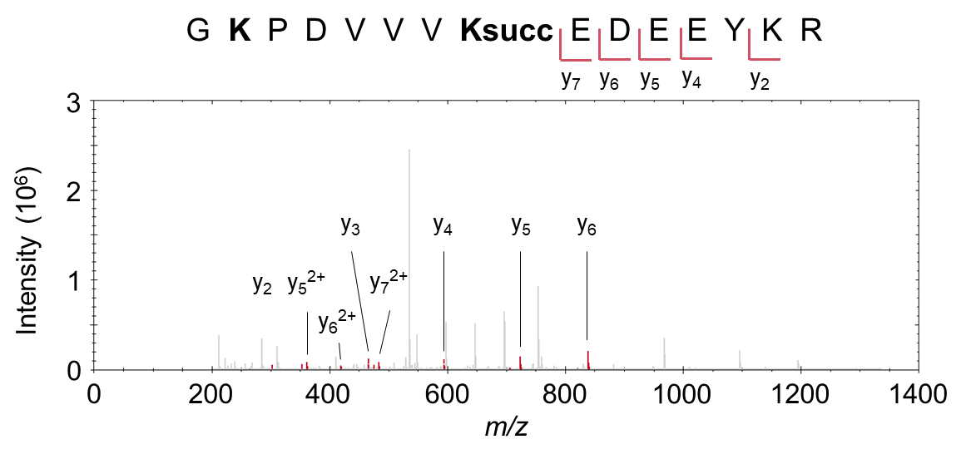
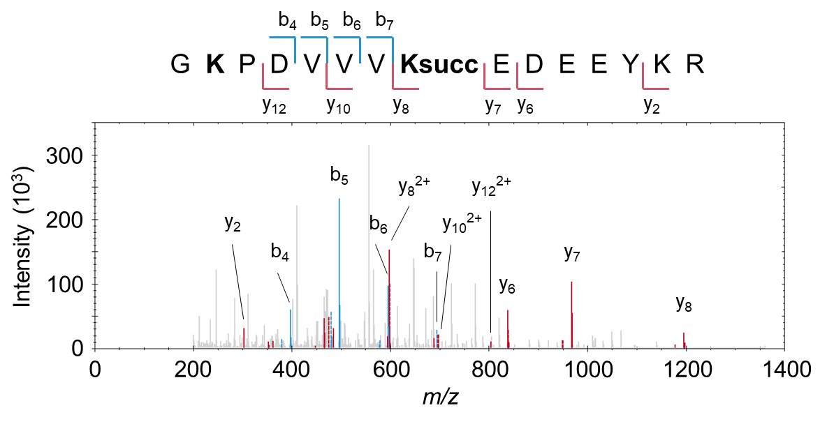
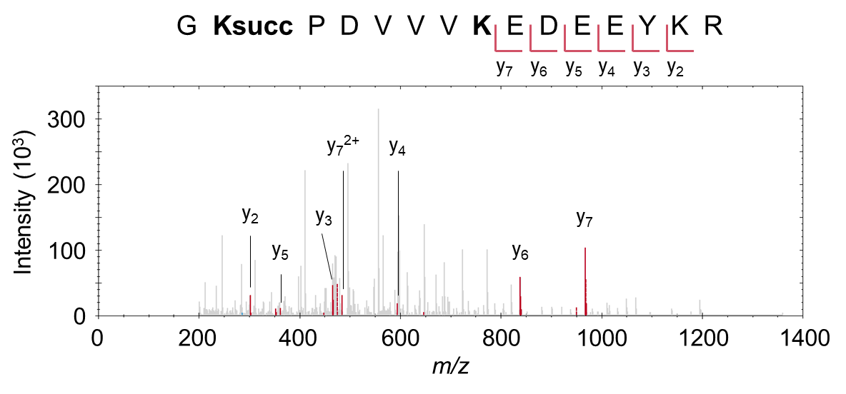
Supplementary Figure S5
Differentiation of succinyl isomers: G²⁴²KPDVVV²⁴⁸KEDEEEYKR (THIL)
Confirmed position
Refuted (incorrect) position
DIA spectrum #1
DIA spectrum #2
Supplementary Figure S5. Example of isomer differentiation for two succinyl sites using the Spectronaut PTM site localization algorithm. For the peptide G²⁴²KPDVVV²⁴⁸KEDEEEYKR of the mitochondrial acetyl-CoA acetyltransferase (THIL), all possible succinyl sites were assessed, specifically K242, K248, and K255 (not shown). Several scores relying on different metrics, including confirming ions and refuting ions, are computed to determine PTM site localization. Confirming ions are highlighted in the displayed DIA MS/MS spectra. DIA spectrum #1 at the apex of the MS2 XIC peak (not shown; m/z 473.49, z = 4+) evidenced the localization of the succinyl site at position K242, and refuted its localization at position K248. Similarly, DIA spectrum #2 at the apex of the other MS2 XIC peak (not shown; m/z 473.49, z = 4+) confirmed the position K248.

